Slide 1
Brain Tumors
Jason Fangusaro, MD
Emory University and
Children’s Healthcare of Atlanta
jfangus@emory.edu
2021 ASPHO Board Review Course

Slide 2
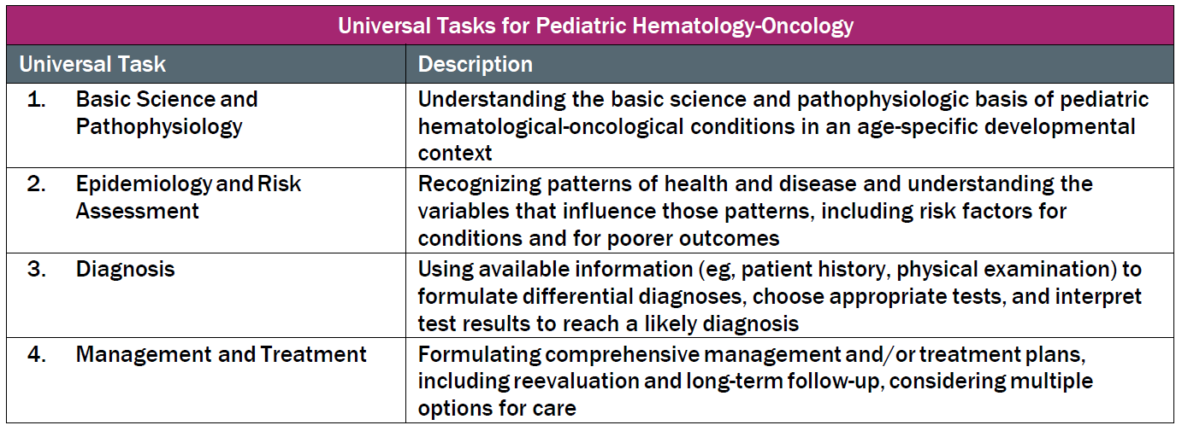
This talk will follow the topical structure suggested by the ABP:

Slide 3
2021 ABP Content Outline:
Brain Tumors
Domain 9: Solid Tumors
  General considerations
    Clinical presentations
    Diagnostic imaging
    Pathology
    Other laboratory tests
Brain tumors
  Medulloblastoma
  Low-grade glioma (LGG)
  High-grade glioma (HGG)
  Ependymoma
  Central nervous system germ-cell tumors (CNS GCT)
  Rare brain tumors
Late Effects

Slide 4
Goals/Overview
Discuss general CNS tumor epidemiology and etiology
Quick neuroanatomy lesson
Discuss specific CNS tumors
  LGG, HGG, Medulloblastoma, Ependymoma, CNS GCT and “Other” rare tumors (AT/RT, Choroid Plexus Tumors, Craniopharyngioma)
    Epidemiology and Risk Assessment (including genetic associations)
    Diagnosis (imaging, staging, pathology and unique testing)
    Pathophysiology/biology
    Management and Treatment
    Outcomes
Late Effects

Slide 5
My Own Personal Goals
Make sure everyone in this room gets the probable 4-5 brain tumor questions on the test correct!
Help you all recognize that Pediatric Neuro-Oncology is clearly the most exciting subspecialty!

Slide 6
Red Font
Red Font is my way of highlighting key points throughout the presentation that I think are:
  Important to remember/memorize
  Key concepts that make for good test questions

Slide 7
Pediatric CNS Tumors:
General Overview

Slide 8
CNS Tumors:
General Epidemiology
CNS tumor are the most common solid malignancy in children and the second most common malignancy overall (after leukemia).
  Astrocytomas are the most common brain tumor overall (most commonly low-grade)
  Medulloblastomas are the most common “malignant” brain tumor
The incidence rate is overall higher in males than females.
  Approximately 1.2:1
An estimated 3000-4000 new cases of childhood primary brain and other CNS tumors are diagnosed each year in the US.
Overall 5-year survival rate is approximately 70-75% (0-19 y/o).
  Misleading as many specific diagnoses with worse survival outcomes and high morbidity
Notes:
Central Brain Tumor Registry of the United States (CBTRUS)

Slide 9
Pediatric CNS Tumor:
General
Completely different from adult brain tumors.
  Histologically, biologically, treatment paradigms and outcomes
Data from Ostrom QT, Haley Gittleman H, Liao P, et al. CBTRUS statistical report: primary brain and central nervous system tumors diagnosed in the United States in 2007–2011. Neuro Oncol. 2014;16(suppl 4):iv1-iv63. https://doi.org/10.1093/neuonc/nou223. ©2014 Oxford University Press. Reprinted with permission.

Slide 10
Pediatric CNS Tumors:
General Etiology
Far and away, the etiology is unknow with rare exception:
  History of ionizing radiation (typically history of CNS radiation for a previous CNS tumor or other oncologic condition, like CNS leukemia)
  Genetic brain tumor predisposition syndromes (see next slide)

Slide 11
Brain Tumor Genetic Predisposition Disorders
Table 3
Syndrome | Gene Abnormality | Characteristic CNS Lesion | Other Findings
Nuerofibromatosis Type-1 | NF1 | Low-grade glioma (optic pathway and brainstem) | Café-au-lait spots, lisch nodules, axillary freckling
Neurofibromatosis Type-2 | NF2 | Bilateral acoustic schwannomas, meningiomas and ependymomas | Increased risk of cataracts and seizures
Tuberous Sclerosis | TSC1 and TSC2 | Subependymal giant cell astrocytoma (SEGA) | Increased risk of skin and renal growths
Li Fraumeni | TP53 | Malignant glioma, choroid plexus carcinoma | Numerous cancers at younger ages (breast, sarcoma, adrenal cortical carcinoma)
Gorlin's (Nevoid Basal Cell Carcinoma Syndrome) | PTCH | Medulloblastma | Basal cell carcinoma
Familial Adenomatous Polyposis (Gardner’s, Turcot’s) | APC | Medulloblastoma and malignant glioma | Multiple colon polyps and increased risk of colon cancer
Rhabdoid Tumor Predisposition Syndrome | SMARCB1 and SMARCB4 (INI-1) | Atypical Teratoid Rhabdoid Tumor (AT/RT) | Rhabdoid tumors in kidney, schwannomatosis; usually < 1 y/o at diagnosis
Retinoblastoma (germline) | RB1 | Trilateral retinoblastoma (unilateral or bilateral retinoblastoma + pineoblastoma) | The pineoblastoma in these cases is usually diagnosed after the retinoblastoma but often before the age of 5 y/o

Slide 12
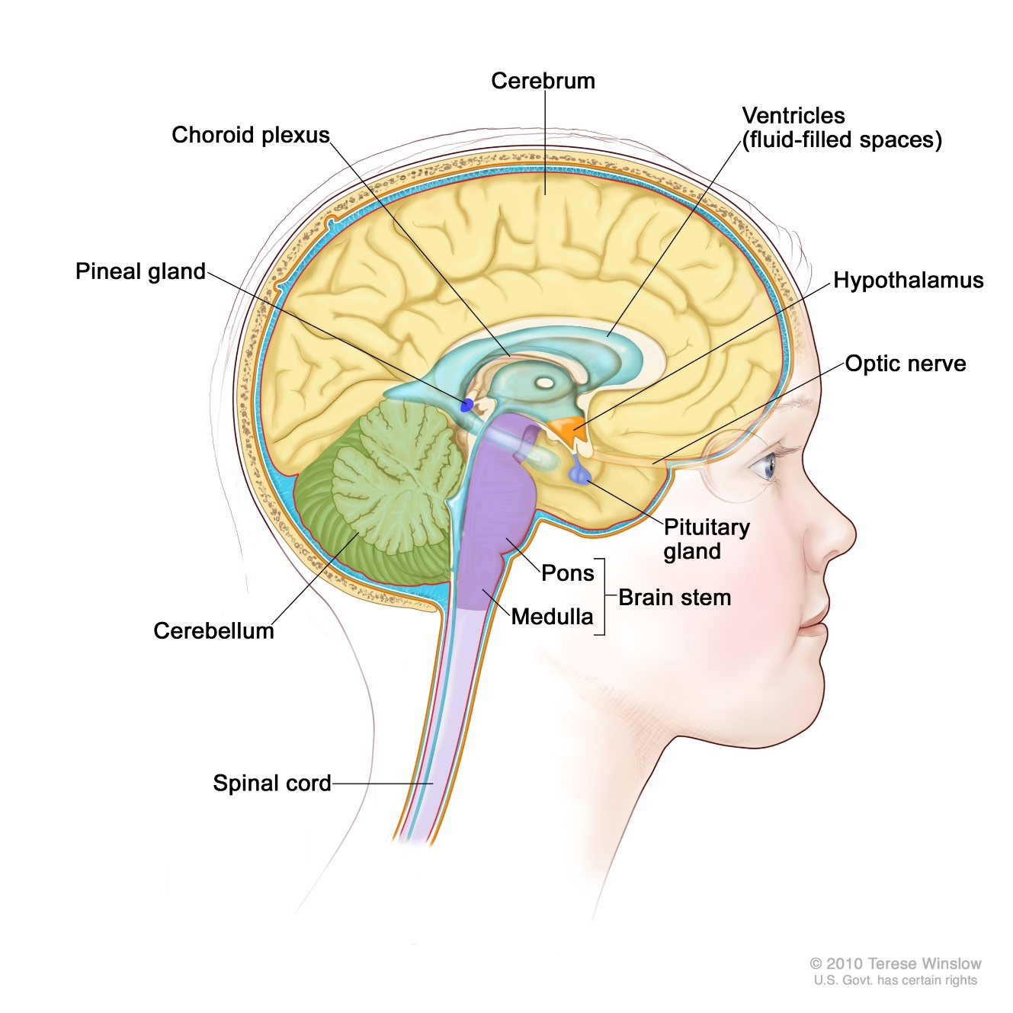
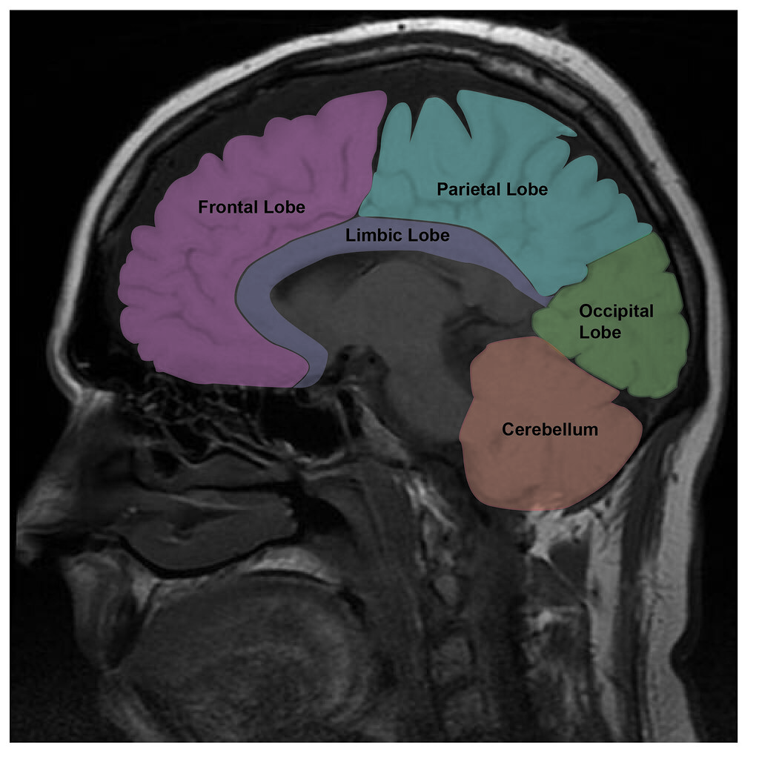
Neuroanatomy Basics
Supratentorial
(1/3)
Infratentorial
(2/3)
"Brain lobe MRI Image - Tacking on the Styx - http://bookstore.authorhouse.com" by hatcher10027 is licensed under CC BY-NC-SA 2.0
Figure 1
© 2010 Terese Winslow. US Govt. has certain rights.
Figure 2

Slide 13
CNS Tumors:
Localizing Symptoms Based on Anatomy
Table 1
Anatomic Location | Common Signs and Symptoms
Frontal lobe | Personality changes, decreased motor speech (Broca’s), seizures
Temporal lobe | Seizures, poor memory, language comprehension (Wernicke’s)
Parietal lobe | Decreased sense of touch/pain, poor spatial and visual perception, poor interpretation of language
Occipital lobe | Poor/Loss of vision
Cerebellum | Ataxia, muscle movement/coordination, posture
Brainstem | Weakness, cranial neuropathies (III-XII), autonomic dysfunction
Thalamus | Weakness/motor control, consciousness, sleep/wake cycle
Hypothalamus | Autonomic dysfunction (temperature regulation, thirst, hunger, etc.) endocrinopathies
2017 Review Course, Brain Tumors, Kenneth J. Cohen, MBA MD

Slide 14
CNS Tumors:
Symptoms
Table 2
Generalized "Non-Localizing" Symptoms | Increased Intracranial Pressure/Obstructive Hydrocephalus | "Localizing Symptoms" | Endocrine Symptoms
Developmental Delay | Headache | Seizures (temporal or frontal lobe tumor) | Diabetes Insipidus
Behavioral Changes | Emesis | Vision Changes (optic pathway or occipital lobe tumor) | Hypothyroidism
Decline in School Performance | Sleepiness/Lethargy | Motor Weakness (tumor in motor strip of cerebrum) | Weight Gain or Loss
Tiredness/Sleepiness | Papilledema (Vision Changes) | Cranial Neuropathies (brainstem tumor) | Panhypopituitarism
 | Full/Bulging Fontanelle |  | Precocious Puberty

Slide 15
CNS Tumors:
“Localizing” Symptoms Match Game
Symptom
  New onset seizures (rare overall)
  Left-sided arm weakness
  Swallowing difficulty/drooling
  Visual acuity decline
  Ataxic gait
Tumor Location
  Right motor cortex (cerebrum)
  Optic pathway
  Temporal lobe
  Brainstem
  Cerebellum

Slide 16
Low-Grade Glioma

Slide 17
Low-Grade Glioma:
General
Low-grade glioma is the most common CNS tumor.
This is a broad term encompassing numerous histologies that all fall into World Health Organization (WHO) grade I and II glial tumors (oligodendroglioma, ganglioglioma pleomorphic xanthoastrocytoma, diffuse fibrillary astrocytoma, etc.).

Slide 18

Low-Grade Glioma:
Epidemiology
Figure 4
15-20%
2-3%
40-50% Low Grade Glioma:
WHO I/II
Astrocytoma/Glioma
Ependymoma
6-9%
50-60%
Craniopharyngioma
ATRT
8-10%
Medulloblastoma

Slide 19
Low-Grade Glioma:
Risk Assessment
Subependymal Giant Cell Astrocytoma (SEGA) is associated with Tuberous Sclerosis.
  Historically treated with surgery, but now mtor inhibitors are typically front-line therapy
Increased risk of LGG in children with Neurofibromatosis type-1 (NF1)
  Need 2 or more of the following to diagnose NF-1 clinically:
    6 or more café au lait macules (> 0.5 cm in children)
    2 or more cutaneous/subcutaneous neurofibroma or plexiform neurofibroma
    Axillary or groin freckling
    Optic pathway glioma
    2 or more Lisch nodules
    Bony dysplasia
    First-degree relative with NF-1

Slide 20
Neurofibromatosis Type-1 and LGG
Approximately 15-20% of NF1 patients will develop a CNS low-grade glioma, most commonly in the optic pathway.
  Biopsy not necessary if classic appearance
Often can be asymptomatic and indolent, not requiring treatment.
  Treatment typically only initiated with visual acuity decline or other neurologic symptoms
Chemotherapy is usual first line of therapy in children with NF1-associated LGG that require treatment.
  Most common chemotherapies are a combination of carboplatin and vincristine or vinblastine alone
  Avoid radiotherapy and alkylator chemotherapies as NF1 patients have a high-risk of secondary malignancy with these exposures

Slide 21
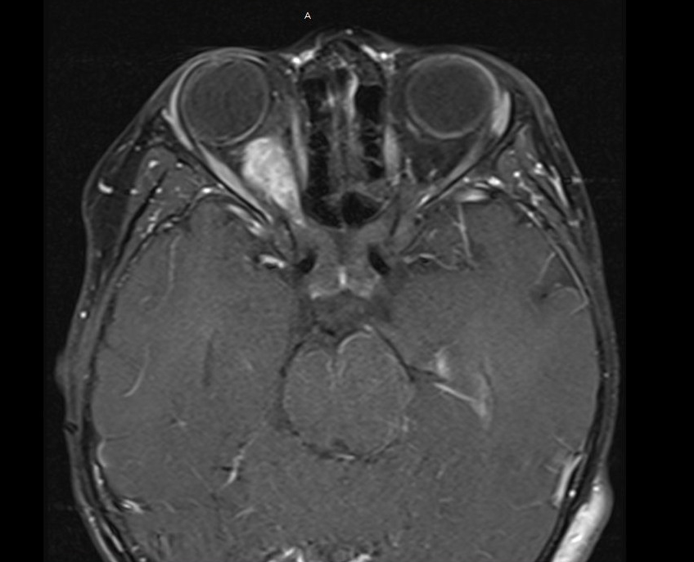
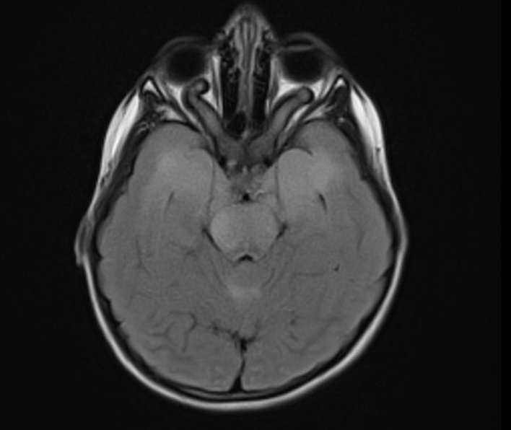
NF-1 and LGG
Figure 5
Figure 6
14-year-old with NF-1 and Right Optic Glioma
Post-Contrast Axial Orbit
3-year-old with NF-1 and Bilateral Optic Gliomas
Axial T2/FLAIR

Slide 22
Low-Grade Glioma:
Diagnosis and Evaluation
Diagnosis made by biopsy or resection with a goal of complete resection whenever possible.
  Exception is in NF1 patients with a classic appearance of a LGG typically within the optic pathway (diagnosis can be made by imaging)
Typically does not spread to other parts of CNS, so full staging not necessary unless clinically indicated based on symptoms or a specific histology.
  If a patient has associated back pain, a spine MRI may be indicated
  If a patient has a unique histology, a spine MRI may be warranted
    For example, there is an increased risk of metastases with pilomyxoid astrocytoma
Lumbar puncture for CSF cytology is not routinely performed or required for staging.

Slide 23
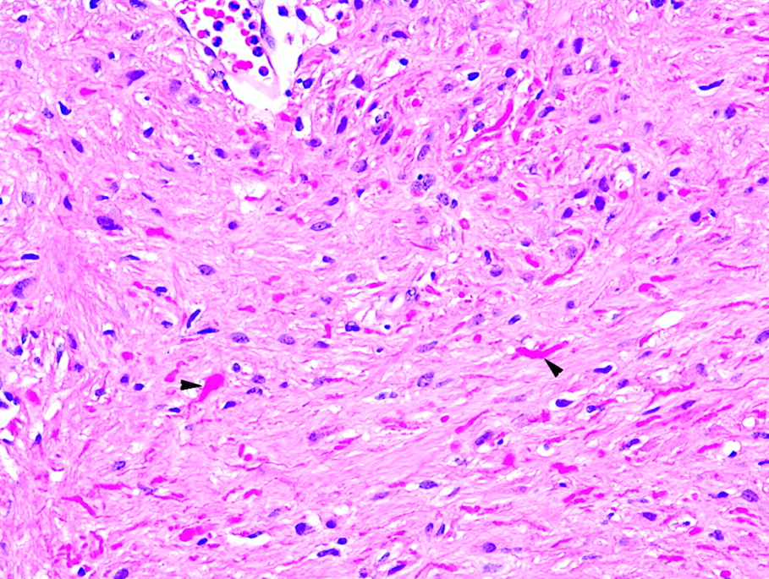
Low-Grade Glioma: Pathology
Figure 7
The most common histology is pilocytic astrocytoma.
  Characterized by low to moderate cellularity, GFAP+ and dense fibrillary areas
  Characterized by Rosenthal fibers
    Astrocytic cytoplasmic inclusions that are typically elongated or “corkscrew” shape and eosinophilic on H and E
Republished with permission of American Journal of Neuroradiology, from Neuropathology for the Neuroradiologist: Rosenthal Fibers. F.J. Wippold, A. Perry and J. Lennerz. © May 2006, 27 (5) 958-961; permission conveyed through Copyright Clearance Center, Inc.

Slide 24
Low-Grade Glioma:
Molecular Biology
Aberrations of the MAPK pathway are the most common abnormality found in low-grade glioma.

Slide 25
MAPK Pathway - Simplified
Figure 8
FGFR
Ras
GTP
Ras
GDP
BRAF
NF-1
MEK
Transcription and Proliferation
ERK
Notes:
FGFR – Fibroblast Growth Factor Receptors

Slide 26
BRAF in Pediatric Low-Grade Glioma
The most common mechanisms of BRAF activation in LGG is a genetic fusion resulting in loss of the regulatory domain of BRAF.
  BRAF KIAA1549 fusion results in activation and has been described in the majority (60-80%) of pilocytic astrocytoma specimens examined by multiple investigators
Another alternative mechanism is the BRAF^{V600E} mutation.
  Found in approximately 10-15% of pilocytic astrocytoma
  Found in other LGG, such as pleomorphic xanthoastrocytoma (~60%) and ganglioglioma (~15-20%)

Slide 27
Low-Grade Glioma:
Management and Treatment
If possible, a gross-total resection should be attempted.
  If achieved, observation alone and surveillance imaging is typically the management of choice
If residual disease or unable to resect due to location, chemotherapy is typically the first line.
  Most common first-line chemotherapy is carboplatin/vincristine, vinblastine alone or combination of thioguanine, procarbazine, CCNU and vincristine (TPCV)
Radiation is very effective, but most practitioners would avoid in young children due to the risk of late effects (neurocognitive, endocrine, ototoxicity and secondary malignancy).
Remember in patients with NF1, no treatment necessary unless there are neurologic symptoms or functional deficits (vision dysfunction)
Targeted therapies now being tested (MEK inhibitors, BRAF inhibitors) in clinical trials.

Slide 28
Low-Grade Glioma:
Outcomes
With a gross-total resection, 5-year overall survival can be > 90-95%.
However, depending on location and ability to resect, many patients have multiple progressions and recurrences.
  On the most recently published CCG/COG (A9952) study comparing carboplatin/vincristine to TPCV, outcomes were as follows for all patients enrolled:
    5-year event-free survival = 45 ± 3.2%
    5-year overall survival = 86 ± 2.2%

Slide 29
Low-Grade Glioma:
Diencephalic Syndrome
Diencephalic syndrome is a rare condition most often caused by a tumor located in the diencephalon, including the hypothalamus and thalamus.
It is usually seen in infants and toddlers and results in a constellation of symptoms, including:
  Failure to thrive and emaciation despite a somewhat normal appetite and intake
  Abnormal eye movements and vision issues
  Vomiting
  Hydrocephalus
Most commonly caused by a low-grade astrocytoma, but the exact mechanism is poorly understood.
Biopsy is often indicated to confirm diagnosis and treatment is typically low-grade glioma chemotherapy (carboplatin/vincristine or vinblastine, for example).
  Symptoms improve with chemotherapy

Slide 30
Low-Grade Glioma:
Diencephalic Syndrome “Classic” Case
Figure 9
2 y/o female presents with 4 months of failure to thrive with no known etiology.
Over the last week, she developed some emesis and new nystagmus.
MRI is performed revealing a large hypothalamic mass with associated hydrocephalus.
Biopsy confirms a pilocytic astrocytoma.
Post-contrast Axial T1

Slide 31
High-Grade Glioma

Slide 32
High-Grade Glioma:
General
High-grade gliomas are highly aggressive and malignant glial tumors classified as either WHO Grade III (anaplastic astrocytoma) or WHO Grade IV (glioblastoma multiforme).
Much more common in adults, however, the biology is distinct between children and adults despite similar histologic appearance.
In pediatrics, high-grade gliomas are much less common than low-grade gliomas.
High-grade gliomas are more resistant to therapy with much poorer survival outcomes compared to LGG.

Slide 33
High-Grade Glioma:
Epidemiology
Figure 10
20%
2%
Astrocytoma/Glioma
Ependymoma
6-9%
50-60%
Craniopharyngioma
CNS GCT
8-10%
Medulloblastoma
10-15%
High-grade glioma

Slide 34
High-Grade Glioma:
Risk Assessment
Increased risk in patients with previous exposure to radiotherapy.
  CNS leukemia or previous CNS tumor
Increased risk in patients with Li Fraumeni syndrome (TP53 gene mutation) and Familial Adenomatous Polyposis (APC gene abnormality).

Slide 35
High-Grade Glioma:
Diagnosis and Evaluation
Diagnosis is made by biopsy/resection and pathology.
  One exception is Diffuse Intrinsic Pontine Glioma (DIPG) which we will discuss separately
The goal is a gross total resection, but this is often difficult due to location and the highly infiltrative nature of high-grade glioma.
Rarely spreads to other parts of the CNS, but a baseline spinal MRI is typically done by most practitioners, especially if clinically indicated.
Lumbar puncture for CSF cytology is not routinely performed or required for staging.

Slide 36
High-Grade Glioma:
Pathology
Classically characterized by being highly cellular with numerous mitoses, vascular proliferation, pseudopalisading necrosis and usually GFAP+.
  Pseudopalisading necrosis is when rapidly proliferating tumor cells are stacked (or palisade) around a central pale area which represents necrotic tissue
I do not think you will need to recognize this, but if these key words (in red above) are used to describe a glial tumor, they are trying to get you to recognize a high-grade glioma, specifically a WHO Grade IV glioblastoma multiforme with a very poor survival outcome.

Slide 37
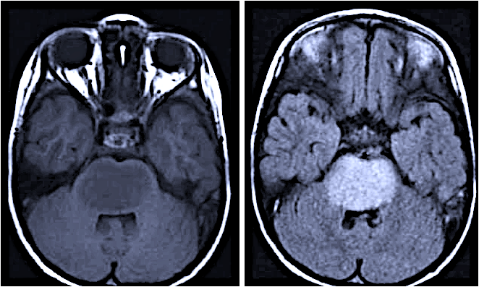
Diffuse Intrinsic Pontine Glioma (DIPG)
Figure 11
Diffusely infiltrative high-grade lesions of the pons.
Represents about 10-12% of all pediatric CNS tumors.
Can be diagnosed with imaging alone.
The classic age is 5-7 years old.
If a biopsy is performed, > 80% will have a histone mutation in H3 K27M (described next slide).
Complete resection not feasible.
Patients most often present with short duration of symptoms (1-2 months) of the classic triad:
  Cranial nerve symptoms
  Long-tract signs
  Ataxia
Focal radiotherapy is the only know beneficial therapy.
Mean survival is about 10-12 months with almost all children succumbing to disease within 2 years regardless of therapy.
Non-contrast Axial T1
Non-contrast Axial T2/FLAIR

Slide 38
High-Grade Glioma:
Molecular Biology
A molecular feature in some pediatric high-grade glioma is H3 K27M mutant.
  This is a histone mutation that characterizes what are now recognized by the WHO as a specific diagnosis: diffuse midline glioma, H3 K27M mutant
  These are highly infiltrative, WHO Grade IV lesions of the midline, most commonly the pons (DIPG), thalamus or spinal cord
  Estimated to be present in 80% of classic diffuse intrinsic pontine glioma (DIPG)
A less commonly seen histone mutation is H3.3 G34R which is seen in high-grade gliomas in the cerebral hemispheres, often in teenagers and young adults.

Slide 39
High-Grade Glioma:
Treatment
The best-known therapy is a maximal safe surgical resection followed by a combination of focal radiotherapy and chemotherapy.
Historic studies have shown improvement with the addition of chemotherapy to radiotherapy, but these data and the exact chemotherapy is controversial.
Infant (most commonly < 3 y/o) high-grade glioma have unique biology and a more indolent course.
  Radiation can sometimes be avoided or delayed with the use of chemotherapy in young children

Slide 40
High-Grade Glioma:
Outcomes
Universally poor, with most large series showing 5-year overall survivals of 15-20%.
Infants with improved outcomes most likely due to unique biology.

Slide 41
Medulloblastoma

Slide 42

Medulloblastoma:
General
Medulloblastoma is the most common “malignant” brain tumor of childhood.
It is a highly aggressive and rapidly growing embryonal tumor.
Located in the posterior fossa (cerebellum) by definition.
© 2010 Terese Winslow. US Govt. has certain rights.

Slide 43
Medulloblastoma: Epidemiology
Figure 12
Medulloblastoma
2nd most common CNS tumor.
Most common “malignant” brain tumor in children.
More common in males
  1.7:1
15-20%
Astrocytoma/Glioma
2-3%
Ependymoma
5-8%
50-60%
Craniopharyngioma
CNS GCT
8-10%
Medulloblastoma

Slide 44
Medulloblastoma:
Risk Assessment
Increased risk in patients with Gorlin’s syndrome, also known as Nevoid Basal Cell Carcinoma Syndrome.
  Due to a PTCH gene mutation
Increased risk in Familial Adenomatous Polyposis (Gardner’s, Turcot’s) Syndrome.
  Due to APC gene mutation

Slide 45
Medulloblastoma:
Diagnosis and Evaluation
Imaging typically reveals a large heterogenous mass in the posterior fossa (cerebellum), often with some contrast enhancement.
Tissue is needed for diagnosis, and usually a gross total resection is attempted.
Approximately 30% of cases will have metastatic spread throughout the CNS, so both a lumbar CSF cytology and spine MRI are needed for staging.
  Spine MRI should be done before surgery or a minimum of 10-14 days post-operatively to avoid post-operative products confounding MRI interpretation
  Lumbar CSF sample for cytology should be done a minimum of 10-14 days post-operatively, again to avoid post-operative products confounding interpretation

Slide 46
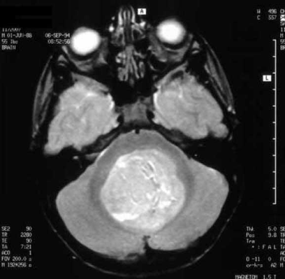
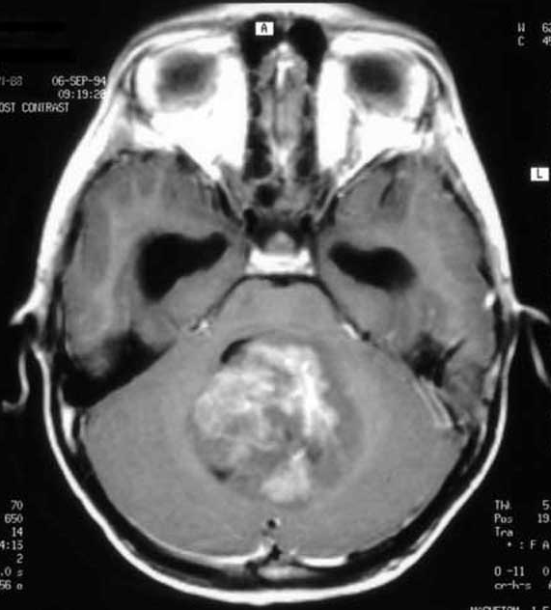
Medulloblastoma:
Imaging
Axial T2
Post-contrast Axial T1
Images reproduced with permission from Medscape Drugs & Diseases (https://emedicine.medscape.com/), Medulloblastoma Imaging, 2015, available at: https://emedicine.medscape.com/article/341527-overview.

Slide 47
Medulloblastoma: Pathology
Figure 14
Highly cellular tumor with prominent mitosis and synaptophysin positive (neuronal component)
There are 4 classic histologic patterns recognized
  Classic
  Desmoplastic
  Extremely Nodular
  d. Anaplastic/Large Cell
Gupta T, Sarkar C, Rajshekhar V, Chatterjee S, Shirsat N, Muzumdar D, Pungavkar S, Chinnaswamy G, Jalali R. Indian Society of Neuro-Oncology consensus guidelines for the contemporary management of medulloblastoma. Neurol India [serial online] 2017 [cited 2018 Oct 31];65:315-32. Available from: http://www.neurologyindia.com/

Slide 48
Medulloblastoma: Molecular Biology
Figure 15
4 major molecular subgroups accepted:
  WNT
  SHH
  Group 3
  Group 4
Treatment paradigms are evolving based on these.
WNT has the best prognosis with many series showing 90-100% overall survival.
  Ongoing COG trial (ACNS1422) to reduce therapy in these patients
From Taylor, M.D., Northcott, P.A., Korshunov, A. et al. Acta Neuropathol (2012) 123: 465. https://doi.org/10.1007/s00401-011-0922-z. This image is licensed under the Creative Commons Attribution Noncommercial License (CC-BY-NC-2.0), https://creativecommons.org/licenses/by-nc/2.0/.

Slide 49
Medulloblastoma:
Molecular Subgrouping
Table 4
Molecular Subgroup | Common Age Groups | Histology/Pathology | Most Common Genetic Aberration | Prognosis
WNT | -Children -Less common in Adults | -Classic -Rarely large call anaplastic (LCA) | -Monosomy 6 -Nuclear beta-catenin -Increased risk in Turcot syndrome | Excellent
SHH | -Infants and Adults -Less common in Children | -Desmoplastic/nodular -MBEN -Classic, LCA | -PTCH1/SMO/SUFU, GLI2 amplification -Increased risk in Gorlin syndrome (basal cell carcinoma syndrome) | -Fair -Poor if SHH TP53-mutant
Group 3 | -Children -Less common in infants | -Classic -LCA | -i17q -MYC amplification | Poor
Group 4 | -Children -Less common in infants and adults | -Classic -LCA | -CDK6 amplification -MYCN amplification | Fair

Slide 50
Medulloblastoma:
“Historic” Risk Groups and Treatment
Classification
  Standard risk
    > 3 y/o
    Gross total resection with < 1.5 cm³ residual disease
    No signs of metastases
    Not anaplastic histology
  High Risk
    > 1.5 cm³ residual tumor
    Metastases (by lumbar cytology or spine MRI)
    Diffusely anaplastic histology
  Infants (usually < 3 y/o)
    Although the exact cutoff age varies depending upon geography and clinical trial guidelines
Treatment
  Standard Risk
    Craniospinal Radiotherapy at lower doses (2340 cGy) +/- weekly vincristine and boost to the posterior fossa (5400 cGy) followed by maintenance chemotherapy
  High Risk
    Full dose craniospinal radiotherapy (3600 cGy) +/- weekly vincristine and boost to posterior fossa (5400 cGy) followed by maintenance chemotherapy
  Infants
    Typically treated with induction chemotherapy followed by high dose chemotherapy with autologous stem cell rescue +/- radiotherapy

Slide 51
Medulloblastoma:
“Historic” Risk Stratification
Table 5
Prognostic Factors | Standard Risk | High Risk
Extent of resection | < 1.5 cm³ residual tumor | > 1.5 cm³ residual tumor
M-staging | No metastases | M+ (M0=none, M1=+CSF lumbar cytology alone, M2=Mets in brain on MRI, M3=Mets in spine on MRI, M4=Mets outside CNS [very rare])
Pathology/Histology | All Others | Anaplastic/Large Cell

Slide 52
Medulloblastoma:
Outcomes
Varies depending on age, risk category and molecular subtype (on retrospective evaluations), though this latter piece is evolving in prospective cohorts.
Standard risk with 5-year overall survivals of about 75-90%.
High risk with 5-year overall survivals of about 40-60%.
Infant studies also vary, but survival is approximately 50-70%.
Remember retrospective analyses of WNT medulloblastoma have shown excellent survivals, greater than 90% at 5 years.

Slide 53
Ependymoma

Slide 54
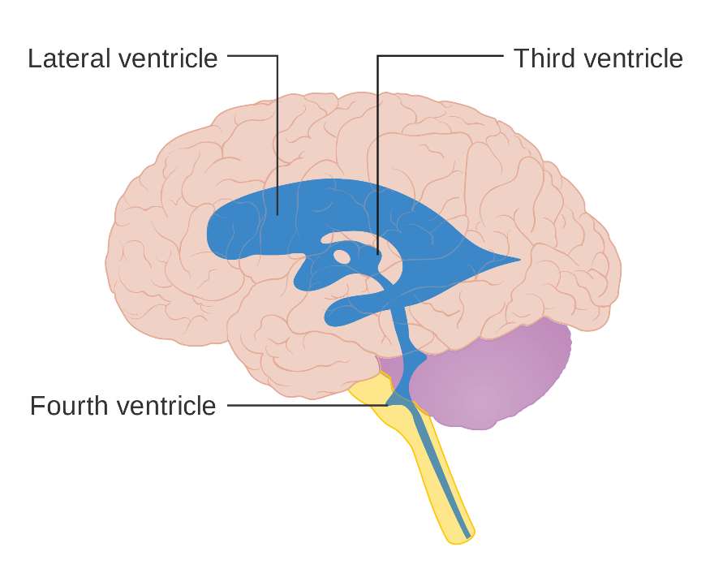
Ependymoma: General
Ependymoma is the third most common pediatric CNS tumor.
It is a glial tumor with ependymal cell differentiation.
Can occur anywhere in CNS, but it is most commonly associated with a ventricular surface.
Most common location is the posterior fossa (cerebellum) followed by the lateral ventricles and then spinal cord.
Figure 16
©2016 Cancer Research UK / Wikimedia Commons; Original email from CRUK; 12 January 2016; https://commons.wikimedia.org/wiki/File:Diagram_showing_where_the_ventricles_are_in_the_brain_CRUK_387.svg. This work is licensed under a Creative Commons Attribution 4.0 International License.
Cerebellum
Spinal cord

Slide 55
Ependymoma:
Epidemiology
Figure 17
15-20%
Astrocytoma/Glioma
Ependymoma
6-9%
50-60%
Craniopharyngioma
CNS Germ Cell Tumor
8-10%
Medulloblastoma
Ependymoma

Slide 56
Ependymoma:
Risk Assessment
Increased risk in patients with Neurofibromatosis type 2

Slide 57
Ependymoma:
Diagnosis and Evaluation
Diagnosis cannot be made on imaging and tissue is required.
Goal is a gross total resection.
There is a risk of CNS metastases in about 10-15% of patients, and therefore, staging must include lumbar CSF cytology and full spine MRI.
  Spine MRI should be done before surgery or a minimum of 10-14 days post-operatively to avoid post-operative products confounding MRI interpretation
  Lumbar CSF sample for cytology should be done a minimum of 10-14 days post-operatively, again to avoid post-operative products confounding interpretation

Slide 58
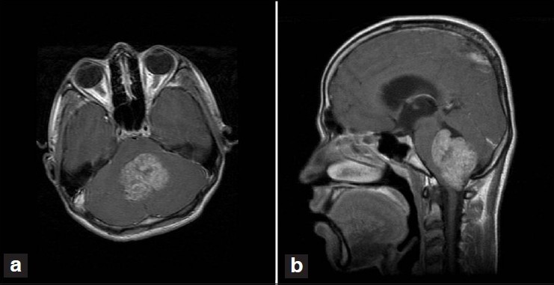
Ependymoma: Imaging
Figure 18
Typically a heterogenous mass in the posterior fossa (cerebellum).
Often with patchy heterogenous enhancement.
Post-contrast Axial T1
Post-contrast Sagittal T1
Ghosal Nandita, Murthy Ganesh, Dadlani Ravi, Hegde. Alangar Sathya, Singh Devendra. CASE REPORT. Recurrent posterior fossa anaplastic ependymoma with prominent chondroid metaplasia: A case report and review of literature. Indian Journal of Pathology and Microbiology. 2010, 53(4):787-789. http://www.ijpmonline.org/. Published October 27, 2010. Accessed November 1, 2018. ©2010 by Wolters Kluwer. Reproduced with permission.

Slide 59
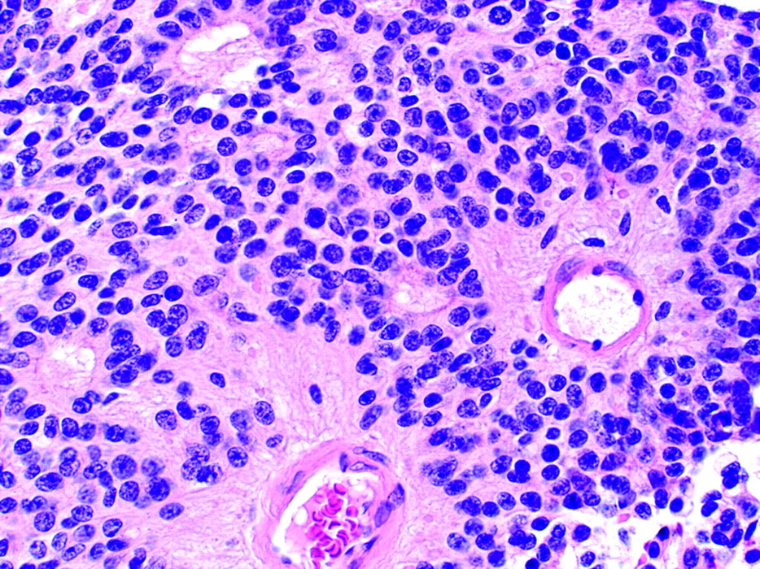
Ependymoma: Pathology
Figure 19
Moderately cellular and composed of monomorphic cells with round to oval nuclei.
A common and key histologic feature is the presence of perivascular pseudorosettes.
Republished with permission of American Journal of Neuroradiology, from Neuropathology for the Neuroradiologist: Rosettes and Pseudorosettes. F.J. Wippold and A. Perry. © March 2006, 27 (3) 488-492; permission conveyed through Copyright Clearance Center, Inc.

Slide 60
Ependymoma:
Molecular Biology
Molecular subgroups are recognized, but these have not yet universally impacted treatment.
Table 6

Slide 61
Ependymoma:
Treatment
Maximum surgical resection.
  Surgical resection has consistently been found to impact outcome in historic studies
Localized tumors are typically treated with resection followed by focal radiotherapy between 5400-5900 cGy.
Metastatic tumors often treated with craniospinal radiotherapy 3600 cGy and boost to focal area 5400-5900 cGy.
The role of chemotherapy remains unclear and recent COG trials are addressing this again.
Chemotherapy alone approaches often used in very young children (typically < 1 y/o) to delay radiation.

Slide 62
Ependymoma:
Outcome
5-year overall survivals are 60-80%, but many patients have multiple and late relapses.
  It is a unique CNS tumor where EFS/OS continues to decline far after 5 years.
Many patients will develop multiply recurrent tumor over several years and eventually succumb to the disease.

Slide 63
Central Nervous System Germ Cell Tumors

Slide 64
CNS Germ Cell Tumors:
General
Rare pediatric CNS tumor with similar histologic feature to gonadal germ cell tumors.
Unique in that diagnosis can sometime be made by circulating tumor markers in the blood and CSF (AFP and Beta-HCG).
Classically, there are 2 major categories:
  Germinoma (aka non-secreting) – better outcome
  Non-germinomatous Germ Cell Tumor (NGGCT) (aka secreting) – worse outcome

Slide 65
CNS Germ Cell Tumors: Epidemiology
Represent only 2-3% of pediatric CNS tumors.
More common in Japan and other Asian countries.
  Can be up to 10-15% of pediatric brain tumors in these geographic areas
Figure 20
CNS GCT
2-3%
15-20%
Astrocytoma/Glioma
Ependymoma
6-9%
50-60%
Craniopharyngioma
CNS Germ Cell Tumor
8-10%
Medulloblastoma

Slide 66
CNS Germ Cell Tumor:
Risk Assessment
There is no significant genetic association with CNS GCT that would be commonly known or tested.

Slide 67
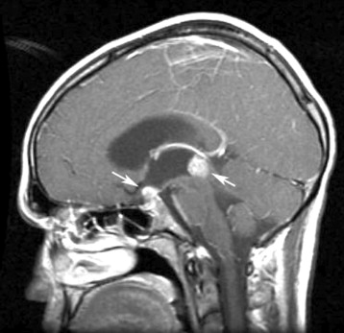
CNS Germ Cell Tumor:
Imaging
Figure 21
The most important take home point would be that you would see a heterogenous and enhancing mass in one of the two most common locations:
  Suprasellar/Pituitary
  Pineal
  Sometimes both present and it is then called a “doublet” lesion or “bi-focal” lesion
Post-contrast Sagittal T1
From Neuroimaging (chapter 8), by JW Jenson and RG Gonzalez, in MJ Aminoff, F Boller, DF Swaab, eds, Neuro-Oncology. Amsterdam, The Netherlands: Elsevier; 2012. Handbook of Clinical Neurology; vol. 104. ©2012 by Elsevier. Reproduced with permission.

Slide 68
CNS Germ Cell Tumors:
Unique Symptoms
Table 7
*Parinaud’s syndrome is a cluster of abnormalities of eye movement and pupil dysfunction, characterized by:
Paralysis of upwards gaze
Pseudo-Argyll Robertson pupil (accommodative paresis and pupils become mildly dilated and show light-near dissociation)
Convergence-retraction nystagmus (on fast up-gaze, the eyes pull in and the globes retract)
Notes:
This Chart was adapted from Dr. Cohen’s talk.

Slide 69
CNS Germ Cell Tumors:
Pathology
Many tumors are mixed but can contain a variety of germinoma and other malignant germ cell tumor elements.
Among the NGGCT group, there are numerous histologic variants, such as endodermal sinus tumor, yolk sac tumor, embryonal carcinoma and teratoma.

Slide 70
CNS Germ Cell Tumor:
Diagnosis and Evaluation
Serum and CSF tumor markers should be drawn on every patient at time of diagnosis.
If tumor markers in serum or CSF (AFP, Beta-HCG) are elevated enough, a diagnosis of NGGCT may be made without tissue.
  On a test question, I imagine they would describe a mass in the pineal or suprasellar region with an AFP or Beta-HCG that is very elevated (> 200) in blood or CSF
In germinoma, the classical teaching is that these tumor markers are not elevated, though this is controversial.
If markers are not diagnostic, a biopsy is necessary for tissue evaluation.
Metastases throughout the CNS is possible, so a full spine MRI and lumbar CSF for cytology are necessary, similar to medulloblastoma and ependymoma.

Slide 71
CNS Germ Cell Tumor:
Treatment
Germinoma
    Neoadjuvant chemotherapy followed by response based XRT
      Typical chemotherapy: Carbo/Etoposide x 4 cycles
      Dose of XRT is dependent on response but ranges between 3000-3600 cGy and always includes whole ventricle
    XRT alone
      Dose in range of 4000-4500 cGy and includes whole ventricle (not commonly used anymore)
NGGCT
  Neoadjuvant chemotherapy followed by XRT (extent and dose is controversial)
In both (germinoma and NGGCT) second-look surgery often advocated after neoadjuvant chemotherapy if residual mass remains prior to radiotherapy to decipher residual mass (scar tissue, malignant tumor, teratoma).
  Risk of “Growing Teratoma Syndrome”

Slide 72
CNS Germ Cell Tumor:
Outcomes
Germinoma
  Excellent prognosis with > 90% OS at 5 years with either XRT alone or a combination of chemotherapy + XRT
NGGCT
  In patients with a good response to neoadjuvant chemotherapy (complete response or very good partial response), 5-year overall survival is approaching 80-90%
  There is a group who have poorer responses (less than a very good PR) to chemotherapy and have significantly worse outcomes.
    As yet, it is unclear what defines these patients

Slide 73
Other “Rare Tumors:”
AT/RT, Choroid Plexus Tumors, Craniopharyngioma

Slide 74
Atypical Teratoid Rhabdoid Tumor
(AT/RT)
A rare embryonal tumor typically seen in young children and infants; about 2% of all pediatric CNS tumors
Requires full CNS metastatic evaluation, including spine MRI and lumbar CSF cytology.
Historically, prognosis was very poor, but with modern multi-modal therapies combining chemotherapy (sometimes autologous stem cell rescue or “sarcoma-like” therapy) +/-radiation, survival has improved.
Pathologically identified by loss of INI-1 on immunohistochemistry or more detailed molecular testing.
Rhabdoid Tumor Predisposition Syndrome is a germline mutation in SMARCB1 and SMARCB4 (INI-1 or hSNF5) associated with increased risk of AT/RT, other rhabdoid tumors (commonly in kidney) and schwannomatosis.

Slide 75
Choroid Plexus Tumors
Represent about 1-2% of all pediatric brain tumors; most commonly located in lateral ventricles.
3 varieties:
  Choroid plexus papilloma (CPP)
  Atypical choroid plexus papilloma
  Choroid plexus carcinoma (CPC) .
Usually presents in younger children/infants with signs of increased intracranial pressure.
Goal is a gross total resection when possible which is usually curative for CPP.
Outcomes for CPC are variable despite a variety of multi-modal therapies with chemotherapy and radiotherapy.
  In CPC, 5-year overall survivals ranges from 20-50%
  CPC can be associated with Li Fraumeni and TP53 germline mutation

Slide 76
Craniopharyngioma
Rare epithelial tumor of thought to be due to maldevelopmental origin.
Represents about 6-9% of all pediatric brain tumors.
Often presents with headache, emesis, visual field cut and endocrinopathies.
Most common location is suprasellar/pituitary.
Imaging usually shows a mixed solid and cystic mass within the suprasellar region.
Pathology consists of squamous epithelium lining cystic cavities, often containing calcium and keratin.
Treatment is maximum surgical resection.
If a gross total resection is not achievable or progressive disease ensues, focal radiotherapy is often used.
Although progression-free and overall survivals are good, many patients have numerous morbidities affecting quality of life (endocrinopathies, behavioral issues, visual dysfunction and seizures).

Slide 77
CNS Tumors:
Late Effects

Slide 78
CNS Tumors:
Late Effects of Therapy
Table 8
After CNS radiation, there is an increased risk of a secondary malignant brain tumor, most commonly high-grade glioma and meningioma.
  This typically occurs 7-10 after radiotherapy treatment
  Risk is approximately < 5% and is dependent upon radiation dose and age
Modality | Late Effect
Radiation | Neurocognitive decline, ototoxicity, endocrine dysfunction (hypothyroidism, GH deficiency, delayed puberty), secondary malignancy, cerebrovascular events
Chemotherapy | -Cyclophosphamide Infertility -Cisplatin Ototoxicity -Etoposide Secondary malignancy -Methotrexate (IT) Leukoencephalopathy -Doxorubicin Cardiac dysfunction

Slide 79
CNS Tumors:
Secondary Malignancy
A classic question would typically be something like the following:
  A 20 y/o male presents to the ER with complaints of headaches, emesis and right sided weakness. He was treated at age 10 with craniospinal radiation and chemotherapy for a diagnosis of medulloblastoma.
  Imaging reveals a left-sided mass with associated hydrocephalus and mild midline shift.
    The differential must include a radiation-induced secondary malignancy, like a high-grade glioma or meningioma
    Latency period of a secondary high-grade lesion is often 7-10 years after radiation

Slide 80
Thank you and Best of Luck!
Please feel free to reach out with specific questions.
  jfangus@emory.edu
BOARDS SMOARDS!

