Slide 1
Congenital and Acquired Hemolytic Anemias
Ellis J. Neufeld MD, PhD

Slide 2
Disclosure Information
Ellis J. Neufeld MD, PhD
Research Funding: Agios Pharmaceuticals
Advisory Board: Agios Pharmaceuticals

Slide 3
Hemolytic Anemia
Increased destruction of erythrocytes
Compensatory increase in erythrocyte production
Etiology
Membrane disorders
“Inside job”:
E.g. enzymopathies, hemoglobinopathies
“Outside job:” extrinsic factors
Antibodies, Toxins, Mechanical Destruction, Hypersplenism, DIC, TTP, and other micro- and macro vascular anemia

Slide 4
Normal red cell physiology in 7 slides
Overall function
Structure
Membrane cytoskeleton
Metabolism
Glycolysis, pentose-phosphate shunt and 2,3 DPG
Hemoglobin function

Slide 5
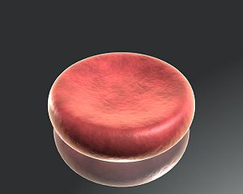
Red Cells
Biconcave disc with diameter of 7.5 μm;
Efficient transport vehicle for oxygen exchange; requires healthy hemoglobin
Shape also allows deformability as the erythrocytes move through capillaries; requires healthy membranes
Normal life span 100-120 days
Source: Rogeriopfm; http://commons.wikimedia.org/wiki/File:Red_blood_cell_on_glass.jpg#file
– used in accordance with Wikimedia license provisions

Slide 6
Red Cell Structure grossly oversimplified
Cell membrane
Lipid bilayer (phospholipids, cholesterol esters), with many other components, e.g. glycolipids, intrinsic and PI-linked membrane proteins
Anchored to cytoskeleton by specific abundant transmembrane proteins
Band 3 and glycophorins A, B, and C
Cytoskeleton
Spectrin, Ankyrin, actin, and a relatively small handful of additional proteins with specific interactions
Hemoglobin
Everything else – Enzymes, electrolytes

Slide 7
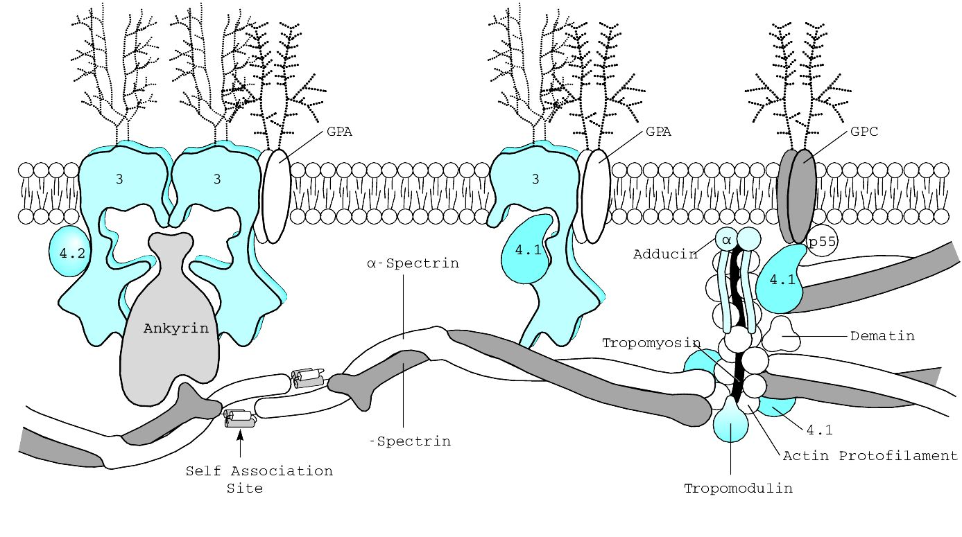
Red Cell Membrane
Cytoskeletal scaffold on the inner surface of the erythrocyte
Spectrin tetramers form a horizontal lattice structure with actin
Spectrin tetramers are linked by ankyrin to the integral membrane protein Band 3
Protein 4.1 binds to glycophorin C and beta spectrin to increased the affinity of spectrin-actin binding
Vertical interactions – ankyrin to band 3
Horizontal interactions – spectrin and attachments

Slide 8
Red Cell Metabolism grossly oversimplified
No nucleus, mitochondria or ribosomes so RBC depends on anaerobic metabolism
Requires a continuous supply of glucose for energy
Energy needs and enzymatic activities decline with red cell age
Energy supplied by glycolysis and used to:
Maintain membrane shape and cationic balance
Prevent oxidative damage (provide reducing equivalents as glutathione)
Provide 2,3-Bisphosphoglycerate (BPG, also called 2,3 DPG)
Maintain hemoglobin in functional, reduced form

Slide 9
Glucose
Hexokinase
G6P
F6P
F1-6DP
DHAP +G3P
1,3DPG
3PG
2PG
PEP
Pyruvate
Lactate
Hexose to pentose Monophosphate Shunt produces NADPH and reduced glutathione
Glucose phosphate isomerase
G6PD
Met Hb Reduction
Triose phosphate isomerase (TPI)
Rapoport-Luebering Shunt produces 2,3DPG
Phosphoglycerate kinase (PGK)
Anaerobic Glycolysis (Embden-Myerhof Pathway)
Pyruvate kinase
Net result 2 mols ATP/ mol glucose

Slide 10
Hemoglobin and oxygen binding
Hb-O₂ Dissociation Curve
Uniquely designed for the transport of O₂ from the lung to the tissues
Oxygen dissociation curve is sigmoidal
100% saturated at pO₂ of 95 mm Hg (lungs)
75% saturated at pO₂ of 40 mm Hg (in the tissues)
Right shift – increased O₂ release (decreased oxygen affinity)
Decreased pH, increased temp, increased 2,3 DPG
Left shift – decreased O₂ release (increased oxygen affinity)
Increased pH, decreased temp, decreased 2,3 DPG
100
75
Percent O2 Saturation
50
25
25 50 75 100
pO₂ (mm Hg)

Slide 11
Variable Clinical Presentation of Hemolytic Anemia
Pallor
Aplastic crisis as a special case
Icterus, jaundice
As anemia becomes very severe, often less icterus because less bilirubin per amount of time
Fatigue
Splenomegaly
Gallstones
Dark urine

Slide 12
Extravascular vs Intravascular Hemolysis
 | Intravascular | Extravascular
Location of RBC Clearance | Inside vessels | In spleen and/or liver (RES)
Antibody Type (if immune)* | IgM (occ. IgG) | IgGs which don’t fix complement
Mechanism of Hemolysis | Complement or shear mediated | Macrophages digest RBCs
Lab Findings | Hgbinemia & Hgbinuria ,  LDH Haptoglobin |  Bilirubin LDH Haptoglobin 
Example | PCH*, PNH, valves | Warm AIHA*, HDN*, HS
* In autoimmune hemolysis

Slide 13
Red Cell Inclusions
Heinz bodies | Denatured hemoglobin – requires supravital stain; evidence of oxidative damage
Howell-Jolly bodies | Nuclear remnants seen on ordinary Wright stain – splenectomy and/or ineffective erythropoiesis
Basophilic stippling | Residual RNA on polysomes – seen with impaired translation (thalassemias, lead, some enzymopathies)
Pappenheimer bodies | Iron inclusions seen on Wright stain

Slide 14
Red Cell Membrane Disorders

Slide 15
Hereditary Spherocytosis
Most common cause of non-immune hemolytic anemia
Autosomal dominant transmission ~ 2/3 of total*
25-30% sporadic mutations without family history
Autosomal “recessive” cases often more severe*. Often possible to detect some abnormalities in at least one parent, other may be silent.
Loss of membrane surface area relative to intracellular volume  spheres and decreased deformability. Membrane insufficiently tacked to cytoskeleton because of defects in vertical membrane interactions*
Abnormalities of spectrin and/or ankyrin, and less commonly Protein 4.2 or Band 3*

Slide 16
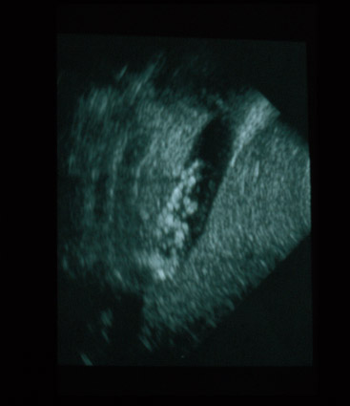
Clinical Manifestations of HS*
Hemolytic anemia
Degree of anemia varies with different mutations
At least 25% with compensated hemolysis and no anemia
Pallor, fatigue
Jaundice
Neonatal jaundice in first 24 hours of life
Exacerbation of anemia during newborn nadir is very common (>7 days to 1-2 months)
Splenomegaly
Gallstones
Positive family history (not always!)
May present with parvovirus-associated aplasia*
Post splenectomy -
sepsis risk definite*; - perhaps less after partial splenectomy
thrombosis risk suspected
Hemolysis ameliorated or eliminated
Gallstone risk reduced (reduced less after partial splenectomy)

Slide 17
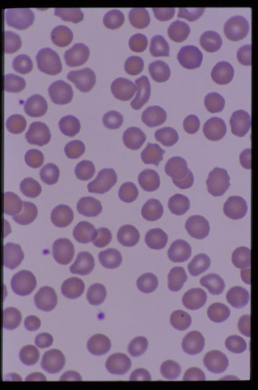
Laboratory Manifestations of HS
Spherocytes on peripheral blood smear (ideally surrounded by cells with central pallor)
Reticulocytosis
Increased incubated osmotic fragility
Negative DAT
Increased MCHC > 36% due to relative cellular dehydration
Increased bilirubin, LDH (may be subtle)

Slide 18
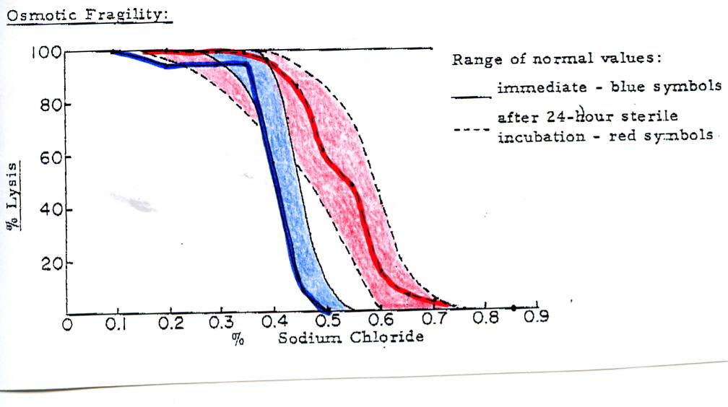
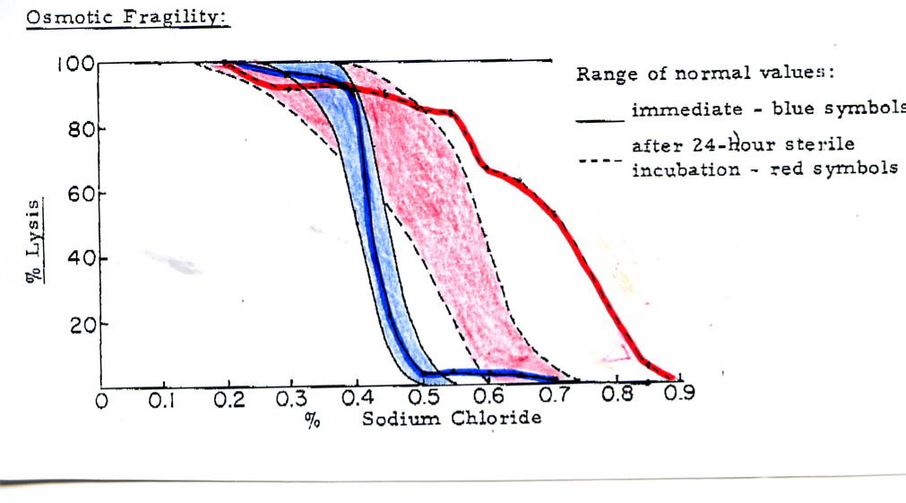
(Incubated) Osmotic Fragility Testing*
Red cells are incubated in varying concentrations of saline (0 – 0.9%)
“immediate” vs overnight
With ↓ salinity, cells take on water and lyse
Normal cells around 0.5%
HS cells at higher NaCl concentrations
Degree of hemolysis is detected by spectrophotometry
Fetal cells can be relatively resistant, so test is imperfectly reliable in neonates.
↓ Normal saline
water
Normal OF
Increased Sensitivity to Lysis in HS

Slide 19
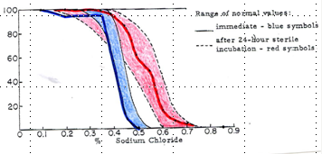
Watch out, variability among labs
In your speaker’s hospital, the lab presents this curve as the mirror image from the prior slide.
Both ways leave a lot to be desired.
↓ Normal saline
Water

Slide 20
Hereditary Elliptocytosis
HE with elliptical, cigar-shaped RBCs (>25%)
Most asymptomatic (e.g. non-hemolytic) *, but some have significant hemolytic anemia, esp. with a second “silent” allele.
Most common cause is abnormal spectrin* heterodimer association (cytoskeletal lateral interactions)
Inherited in autosomal dominant pattern*, but significant clinical variability, even within the same kindred
Southeast Asian Ovalocytosis (SAO) is a variant with rigid, hyperstable cells, caused by mutation in Band 3; confers some malaria protection*
Splenectomy ameliorates anemia in HE severe cases, but does not change cell shape. *

Slide 21
Hereditary Pyropoikilocytosis (HPP)
Rare cause of severe hemolytic anemia
Smear with bizarre RBC shapes similar to findings after thermal burn
MCV 55 – 74 fL
Strong association with HE ~ 1/3 have family members with HE
Many HPP pts have severe hemolysis in childhood, then typical HE later in life*
Spectrin abnormality is most common membrane abnormality – e.g. severe, recessive/compound heterozygous hereditary elliptocytosis is the most common kind of HPP*

Slide 22
Hereditary Stomatocytosis Syndromes
RBCs with “mouth-shaped” (stoma) area of central pallor
Associated with altered red cell cation permeability leading to changes in volume.
Hydrocytosis (overhydrated cells)
Increased MCV, decreased MCHC
Xerocytosis (dehydrated cells) *
Increased MCHC, MCV
Contracted, spiculated cells on smear
Laboratory diagnosis by assessing cation leak overnight
Marked increased risk of thrombosis after splenectomy
Differential diagnosis of stomatocytes: acute ethanol intoxication, liver disease, Rh null disease, Tangier disease

Slide 23
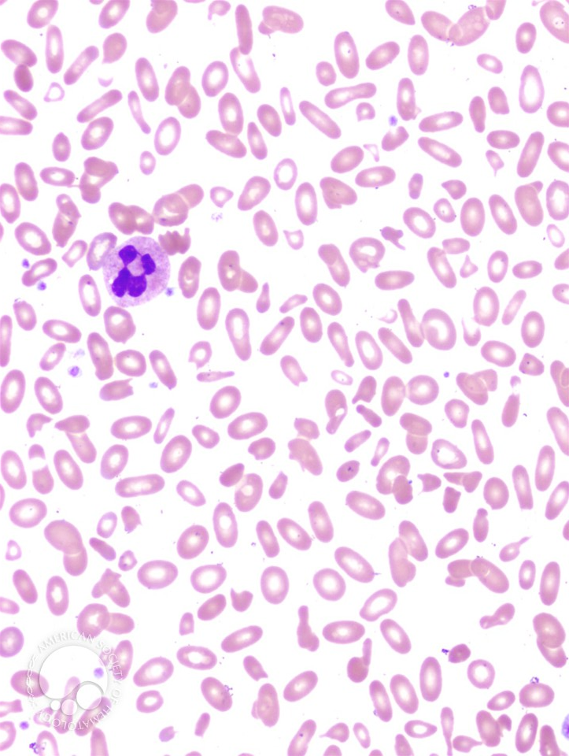
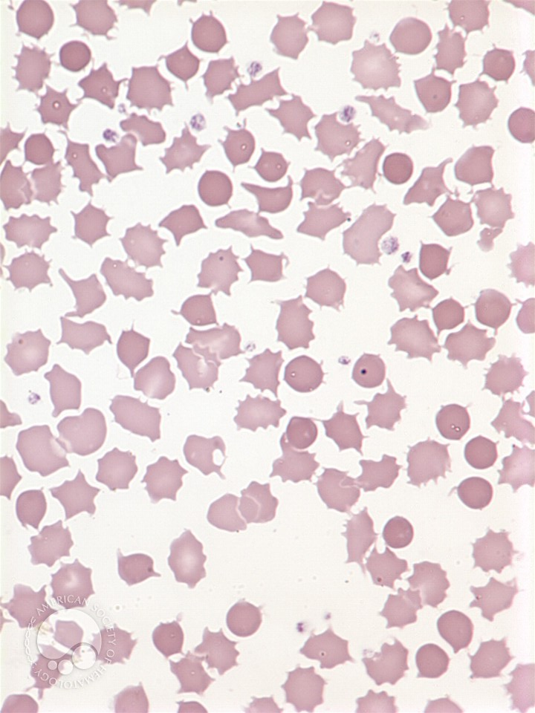
Red cell morphologies
Symptomatic elliptocytosis/HPP in an adult
acanthocytosis

Slide 24
Rh Null Phenotype – rare!
Absent or markedly reduced Rh expression on RBCs (n.b. not the same as Rh-)
Associated with mild to moderate, compensated hemolytic anemia*
Stomatocytes on peripheral smear may be related to altered RBC permeability to K⁺
HbF levels often elevated

Slide 25
Red Cell Enzyme Disorders

Slide 26
RBC Enzyme Disorders
RBC enzymes are important for:
Energy production through glycolysis and the pentose phosphate shunt
Maintaining cation gradient
Protecting from oxidative damage
Production of 2,3 DPG
Maintenance of ferrous 2+ heme iron
Nucleotide salvage
Abnormalities result in diverse phenotypes, both hematologic and non-hematologic

Slide 27
Pentose phosphate pathway defect: G6PD Deficiency
Most common red cell enzymopathy >>10⁸ humans affected
X linked inheritance*. Most common variant in persons of African descent (A-) is subtly unstable*. New cells have sufficient enzyme for most stress.
More severe in Mediterranean and Chinese forms.
Decreased production of NADPH: inability to maintain reduced glutathione levels
Hemolysis occurs in response to oxidative stresses* such as infections, drugs, fava beans (“favism”), naphthalene (moth balls)
Anemia may be low grade and chronic (CNSHA) or acute after exposure to oxidant*
Denatured hemoglobin seen as Heinz bodies on blood smear; also with “blister cells” on smear*
Reticulocytes have 5X higher G6PD: assay after resolution of hemolytic crisis
Frequent cause of intermittent jaundice*.

Slide 28
Pyruvate Kinase Deficiency
Clinical features* as would be expected for congenital hemolytic anemia.
Reduction in ATP production, with loss of membrane stability, water loss, cell shrinkage, and hemolysis*, but smear can be bland
Autosomal recessive inheritance. * Virtually every patient is compound heterozygote or has partial enzyme activity if homozygous.* Common among the Amish.
Increased shunting through Rapaport-Luebering shunt resulting in increased 2,3 DPG production
This increased 2,3 DPG facilitates O₂ release from hemoglobin to the tissues and partially compensates for anemia*
Unlike HS and some other hemolytic states, reticulocytosis can be markedly pronounced after splenectomy* with moderate amelioration of anemia; risk of gallstones persist*.
Retics have more mitochondria which aids survival post splenectomy
Transfusion-dependence is not rare in PK deficiency. Splenectomy may improve both un-transfused and transfused hemoglobin.
Laboratory confirmation may require testing with substrates at low (non-saturating) concentrations (“Km mutants), or nowadays, sequencing.

Slide 29
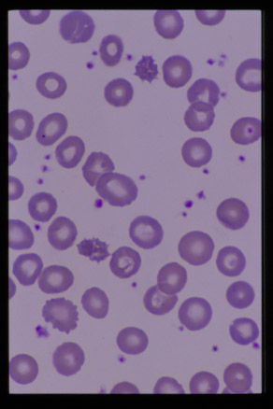
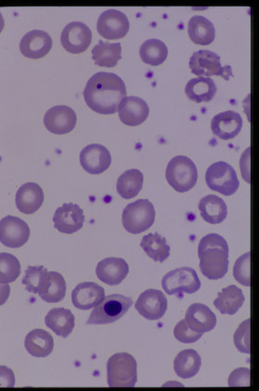
PK Deficiency Peripheral Blood Smear

Slide 30
Other Enzymopathies
Triose Phosphate Isomerase (TPI) Deficiency
A rare autosomal recessive enzymopathy
Associated with progressive neuromuscular dysfunction*, increased susceptibility to infection, and cardiomyopathy
Most patients die by 5-6 years of age
Phosphoglycerate Kinase (PGK) Deficiency
X linked disorder*
May also have associated neurologic abnormalities or myopathy
Pyrimidine 5’-Nucleotidase Deficiency
Responsible for nucleotide salvage
Associated with basophilic stippling on peripheral smear*
Aldolase A deficiency
Combined hemolysis and myopathy.
Biochemical hallmark: elevated serum CK without concomitant elevation in aldolase.

Slide 31
Hemoglobin Disorders
Most hemoglobinopathies covered by Dr. Quinn in his lecture

Slide 32
Unstable Hemoglobins
Most are autosomal dominant mutations that alter the solubility of hemoglobin in the red cell
Most lead to alterations in tertiary or quaternary structure of hemoglobin
Heinz bodies present in RBCs with supravital stain and lead to extravascular hemolysis and ineffective erythropoiesis
May see abnormal “smeared” band on electrophoresis but severely unstable globins may not be found in peripheral blood.
Examples include:
Hb Zurich with increased affinity for CO
Hb Köln
Hb γ Poole is an unstable gamma chain variant*
Hb Indianapolis – too unstable to find in peripheral blood.

Slide 33
Methemoglobinemia: pathophysiology
Normal heme group is in Fe²⁺ (ferrous) state which can combine with oxygen to form oxyhemoglobin
When Hgb is oxidized it becomes Fe³⁺ (ferric) heme or methemoglobin
The result of methemoglobinemia is increased O₂ affinity and poor tissue oxygen delivery
Oxygen dissociation curve left shifted

Slide 34
Methemoglobinemia - Etiology
Acquired causes
Drugs such as lidocaine, pyridium,
Aniline dyes, other toxins, e.g. bluing *
Nitrates or nitrites (well water *, whippets)
Congenital causes
Hb M variants - AD transmission; consider in cyanotic infants * (with brown blood)
NADH MetHb Reductase * Deficiency (Cytochrome b₅ reductase) – autosomal recessive.

Slide 35
Methemoglobinemia Clinical Presentation
Cyanosis with MetHb levels > 10 - 15%
May be “blue” before other symptoms occur
Normal PaO₂, but reduced O₂ sats by oximetry
As MetHb levels increase > 40-50%, cardiopulmonary and neurological symptoms develop
Infants particularly vulnerable – "bluing" for diapers; diarrhea
Classic chocolate brown color of blood
Does not become red with oxygen exposure
Treatment: Remove inciting agent, administer oxygen, methylene blue to increase reduction of MetHb
Methylene Blue contraindicated with G6PD deficiency*

Slide 36
Extrinsic and Acquired Causes of Hemolytic Anemia
Immune mediated hemolysis
Mechanical Destruction
Microangiopathic Hemolytic Anemia (MAHA)
DIC, TTP, HUS: garroting of red cells on fibrin strands
Drug Induced Hemolysis, e.g. alpha methyl dopa
Thermal Burns
Toxins
Hypersplenism
Complement Mediated Destruction
Paroxysmal Nocturnal Hemoglobinuria – a special case

Slide 37
Neonatal Alloimmune Hemolytic Anemia (Erythroblastosis Fetalis or HDN)
Transplacental passage of maternal alloantibody directed against fetal antigens, leading to hemolysis of fetal RBCs with clinical syndrome of :
anemia, hyperbilirubinemia, risks of hydrops fetalis, kernicterus *
leading cause of kernicterus and key cause of cerebral palsy before 1950s
May be due to Rh incompatibility (including Cc, Ee, ABO incompat., or other blood groups (Kell, Duffy, etc)
Feto-maternal hemorrhage leads to maternal immune response
May occur spontaneously or following amniocentesis, trauma, abortions, external cephalic version

Slide 38
Pearls * of alloimmune hemolytic anemia
ABO incompatibility decreases risk of primary Rh allosensitization – maybe due to rapid cell clearance?
Sensitization by maternal fetal hemorrhage probably most common. Outside resource-rich natinos, mismatched transfusions of girls/young women are a major cause.
Kell, Rh cause severe HDN, as they are expressed early * on fetal red cells. Lewis antibodies never cause HDN, the antigens are not red cell intrinsic *.
Definitions of mild, moderate, severe hemolysis, indications for early exchange in extensive tables in N&O.
Consider alloimmune HDN to minor antigens in multiparous deliveries with +DAT and no ABO/Rh setup.

Slide 39
Rh Hemolytic Disease
Rh is the most immunogenic of blood groups
Hemolysis does not occur with first pregnancy
Alloimmunization does occur with first pregnancy
Laboratory findings:
Infant’s Direct Antiglobulin Test (DAT) will be positive
Maternal antibody screen will be positive for a paternal antigen she lacks; sometimes with extremely high titers.
Smear with NRBCs, polychromasia, but not usually spherocytes (RBCs don’t exit spleen)
Prevention * : RhIgG (Anti-D as RhoGam or WinRho) is given to Rh- mothers to prevent alloimmunization
Given at 28 weeks, at delivery, and after any invasive procedure (amniocentesis, chorionic villus sampling, version)

Slide 40
Direct Antiglobulin Test
RBCs
Antibodies on surface of RBCs
Anti human IgG
“Coombs reagent”
Detects antibodies present on the surface of RBCs in vivo
Addition of anti human IgG leads to agglutination of RBCs in vitro

Slide 41
ABO Incompatibility
Isohemagglutinins are naturally occurring antibodies
Typically IgM, but only IgG can cross placenta
Can occur in the first pregnancy
“ABO Set up” with Group O mom and Group A or B infant (20% of pregnancies, but only 2% affected by HDN)
DAT is usually positive (may be weak)
Peripheral smear with polychromasia, NRBCs, spherocytes
ABO antigens not expressed in early fetal RBCs, thus ABO HDN is not usually severe

Slide 42
Warm Reactive Autoimmune Hemolytic Anemia (AIHA)
IgG mediated
Extravascular clearance primarily via the reticuloendothelial system (spleen)*
May be idiopathic or associated with SLE, lymphoid malignancies, immunodeficiency *, Evans syndrome
Antibodies usually against “common” antigens
DAT positive (IgG + C3)
Treatment: Steroids, splenectomy, other immunosuppressive drugs, + IVIG, transfusion with least incompatible blood *

Slide 43
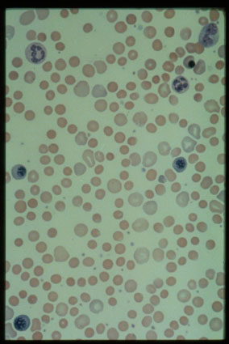
AIHA Peripheral Blood Smears

Slide 44
Cold Agglutinin Disease
IgM mediated
IgM-RBC immune complex forms at 4°C
Activates complement when warmed centrally
Often react with I/i blood group system*
Can be associated with Mycoplasma, EBV *
DAT + for C3, thus intravascular lysis
Treatment *: Keep patient warm, supportive therapy, plasmapheresis for severe disease
Use blood warmer! If hemolysis worsens with transfusion, consider tx washed cells to reduce amount of complement provided.

Slide 45
IgG vs IgM mediated hemolysis
 | IgM | Warm IgG
Fixes Complement | Yes | Usually not
Mechanism of Hemolysis* | Complement | Macrophages digest Ab-coated RBCs
Steroid response* | Poor | Fair to good
Pheresis response | Good (intravascular) | Fair or poor (tissue distribution)
Distinguishing AIHA from HS*: DAT, family history, acquired vs congenital;
NON-distinguishing features: spherocytes, Osmotic fragility, and the confusing
Situation of negative standard DAT requiring super-sensitive methods.

Slide 46
Paroxysmal Cold Hemoglobinuria (PCH)
Acute illness, often after viral URI
Inciting infections include measles, mumps, varicella, syphilis, Mycoplasma
Caused by cold reactive IgG (Donath Landsteiner Antibody) of anti-P specificity that leads to intravascular hemolysis
Antibody binds in the periphery (cold), lysis at central temperatures (fixes C'). *
Donath-Landsteiner test:
Keep sample warm until plasma separated*
Incubate at 4°C, then measure lysis at 37°C
Typically self limited illness in days to weeks
Treatment: Supportive care – steroids and splenectomy not usually helpful since intravascular, complement mediated lysis; pheresis much less effective than for IgM.

Slide 47
Red cell fragmentation disorders *
Microangiopathic Hemolytic Anemia (MAHA)
Shearing of red cells (schistocytes)
May also see spherocytes on smear
May occur with vasculitic disorders, burns, DIC, post stem cell transplantation (TTP), pregnancy, drugs including cocaine, cyclosporine A, tacrolimus
Other RBC shearing
congenital heart disease (especially after surgery with a rough suture line or residual high-pressure-gradient jet).

Slide 48
Drug-induced hemolytic anemia*
Often immunological – ABP content:specify mechanisms
Haptenized red cell proteins (Penicillins) *
Bystander*immunological -antibodies to drugs adsorbed to RBC
Often drug metabolites, not parent drug *
Common current culprits: Piperacillin (including Zosyn), Cefotetan, ceftriaxone
Generally detected as drug-dependent DAT
Distinguish from immunomodulatory drugs which cause AIHA and are independent of antibody (Tacrolimus, fludarabine)
Distinguish from non-specific + DAT after IVIG
Much less common than drug related ITP or neutropenia

Slide 49
Thrombotic Thrombocytopenia Purpura (TTP)
“Classical Pentad” of fever, MAHA, thrombocytopenia, renal dysfunction, and neurological changes. Not all seen in modern cases.
Abnormal von Willebrand factor cleaving protease encoded by ADAMTS13 gene
Very large MW vWF multimers present
Lead to microvascular fibrin deposition
Platelet trapping leads to thrombocytopenia
Microangiopathic schistocytic hemolytic anemia
May be congenital absence of enzyme OR autoantibody to the vWF cleaving protease
Assays for ADAMTS13 activity and antibodies are evolving, have slow turnaround, and still not perfect for directing care.
Treatment: Plasmapheresis or FFP infusions with steroids or other immunosuppression for refractory patients; current trials of rituximab and agents to block VW:platelet interactions

Slide 50
Toxins and external causes of hemolysis
Clostridium sepsis
Phospholipases result in red cell membrane loss and spherocytes
Occurs in ill patients – smear or automated cell count findings consistent with spherocytes may be the first clue for an ICU patient with ischemic injuries to bowel or extremities.
Brown Recluse spider bite*
Some snake and other venoms due to phospholipases*
Wilson’s disease*
Copper toxicity to red cells must be considered in a patient with unexplained liver disease and new hemolysis.
Cu and ceruloplasmin levels should be obtained immediately in this clinical scenario, as irreversible hepatic disease may follow shortly on heels of overt hemolysis in patients not yet diagnosed.
Burns – may have acquired spherocytic or HPP-like anemia *

Slide 51
Paroxysmal Nocturnal Hemoglobinuria
Acquired, clonal stem cell disorder (why does this clone take over?)
Cells sensitive to complement mediated hemolysis
Lack of GPI linked proteins
Somatic PIG-A gene mutation (X linked)
Clinical manifestations include:
Hemoglobinuria due to intravascular hemolysis and consequent NO clearance*
Other symptoms include abdominal pain, dysphagia, erectile dysfunction
Thrombosis, particularly in intraabdominal and cerebral veins*
Pancytopenia/PNH clones in marrow failure discussed elsewhere in course.
Increased risk of developing leukemia
Laboratory testing:
Ham’s test (acidified serum lysis test)
Flow cytometric analysis for CD55 and/or CD59 and leukocyte PI-linked proteins
Treatment with eculizumab to block complement-mediated lysis has revolutionized treatment

Slide 52
Management of Congenital Hemolytic Anemia
Observe growth, development
Determine baseline hemoglobin/retics
Follow for splenomegaly
Educate family regarding risks for gallstones, parvovirus B19 aplastic crisis
Folate supplementation (especially if severe) *, but folate now provided in many enriched foods since 1997 * (so we now rarely prescribe in mild-moderate cases)
Erythrocyte transfusions, intermittent vs chronic
Splenectomy – partial or total, laparoscopic
Cholecystectomy if symptomatic gallstones
HS is a special case, in that hemolysis is essentially eliminated by splenectomy*.

Slide 53
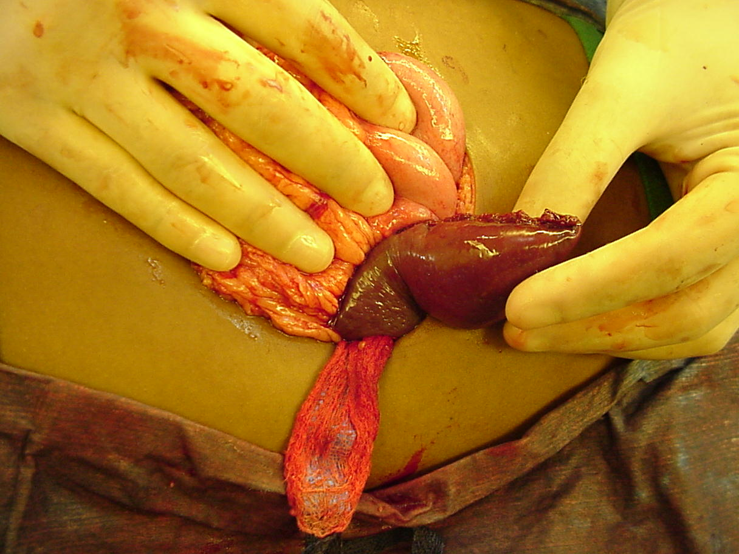
Intraoperative photograph of partial splenectomy used with permission of Dr. Henry Rice, Pediatric Surgery, Duke Children’s Hospital

Slide 54
Indications for Splenectomy
Controversy re: need for and timing of splenectomy
Splenectomy typically leads to marked improvement in RBC survival and laboratory parameters
Risk of gallstones is reduced (but not gone, except most HS)
Complications include local infection, bleeding, postsplenectomy sepsis, thrombosis, cardiovascular disease, pulmonary HTN
Pneumococcal, meningococcal vaccines preop
Indications: growth failure, skeletal changes, transfusion dependence, massive splenomegaly

Slide 55
REFERENCES
Nathan and Orkin: Hematology of Infancy and Childhood, 8th ed, W.B. Saunders Company, Philadelphia, PA. 2014.
Gallagher PG. Red Cell Membrane Disorders, American Society of Hematology Education Book, Hematology 2005:13-18.
Van Wijk R, van Solinge WW. The energy-less red blood cell is lost: erythrocyte enzyme abnormalities of glycolysis, Blood 2005;106:4034-4042.
Prchal JT, Gregg XT. Red Cell Enzymes, American Society of Hematology Education Book, Hematology 2005:19-23.

Slide 56
5 HEREDITARY HEMOLYTIC ANEMIAS | Slide number(s)
Know that Rh null phenotype is associated with a hereditary hemolytic anemia | 24
Know the relationship between parvovirus infection and aplastic crisis in congenital hemolytic anemias | 16 ,52
Recognize the role of folate supplementation in patients with hemolytic anemia | 52
5A Inherited Disorders of the Red Cell Membrane
(1) HS
(a). Genetics
Recognize the differences in the phenotypes of the autosomal dominant and autosomal recessive variants of hereditary spherocytosis | 15
(b). Pathophysiology
Know the cytoskeletal defects associated with hereditary spherocytosis | 15
(c). Evaluation
Understand the clinical and laboratory diagnosis of hereditary spherocytosis | 16-19
Know the basis for and pattern of abnormal osmotic fragility in hereditary spherocytosis | 18-19
Distinguish between hereditary spherocytosis and autoimmune hemolytic anemia | 12 among others
(d). Management
Know the rationale for and hematologic sequelae of splenectomy in hereditary spherocytosis | 16
(e). Complications

Slide 57
Understand the complications seen in hereditary spherocytosis before and after splenectomy | 16
(2). Hereditary elliptocytosis and pyropoikilocytosis
(a). Genetics
Know the mode of inheritance of hereditary elliptocytosis and pyropoikilocytosis | 20
(b). Pathophysiology
Know the cytoskeletal defects associated with hereditary elliptocytosis and hereditary pyropoikilocytosis | 20-21
(c). Clinical features
Recognize hemolytic and non-hemolytic variants of hereditary elliptocytosis | 20
Know the clinical features of elliptocytosis and pyropoikilocytosis and the clinical problems of distinguishing them in the neonatal period | 20-21
(d). Laboratory evaluation
Recognize the morphologic characteristics and other laboratory features of hereditary elliptocytosis and hereditary pyropoikilocytosis | 20,21,23
(e). Management
Know the effects of splenectomy on hereditary elliptocytosis and pyropoikilocytosis | 20
3. Acanthocytosis
(a). Clinical features
Recognize the clinical and laboratory feasures of congenital and acquired conditions characterized by acanthocytosis | 25

Slide 58
(4). Other membrane disorders | 22
(a). Clinical and laboratory features
Recognize the patterns of inheritance and the clinical and laboratory features of other membrane disorders such as stomatocytosis, xerocytosis, pyknocytosis, ovalocytosis, and Wilson disease | 22
b. Inherited disorders of anaerobic glycolysis
(1). Pyruvate kinase deficiency
(a). Genetics | 29
Know the inheritance pattern of pyruvate kinase deficiency
(b). Cellular physiology | 29
Recognize how pyruvate kinase deficiency may lead to impaired erythrocyte metabolism | 29
(c). Clinical and laboratory features
Recognize the clinical and laboratory manifestations of pyruvate kinase deficiency | 29
(d). Management
Know the effects of splenectomy on pyruvate kinase deficiency | 29
(e). Complications
Know that hemolysis and gallstone production may persist following splenectomy | 29
(2). Triose phosphate isomerase deficiency
(a). Clinical features

Slide 59
Know the relationship between erythrocyte triose phosphate isomerase deficiency and neuromuscular disease | 31
(3). Other enzyme deficiencies
(a). Genetics
Know that phosphoglycerate kinase (pgk) deficiency is an X-linked disorder, while other glycolytic disorders are autosomal recessive | 31
(b). Laboratory evaluation
Know the association of pyrimidine-5'-nucleotidase deficiency with basophilic stippling | 31
c. Inherited disorders of the pentose phosphate pathway
(1). Glucose-6-phosphate dehydrogenase deficiency | 28
(a). Genetics
Recognize that G6PD deficiency is X-linked | 28
(b). Cellular physiology
Understand the pathophysiology whereby oxidant damage causes hemolysis in G6PD deficiency | 28
(c). Clinical features
Know the association of favism with the Mediterranean and Chinese forms of G6PD deficiency | 28
Know the association of intermittent jaundice with G6PD deficiency
Recognize the clinical and laboratory differences between the major G6PD variants (eg, A-Mediterranean) | 28

Slide 60
Recognize the etiologic role of infection and drugs in hemolytic episodes associated with G6PD deficiency | 28
(d). Laboratory evaluation
Recognize the difficulty in making diagnosis in A-variant G6PD deficiency during an acute hemolytic episode | 28
Recognize the erythrocyte morphologic abnormalities during an episode of hemolysis in G6PD-deficient individuals
6. Acquired hemolytic anemias
a. Alloimmune hemolytic anemia; erythroblastosis fetalis
(1). Pathophysiology
Understand the effect of a major blood group incompatibility on Rh sensitization | 39
Know the erythrocyte antigens that most frequently cause erythroblastosis fetalis | 38-40
(2). Clinical and laboratory features
Recognize the clinical features of erythroblastosis fetalis | 40
Know that transient conjugated hyperbilirubinemia may occur as a complication of severe isoimmune hemolytic disease | 40
(3). Diagnosis
Know the diagnostic criteria for ABO incompatibility | 42, 39
Know the relative predictive value of tests of Rh sensitization | 39
Differentiate fetomaternal minor blood group incompatibility from other causes of jaundice in the neonate | 39

Slide 61
Understand the appropriate laboratory evaluation of neonatal jaundice secondary to a minor blood group fetomaternal incompatibility | 39
Know that maternal anti-Lewis antibodies do not cause hemolytic disease of the newborn | 39
(4). Treatment
Know when to expect and how to treat the late anemia of isoimmune sensitization
Know the indications for exchange transfusion | 39
Know what type of blood to use for exchange transfusions and delayed simple transfusions in sensitized infants | 39
(5). Prevention
Know the indications for the use of anti-D | 40
b. Autoimmune hemolytic anemia
(1). Pathophysiology
Know the biologic properties and clinical significance of IgG and IgM erythrocyte antibodies | 43, 45, 46
Know the mechanism of erythrocyte destruction in IgG-mediated autoimmune hemolytic anemia | 46
Know the relationship between the response to corticosteroid therapy and the type of autoantibody | 46
Know the direct antiglobulin test results with warm-reactive antibodies, cold agglutinin disease, and paroxysmal cold hemoglobinuria | 41-47
(2). Warm-antibody hemolytic disease

Slide 62
Know the antigen specificity (or lack thereof) in warm autoimmune hemolytic anemia | 43
Know the clinical presentation and features of idiopathic autoimmune hemolytic anemia of childhood | 43,45,47
Know of the association of warm-reactive antibodies with other autoimmune disorders | 43
Plan the therapy for autoimmune hemolytic anemia
(3). Cold agglutinin disease
Know the antigen specificity of cold-reactive antibodies | 45
Recognize the infections that are associated with cold-reactive antibodies | 45
Know the principles of therapy for cold agglutinin disease | 45
(4). Paroxysmal cold hemoglobinuria
Identify the clinical features of autoimmune hemolytic anemia due to a Donath-Landsteiner antibody | 47
Know the characteristics of the Donath- Landsteiner antibody | 47
(5). Drug-induced immune hemolytic anemia
Know the mechanism of hematologic toxicity of offending drugs | 49
Recognize the examples of drug-induced immune hemolysis | 49
c. Anemia due to infection, chemical, physical agents | 51
Recognize intravascular hemolysis as a complication of recluse spider bites | 51
Know that thermal burns and envenomization may be complicated by acquired spherocytic anemia | 51
d. Erythrocyte fragmentation syndromes

Slide 63
Recognize the pathogenic mechanisms and the clinical and laboratory features of the erythrocyte fragmentation syndromes | 50
e. Paroxysmal nocturnal hemoglobinuria
Recognize the laboratory and clinical manifestations of paroxysmal nocturnal hemoglobinuria | 52
Know the association of paroxysmal nocturnal hemoglobinuria with thrombosis | 52
Understand the molecular and pathophysiologic basis for paroxysmal nocturnal hemoglobinuria | 52
Methemoglobinemia | 34-36
a. Toxic methemoglobinemia | 35
Know the basis for the increased vulnerability of infants to methemoglobinemia
Know the mechanism for methemoglobin reduction in normal erythrocytes
19
Associate the treatment failure of methemoglobinemia with methylene blue and G6PD deficiency | 36
Know that consumption of well water contaminated with nitrates causes methemoglobinemia in infants but not in older children and adults | 35
Know the association of methemoglobinemia with diarrhea and acidosis in young infants | 34
b. Congenital cytochrome b5 reductase deficiency
Know how to differentiate methemoglobinemia due to deficient methemoglobin reduction from methemoglobinemia due to increased methemoglobin production | 35
c. Hgb M disorders
Recognize the clinical and laboratory findings of hgb M disease in the newborn infant | 35

