Slide 1
Welcome!
To join the call dial (866) 740-1260, passcode 3754894#.
All participants are placed on mute for the duration of the webinar.
If you have questions, type them in the chat box at the bottom left hand side of your screen. They will be answered at the end of the presentation.
This conference is being recorded for future use.
The recording will be made available on the ASPHO website afterwards.

Slide 2

Leukemias in Children with Down Syndrome
Jeffrey Taub MD – Children’s Hospital of Michigan
Kelly Maloney MD – Children’s Hospital Colorado
Glen Lew MD (Moderator) – Children’s Healthcare of Atlanta
Notes:
Unmute (* 7)
Good afternoon. My name is Glen Lew and I have the pleasure of moderating the ASPHO webinar
entitled “Leukemias in Children with Down Syndrome”
I have a few housekeeping items before we get started;
Please note that all participants have been muted for the presentation this afternoon.
I would like to direct your attention to the chat room on your screen. Please use this chat
room to ask any questions which I will direct to the speakers at the end of our presentation.
You can also use this area to let me know about any AV issues or technical issues.
Our speakers today are Jeffrey Taub from ***, and Kelly Maloney from Colorado.
I’ll begin with two quick case vignettes to set the stage.

Slide 3
Case Study 1
A newborn baby has dysmorphic facial features, transverse palmar creases, systolic ejection murmur, liver palpable 2 cm BCM.
A CBC reveals:
WBC: 59,000/µl
Hemoglobin: 17 gm/dL
Platelets: 80,000/µl
Peripheral smear: 50% blasts
Total bilirubin: 1.8 mg/dL, direct bilirubin 0.4 mg/dL
ALT: 37 U/L, AST: 30 U/L

Slide 4
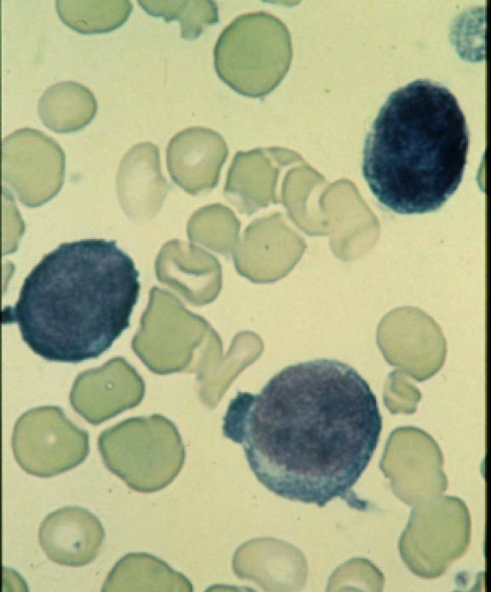
Transient Myeloproliferative Disorder (TMD)
Transient Abnormal Hematopoiesis (TAM)

Slide 5
Transient Myeloproliferative Disorder (TMD)
Estimated that ~10% of Down syndrome newborns have a precursor of acute megakaryocytic leukemia (AML-M7; AMKL), TMD, in which blasts in the peripheral blood and/or bone marrow have the same morphology and antigen expression as AMKL.
Incidence may be higher with the use of next-generation sequencing for GATA1 mutation detection which has identified “silent” cases in an additional ~20% of newborns. [Roberts et al., Blood 2013]
TMD has also been diagnosed in Down syndrome mosaics and in infants with isolated trisomy 21 in blast cells with no other evidence of mosaicism.
Majority of TMD cases can spontaneously regress with supportive care alone, though ~20-30% of patients will subsequently develop AML.
There are no known factors at the current time to predict which babies will subsequently go on to develop AML.

Slide 6
Children’s Oncology Group (COG) AAML08B1:
Biology Study of Transient Myeloproliferative Disorder in Children with Down Syndrome
Study Chair: April Sorrell, MD
Primarily a biology study with treatment recommendations for the use of low dose araC based on the COG A2971 study.

Slide 7
TMD Patients Stratified by Mortality-risk Group
COG A2971
High Risk TMD
TMD patients with life threatening cardio-respiratory compromise due to complications of TMD such as organomegaly or effusions. Life threatening cardio-respiratory compromise is defined as cardiovascular Grade 4 edema, Grade 4 pericardial effusions, or Grade 4 pleural effusions.-OR TMD patients with hyperleukocytosis defined as a WBC greater than 100 x 10³/μL. -OR TMD patients with any degree of hepatomegaly (palpable on physical exam) combined with life threatening hepatic dysfunction. Life threatening hepatic dysfunction is defined as any of the following: Grade 4 DIC, Grade 4 ascites, Grade 4 bilirubin (> 10.0 x ULN), Grade 4 AST (> 20.0 x ULN), or Grade 4 ALT (> 20.0 x ULN).
Intermediate Risk TMD
TMD patients with hepatomegaly (palpable on physical exam) combined with non-life threatening hepatic dysfunction (Grade 1, 2, or 3 hepatic dysfunction: AST or ALT > ULN-2.5 x ULN, and/or a total or direct bilirubin > ULN-1.5 x ULN), And No evidence of life threatening cardiovascular, respiratory, or hepatic compromise due to complications of TMD. Life threatening disease is defined as Grade 4 toxicity.
Low Risk TMD
TMD patients without palpable hepatomegaly on physical exam or TMD patients with hepatomegaly but without hepatic dysfunction (i.e., Grade 0 hepatic dysfunction) And No evidence of life threatening cardiovascular, respiratory, or hepatic compromise due to complications of TMD. Life threatening disease is defined as Grade 4 toxicity.
Notes:
Down syndrome or Down syndrome mosaicism -cytogenetic or FISH confirmation within 21 days of enrollment

Slide 8
Case Study 2
  Following resolution of TMD, the patient has had CBCs monitored every 3 months with a slight decline in the platelet count.
  Platelets 54,000/µL,
  mild neutropenia & anemia
  No overt blasts
  You decide to perform a BMA/Bx…
Acute Megakaryocytic Leukemia-AMKL M7

Slide 9
Myeloid Leukemia of Down Syndrome
(ML-DS)
2008 WHO classification of ML-DS encompasses the group of both MDS patients (blasts <30%) as well as AML patients who predominantly have the AMKL phenotype.
Approximately 95% of ML-DS cases diagnosed before the age of 4 years.
Median age of diagnosis 1.8 years vs 7.5 years for non-Down syndrome AML (Children’s Cancer Group 2891 study). [Gamis et al., J Clin Oncol 2003]
Down syndrome children represent ~15% of total pediatric AML patients. [Nordic Society of Pediatric Hematology and Oncology Zeller et al. Br J Haemat 2005; CCG 2891]

Slide 10
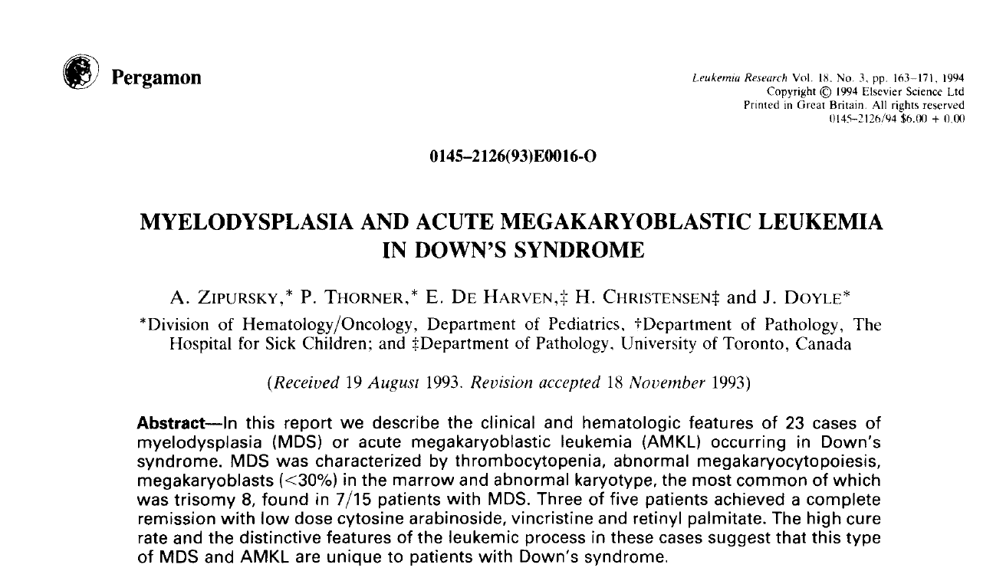
Down syndrome children have a 500-fold increase risk to develop AMKL compared to non-Down syndrome children

Slide 11
Characterization of Blast Cells
Immunophenotype: CD41/61 (platelet antigens glycoprotein IIb/IIIa, CD7 (aberrant T-cell antigen expression), CD36 (thrombospondin receptor).
Common cytogenetics abnormalities include trisomies +8, +21, +11 and structural abnormalities dup(1q), del(6q), del(7p), dup(7q), del(16q). [Forestier et al., Blood 2008]
Classic cytogenetic abnormalities detected in pediatric AML cases are extremely rare in ML-DS including t(8;21), inv(16), t(15;17), MLL (11q23) rearrangements or t(1;22) seen in non-DS AMKL cases.

Slide 12
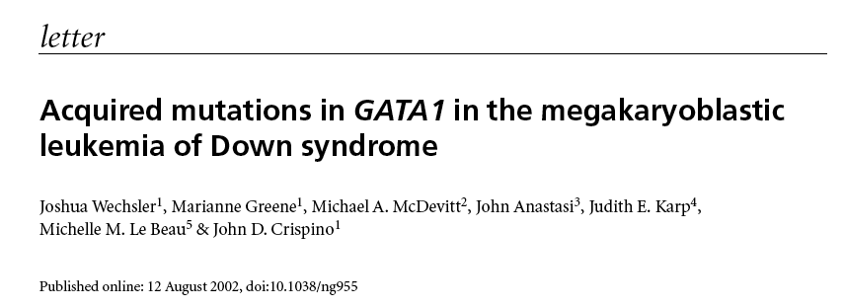
Identification of GATA1 Mutations in ML-DS
2002

Slide 13
AAML0431 PROTOCOL SCHEMA
Recommended criteria for proceeding to each cycle of therapy: ANC ≥1,000/µL and platelets ≥100,000/µL.
Cumulative Doses for Induction I and II:
AraC: 24,800 mg/m²
Daunorubicin 160 mg/m²
Study Entry
< 4 years of age at diagnosis
BMA/MRD At Diagnosis
Induction I CI-TAD + IT AraC
BMA/MRD Day 14
BMA/MRD Day 28
If cellular, moderately cellular, ≥ 20% blasts
Induction II Capizzi II Course
BMA/MRD Day 14 and 28 if PR or RD after Induction I Day 28 marrow
Induction III CI-TAD + IT AraC
If RD
Induction IV CI-TAD
BMA = Bone Marrow Aspirate.
MRD = Minimal Residual Disease
CI-TAD: Continuous Infusion Cytarabine (AraC)/Daunorubicin + 6-Thioguanine
CR = Complete Response
PR = Partial Response
RD = Refractory Disease
Capizzi II: Cytarabine (AraC)/L-asparaginase
VP/Ara-C: Etoposide/Cytarabine (AraC)
IT AraC: Intrathecal Cytarabine
BMA/MRD
Intensification I VP/AraC
PR, RD or Relapse
Off Protocol Therapy
Intensification II VP/AraC
BMA/MRD
Follow-Up

Slide 14
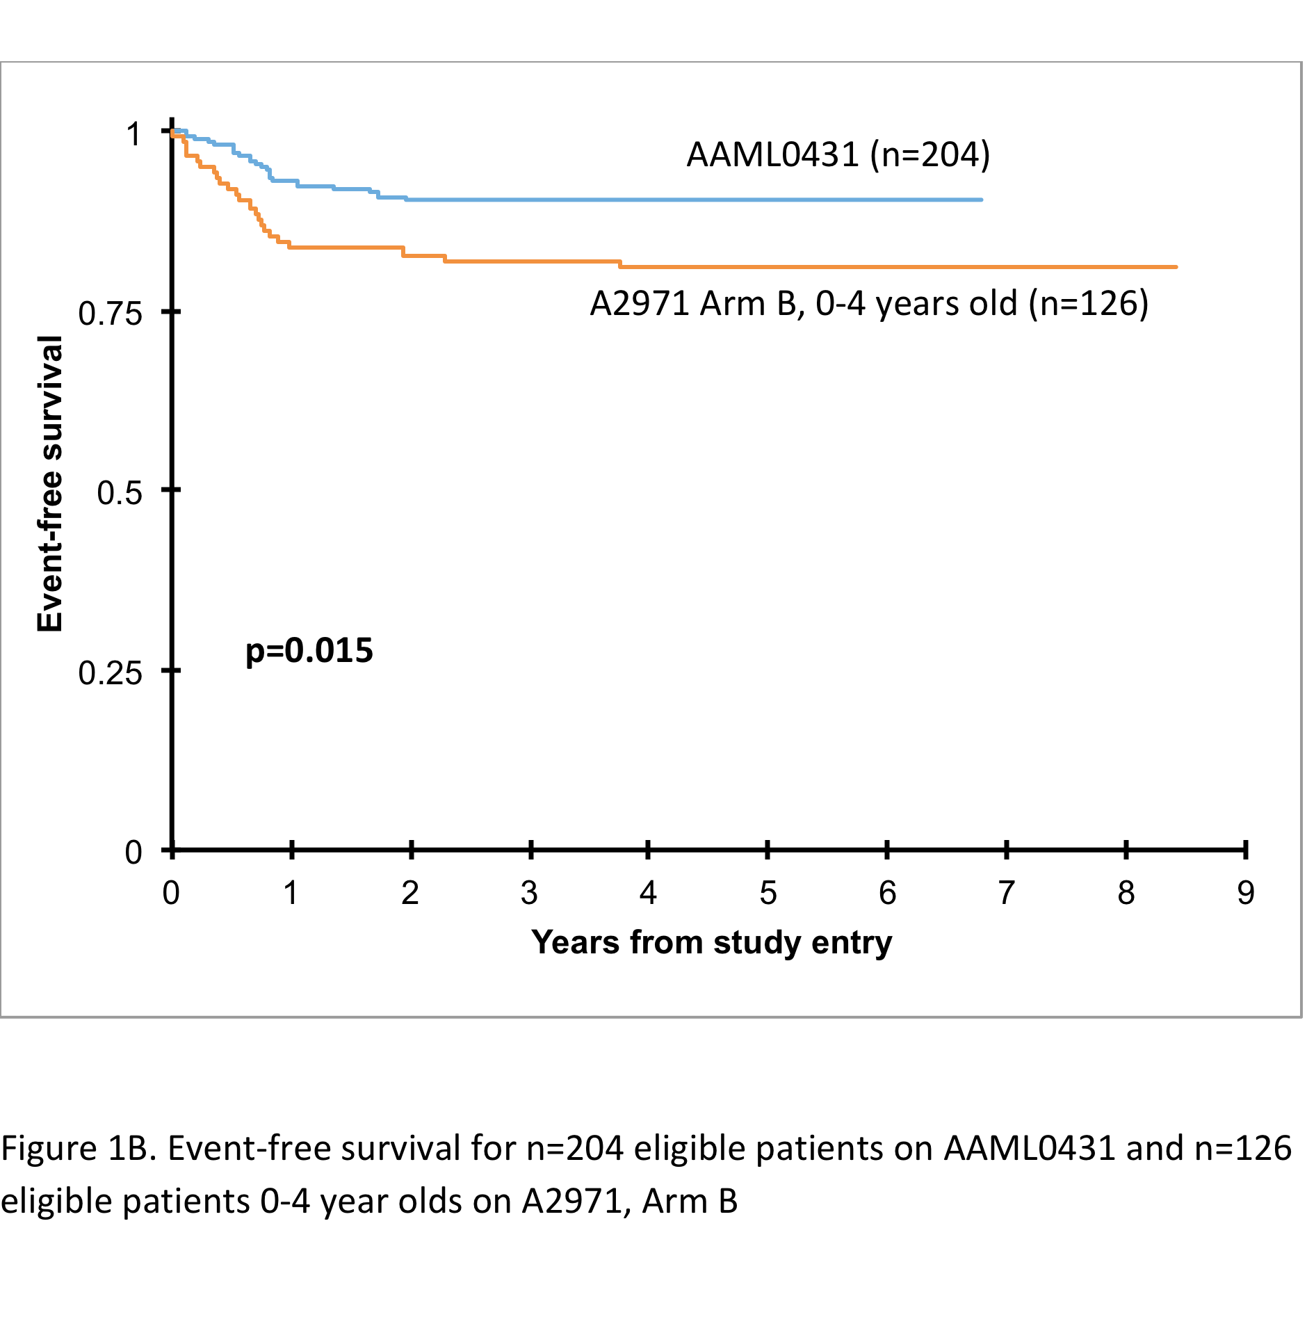
Outcome Results for AAML0431

Slide 15
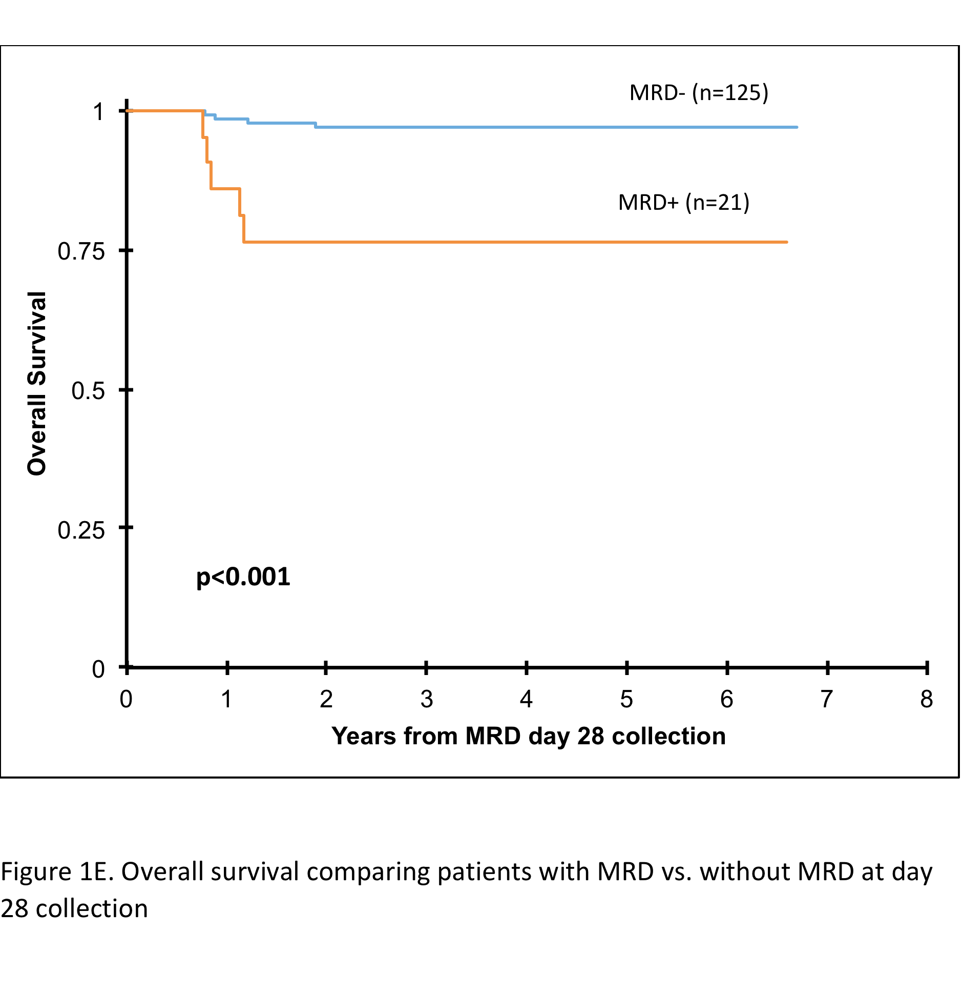
AAML0431 Outcome Based on Minimal Residual Disease (MRD) Status
MRD analysis by flow cytometry was performed after Induction I with a sensitivity level of 0.01%

Slide 16
Challenges in Treating Children with
Down Syndrome and Leukemia
TOXICITY
CURE

Slide 17
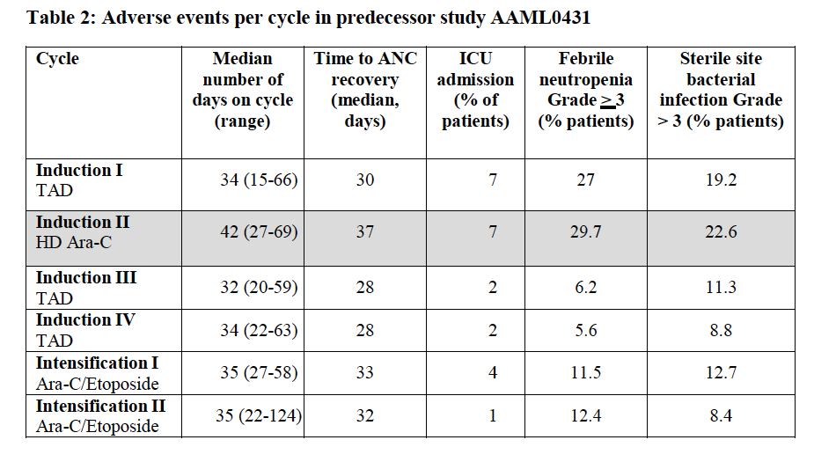

Slide 18
Alternative AraC Dosing
Several studies have indicated that alternatives to high-dose araC-based regimens may be effective for ML-DS patients.
Dr. Zipursky pioneered the use of very low-dose araC (10 mg/m²/dose) for ML-DS as an effective and less toxic therapy compared to conventional araC dosing. [Al-Ahmari A et al., Br J Haematol 2006]
Studies from Japan have utilized repetitive cycles of araC 100 mg/m²/day x 7 days along with an anthracycline with EFS rates of ~80%. [Kudo K et al., J Clin Oncol 2007]

Slide 19
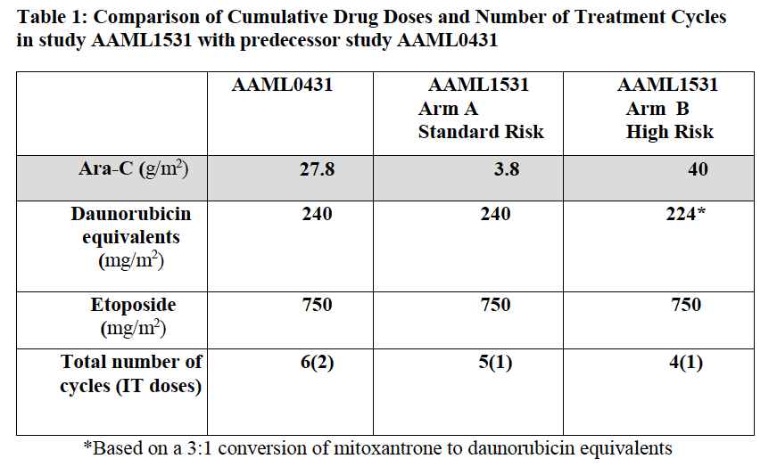
AAML1531 Risk-stratified Therapy for Acute Myeloid Leukemia in Down Syndrome
Primary Aims
To determine the EFS for children with standard risk DS AML (MRD-negative after Induction I therapy) after elimination of HD AraC.
To determine the EFS for children with high risk DS AML (MRD-positive after Induction I) after intensification of treatment equivalent to that used for high risk AML in children without DS.

Slide 20
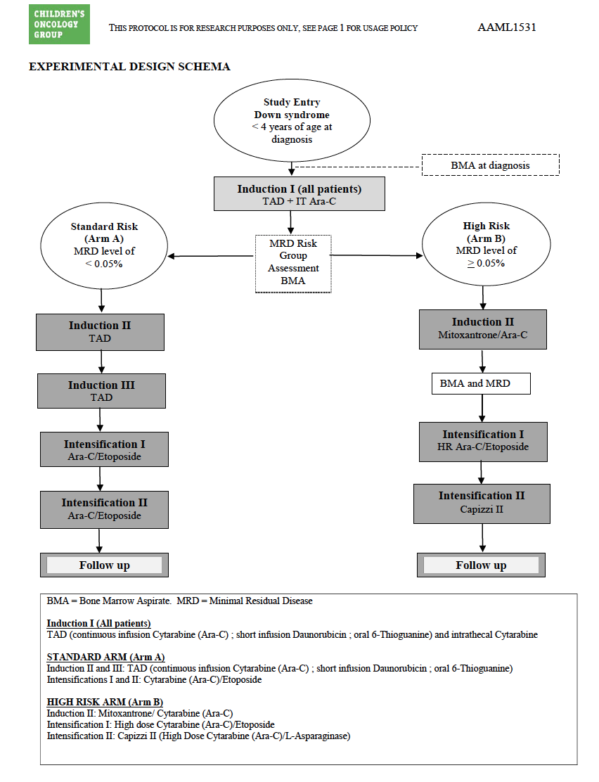
AAML1531
Study Chairs:
Jason Berman
Hans Hitzler

Slide 21
Relapsed ML-DS
Patients with either refractory or relapsed disease have a very poor prognosis.
POG 9421 and CCG2891 overall survival of 12%. [Loew TM et., ASH 2004]
26 patients in a Japanese study had an overall survival of 25.9%. [Taga T et al., Blood 2012]
Relapse after stem cell transplant remains the leading cause of death for ML-DS patients; 19% survival rate. [Hitzler et al., Biol Blood Marrow Transplant 2013]

Slide 22
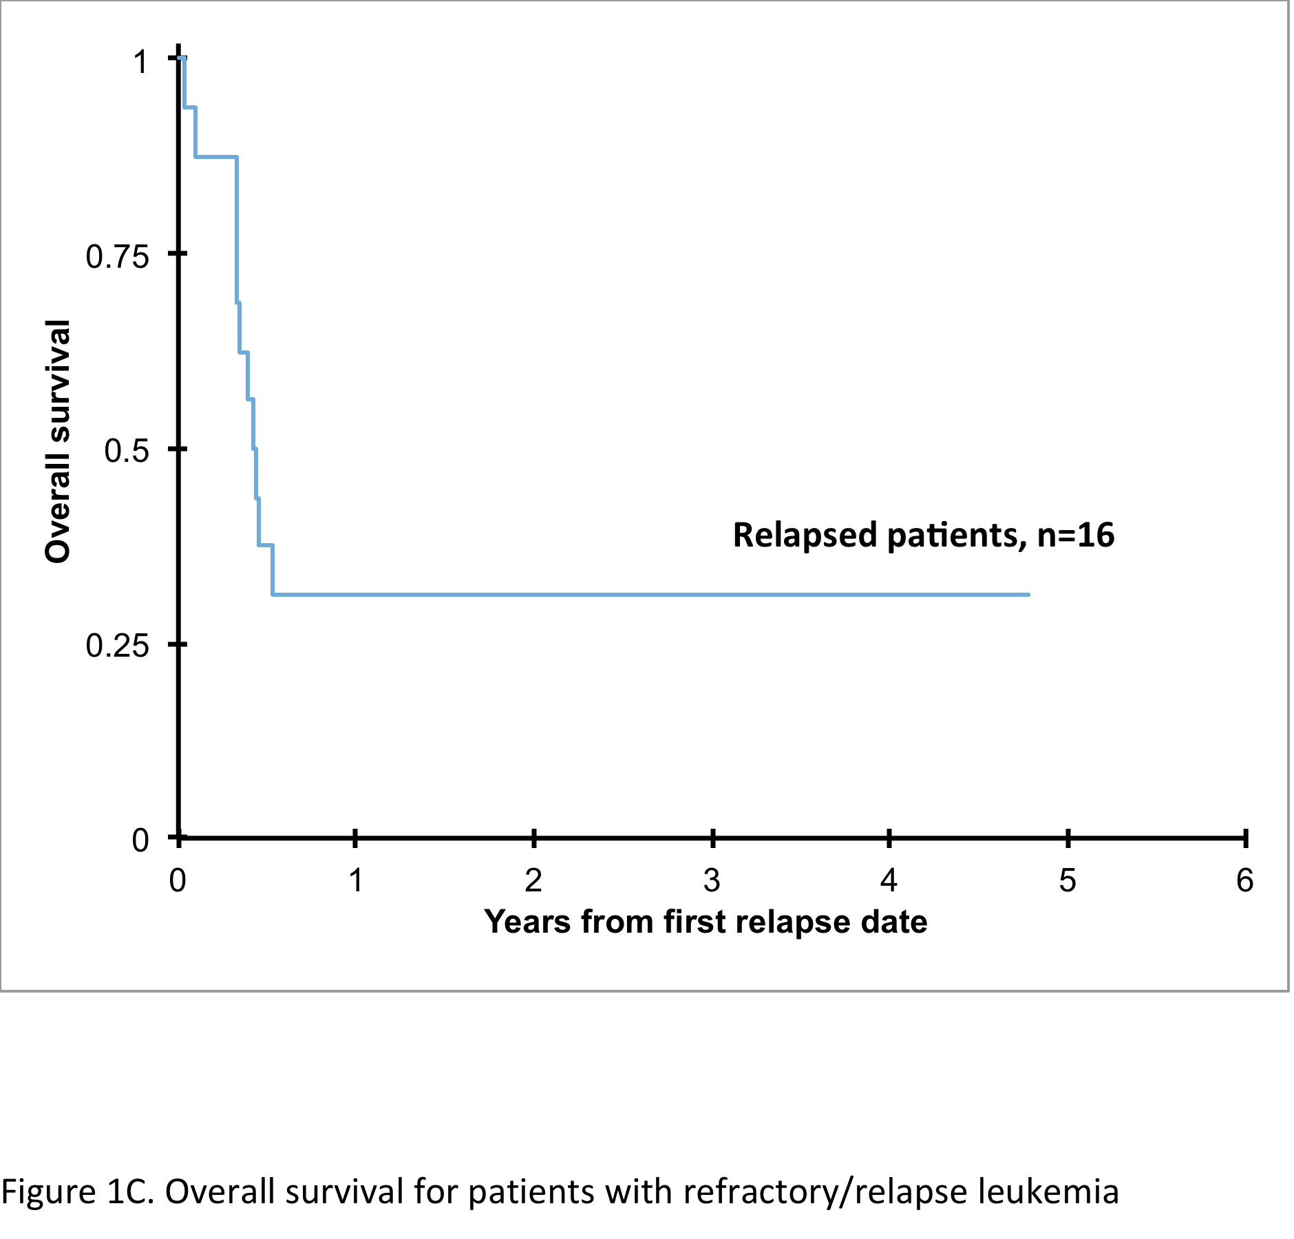
AAML0431 Relapse Results

Slide 23
Why does ML-DS have very high cure rates?

Slide 24
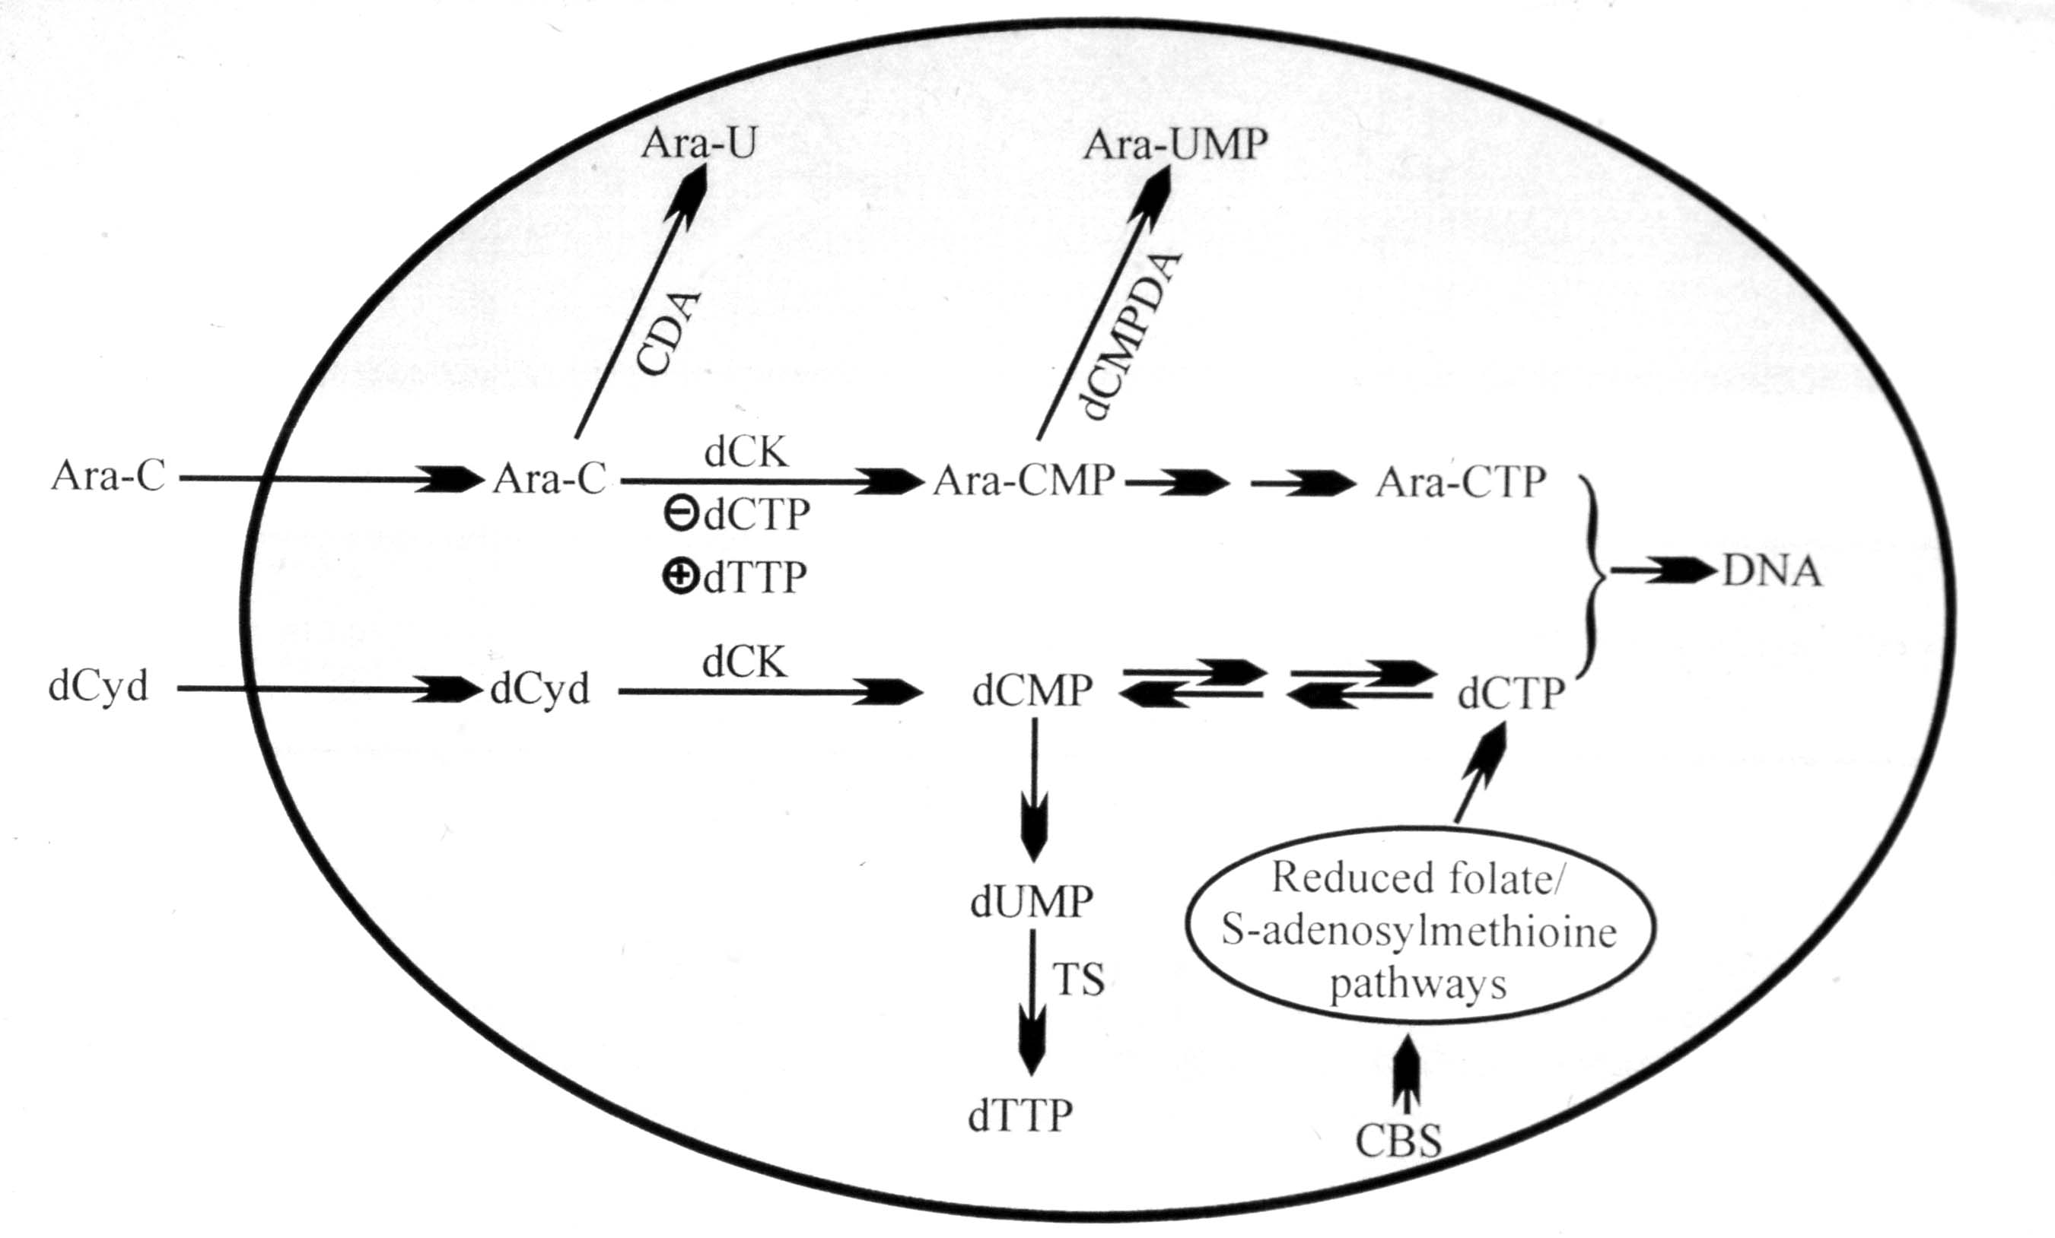
Cytarabine (AraC) Mechanism of Action

Slide 25
Ex Vivo Chemotherapy Sensitivity of ML-DS Blasts
 | Down Syndrome AML (n=22) | Non-Down Syndrome AML (n=362)
AraC IC₅₀ (nM) | 77.5 | 350.9
Daunorubicin IC₅₀ (nM) | 5.8 | 71.2
Ara-CTP (pmol/mg prot) | 737.3 (n=11) | 166.9 (n=20)

Slide 26
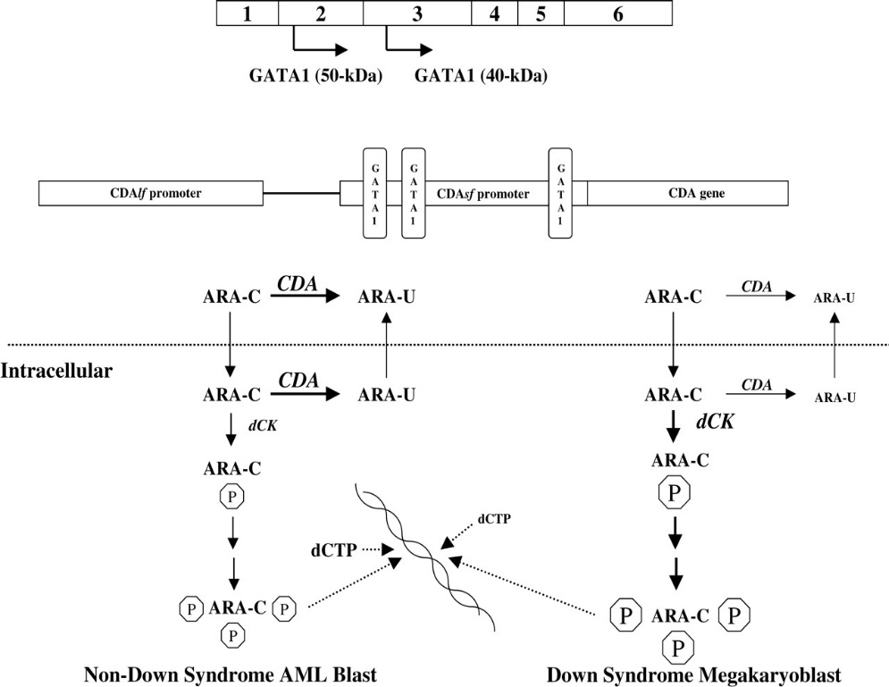
Cytidine Deaminase Expression and AML
CDA transcripts were a median 5.1-fold lower in Down syndrome AML blasts compared to non-Down syndrome AML blasts.
CDA transcript is transcribed from a CDA “long form” promoter (CDAlf) while a “short form” promoter (CDAsf) acts as an enhancer for the promoter.
GATA1s protein in Down syndrome AML cases, results in reduced CDA enhancer activity and decreased CDA expression compared to non-DS AML cases. [Ge et al., Cancer Research 2004; JNCI 2005, Blood 2006 ]

Slide 27
How do GATA1 mutations arise in
ML-DS?

Slide 28
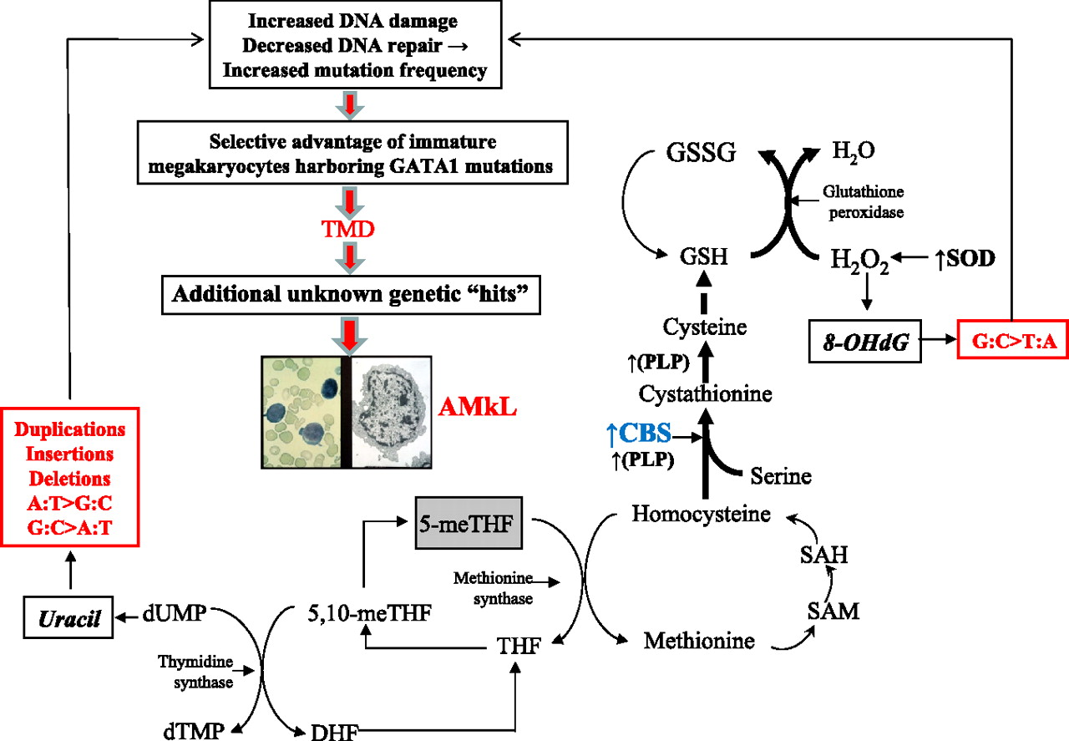
Model: Trisomy 21 accelerates CBS activity and drives mutagenesis of GATA1 toward TMD/AMkL
Cabelof et al., Blood 2009

Slide 29
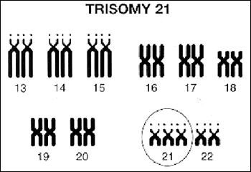
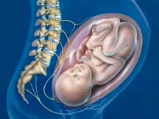

LINKAGE OF LEUKEMOGENESIS AND TREATMENT RESPONSE IN DS AML
Diagnosis of AMKL
Uncontrolled proliferation of immature megakaryocytes/Additional unknown genetic hits
↑expression of chromosome 21-localized genes
GATA1 exon 2 mutations develop prenatally
AraC/
anthracycline
therapy
Expression of GATA1-target genes/Chromosome 21-localized gene result in altered activity and increased sensitivity to araC/ anthracyclines
DS AMkL patients with EFS rates of
80-100% vs. 50% for non-DS AML patients and <35% for non-DS AMKL patients

Slide 30
Challenges and Unanswered Questions
How does TMD resolve spontaneously?
Why does TMD progress to ML-DS in ~30% of cases?
Do all cases of ML-DS arise from a preceding case of TMD (including silent cases)?
Can an early intervention in the neonatal period prevent the development of ML-DS?
How can the outcomes for refractory/relapsed cases of ML-DS be improved?
Why do Down syndrome children have an increased risk of developing leukemia?

Slide 31
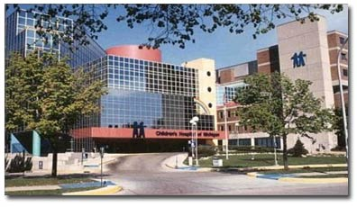
Questions?

Slide 32
Acute Lymphoblastic Leukemia occurs more frequently in children with DS
Most common congenital chromosomal abnormality
Prevalence of 8.5-10 cases/10,000 live births
Association of DS with Acute lymphoblastic leukemia was first noticed over 75 years ago.
  Published in 1957 as a series of case reports
Children with DS have 10-20 fold increased risk of developing leukemia
  ALL occurs in 1 in 300 children with DS vs. 1 in 3500 without DS
CDC 1994, Cocchi 2010, Krivit 1957, Robison 1992, Lange 2000, Hasle 2000

Slide 33
Lange, 2000

Slide 34
Clinical features of DS ALL mostly similar
Age spectrum similar between DS ALL and non DS ALL except in age <1 year
  Very rare in DS ALL but 2-6% of non DS ALL cases occur in infants <1 yr.
Similarities include
  Gender
  Presenting white blood cell count
  Presence of mediastinal mass
  Presence of CNS disease at diagnosis
Chessels 2001, Ross 2005, Whitlock 2005, Maloney 2010

Slide 35
Ross 2005

Slide 36
Biologic features of DS ALL less similar than clinical features
Rarer occurrence of:
  T cell ALL
  Favorable cytogenetic features-trisomies, translocation t(12;21)
  Ph+ t(9;22)
Maloney 2010, Whitlock 2005, Bassel 2005, Bercovich 2008, Mullighan 2009

Slide 37
Molecular genetics of DS-ALL
Study | Reference | # cases | T-cell | t(9;22) | t(1;19) | t(4;11) | t(12;21)
MRC UKALL | Chessells 2001 | 55 | 0 | 0 | 0 | 0 | 6
NOPHO | Zeller 2005 | 64 | 0 | 0 | 0 | - | -
CCG | Bassal 2005 | 59 | 0 | 0 | - | 0 | 0
CCG | Whitlock 2005 | 179 | 7.8 | 0 | - | 0 | -
BFM | Dördelmann 98 | 61 | 0 | 0 | - | 0 | -
POG/SJCRH | Pui 1993 | 76 | 5 | 0 | 0 | 0 | -
iBFM | Forestier 2008 | 215 | 0 | 1 | <1 | <1 | 10
COG P9900 | Maloney 2008 | 80 | - | 0 | - | 0 | 2.5
AIEOP | Arico 2008 | 120 | <1 | - | - | - | 2.2

Slide 38
Response to Induction therapy in DS ALL
More recent studies have shown the response to induction therapy to be similar between DS ALL and non DS ALL when equivalent therapy is used
  Remission induction rates were between 96-99%
  2 studies with lower remission induction rates due to induction mortality
Varying incidences of induction mortality
  Many groups with DS mortality somewhat higher than non DS ALL
  COG experience
Robison 1984, Dordelman 1998, Chessels 2001, Basal 2005, Maloney 2010

Slide 39
ALL0232-pre and post amendment
Induction mortality remained high on AALL0232 after amendment-10%
Permanent closure of AALL0232 to DS ALL
 | Pre-Induction Deaths |  | Pre-Remission Deaths |  | Post-Induction Deaths |  | Post-Induction Deaths
 | DS # (%) | Non-DS # (%) | DS # (%) | Non-DS # (%) | DS # (%) | Non-DS # (%) | DS # (%) | Non-DS # (%)
AALL0232 Age 1-9 | 1/7 (14.3%) | 3/338 (0.9%) | 0/6 (0%) | 4/321 (1.2%) | 0/8 (0%) | 4/560 (0.7%) | 1/6 (16.7%) | 2/466 (0.4%)
AALL0232 Age >10 | 1/12 (8.3%) | 21/652 (3.2%) | 2/9 (22.2%) | 15/570 (2.6%) | 2/12 (16.7%) | 20/1125 (1.8%) | 1/9 (11.1%) | 12/854 (1.4%)
Table values shaded in green had p <0.05

Slide 40
AALL0331-Pre and Post Amendment
Induction mortality following the amendment was 1.7%
  Decreased from 11.5% to 1.7% (p=0.04)
No deaths in remission occurred on the amended AALL0331
 | Pre-Induction Deaths |  | Pre-Remission Deaths |  | Post-Induction Deaths |  | Post-Remission Deaths
 | DS # (%) | Non DS # (%) | DS # (%) | Non DS # (%) | DS # (%) | Non DS # (%) | DS # (%) | Non DS # (%)
AALL0331 | 3/26 (11.5%) | 7/1445 (0.5%) | 3/23 (13%) | 5/1371 (0.4%) | 2/116 (1.7%) | 13/3720 (0.3%) | 0/111 (0%) | 15/3491 (0.4%)
Table values shaded in green had p <0.05

Slide 41
Rapidity of Response to induction therapy
Response measured in various ways by different groups but predicts EFS
  Prednisone response-equal between DS and non DS ALL
  Day 8 and 15 bone marrow aspirate responses-equivalent
  Day 29 bone marrow MRD-equivalent
  Day 8 MRD-higher in DS-?
Dordelmann 1998, Bassal 2005, Whitlock 2005, Maloney 2010

Slide 42
Event free and overall survival for DS ALL
Early trials showed decreased EFS and OS for children with DS ALL
  Likely due to decreased intensity of chemotherapy
  Inadequate supportive care
More recent studies with equivalent EFS and OS between DS ALL and non DS ALL
  Must compare similar biologic groups
  Recent COG studies-5 yr EFS of 68% vs 70.5% and similar 5 yr OS of 86.7% in DS ALL vs 85.4% in non DS ALL
Robison 1984, Levitt 1990, Lance 2000, Bassal 2005, Whitlock 2005, Maloney 2010

Slide 43
Early Era therapy-less intensity for Children with DS ALL
Shah, 2009

Slide 44
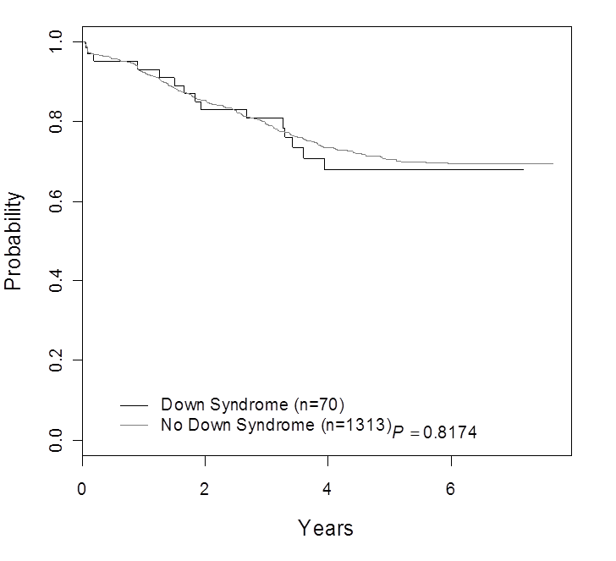
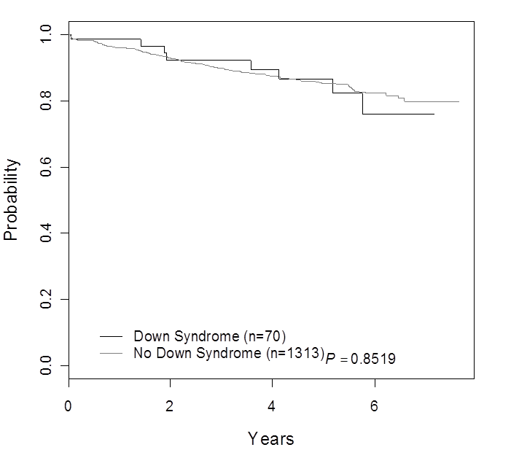
Event Free Survival
Overall Survival
Outcome for all patients excluding those with favorable and unfavorable sentinel cytogenetic lesions: DS-ALL vs. non-DS-ALL. (A) Event-free survival; and (B) Overall Survival. Patients with ETV6-RUNX1, BCR-ABL1, MLL translocations, and trisomy of both chromosomes 4 and 10 are excluded.
Maloney, Blood, 2010

Slide 45
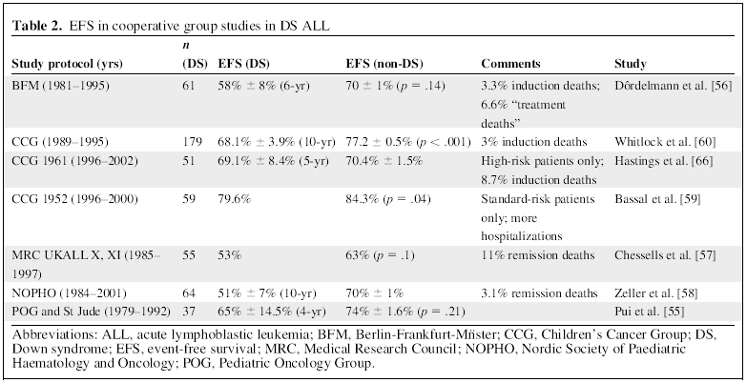
Event-free survival in DS-ALL
Rabin & Whitlock, Oncologist 2009

Slide 46
Increased non-relapse mortality in DS pts
ALL DS more likely to:
  suffer death from infection during remission induction
  Suffer death after attaining remission
MRC ALL 97 trial (1997-2002)
  Death in remission: DS 28% vs non DS 3% (p<0.0005)
Whitlock 2005, DeLaDuente 2005

Slide 47
Treatment-related toxicities higher in DS ALL
More frequent and severe in DS patients
Mucositis
  Increased sensitivity to methotrexate
  Higher incidence of grade 2-4 gastrointestinal toxicities (36% vs 3.6%) and higher incidence grades 3-4 hematologic toxicity (14.5% vs 0.9%)
  MTX pharmacokinetics similar
Infections
  Defects in multiple aspects of immune function (B-cell, T-cell, phagocytic)
  Multiple pathogens (gram pos. and neg., fungal, viral)
  Longer and deeper neutrophil and monocyte nadirs
  Increased soft tissue infections
Hyperglycemia
Kalwinsky, AJMG 1990
Taub, PBC 2005
Whitlock, BJH 2006
Hastings, ASH 2007
Smith, ASPHO 2008
Peeters 1995, Garre 1987, Buitenkamp 2010, Matloub 2011

Slide 48
Relapse in DS ALL
Lower EFS and OS, 17% vs 41% and 51% in non DS, despite “lower risk” relapses in DS pts
More fatal infections, 34% vs 10%
Meyr 2013

Slide 49
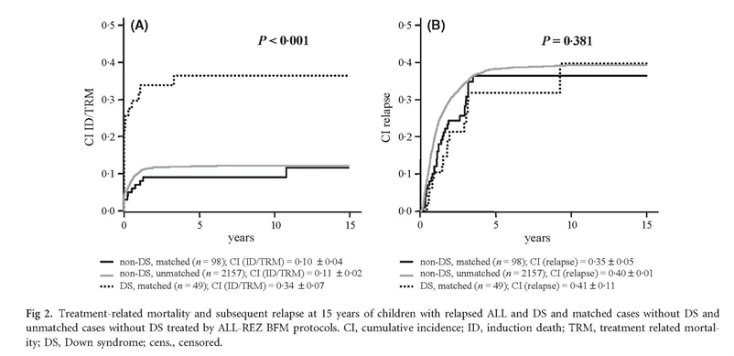
Relapse in DS ALL
Meyr 2013

Slide 50
DS ALL, relapse and BMT
CIBTR, n=27, 2000-2009
52% went to transplant in CR2
Myloablative conditioning in 78%
DFS at 3 yrs was 24%
Hitzler 2014

Slide 51
Immune function and DS
Increased infections
Spectrum of immunological abnormalities
  decreased B cell number, low specific antibody response
  increased IgG, decreased IgM in late childhood
  variable reduction of T cell proliferative responses, T cell-mediated killing
  increased NK cell number, decreased function
Decreased monocyte function/chemotaxis vs. unimpaired function
“most [individuals with Down Syndrome] do not have clear immune dysfunction” (Stiehm, Ochs & Winkelstein: Immunological disorders in Infants & Children, 5th ed)
Ugazio 1990, Lockitchh 1987, Burgio 1983, Montagna 1988, Cossarizza 1990, Park 2000

Slide 52
Newer findings in DS Biology
Increased incidence of t(8;14)(q11.2;q32) in DS-ALL
  22 cases found, 7 were DS ALL.
  EFS improved over non DS ALL with same lesion
  Results in CEBPD-IgH fusion, increased CEBPD expression (BLZ transcription factor) – mechanism of leukemic transformation unknown
JAK2 activating mutations
  18-28% of DS ALL (~10% of HR non DS ALL)
  Not prognostically significant (but small numbers)
  Cause constitutive JAK2 activation and cytokine-independent cell growth in vitro
Messinger 2012, Bercovich 2008, Kearney 2008, Gaikwad 2008, Mullighan 2009

Slide 53
Newer findings in DS Biology
CRLF2 overexpression
  52% of DS-ALL cases (~5% of B cell ALL, 15% of Adult and HR ALL without other sentinal lesions)
  Likely trend to poorer prognosis but not fully characterized
  Overexpression of cytokine receptor-like factor 2 (CRLF2). Jak2-Stat5 activation and increased cell proliferation
IKZF1 deletions
  Incidence 26-35% (similar to NDS)
  Significant adverse prognostic impact, EFS 45% vs 90%
Histone deletions
  22% DS vs 3% NDS
  No prognostic impact
Mullighan 2009, Russell 2008, Yoda 2010, Harvey 2010, Buitenkamp 2016

Slide 54
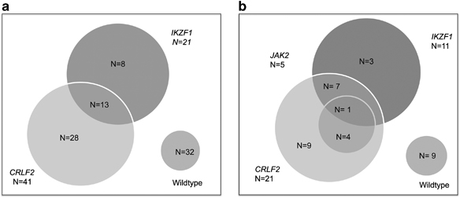
Role of IKZF1 and CRLF2 aberrations
Interplay of the more common genetic aberrations for DS ALL

Slide 55
Current challenge
How to treat DS patients optimally?
Potential culprits
Anthracycline, PEG, dexamethasone, methotrexate
Current interventions
Chemotherapy modifications
  Decreased MTX exposure, less dex/vcr pulses
IVIG, prophylactic antibiotics/antifungals, GCSF, mandatory hospitalization when neutropenic

Slide 56
Questions
Why are IgH rearrangements, JAK2 mutations, and CRLF2 rearrangements more frequent in DS-ALL?
What lesions characterize DS-ALL cases that lack JAK2/CRLF2 aberrations?
Basis for increased toxicities… and potential prevention/treatment
  Immune deficits
  Skin/mucosal barrier deficits

Slide 57
Targeted therapies: challenges for use in DS patients
Opportunities
  Need for less toxic therapies
    Substituting less intensive blocks
    immunotherapy
  Newer targeted therapies available-will children with DS respond similarly?
Risks
  Higher risk of complications
  Small population, difficult to study
  Different baseline immune function
Often
excluded

Slide 58
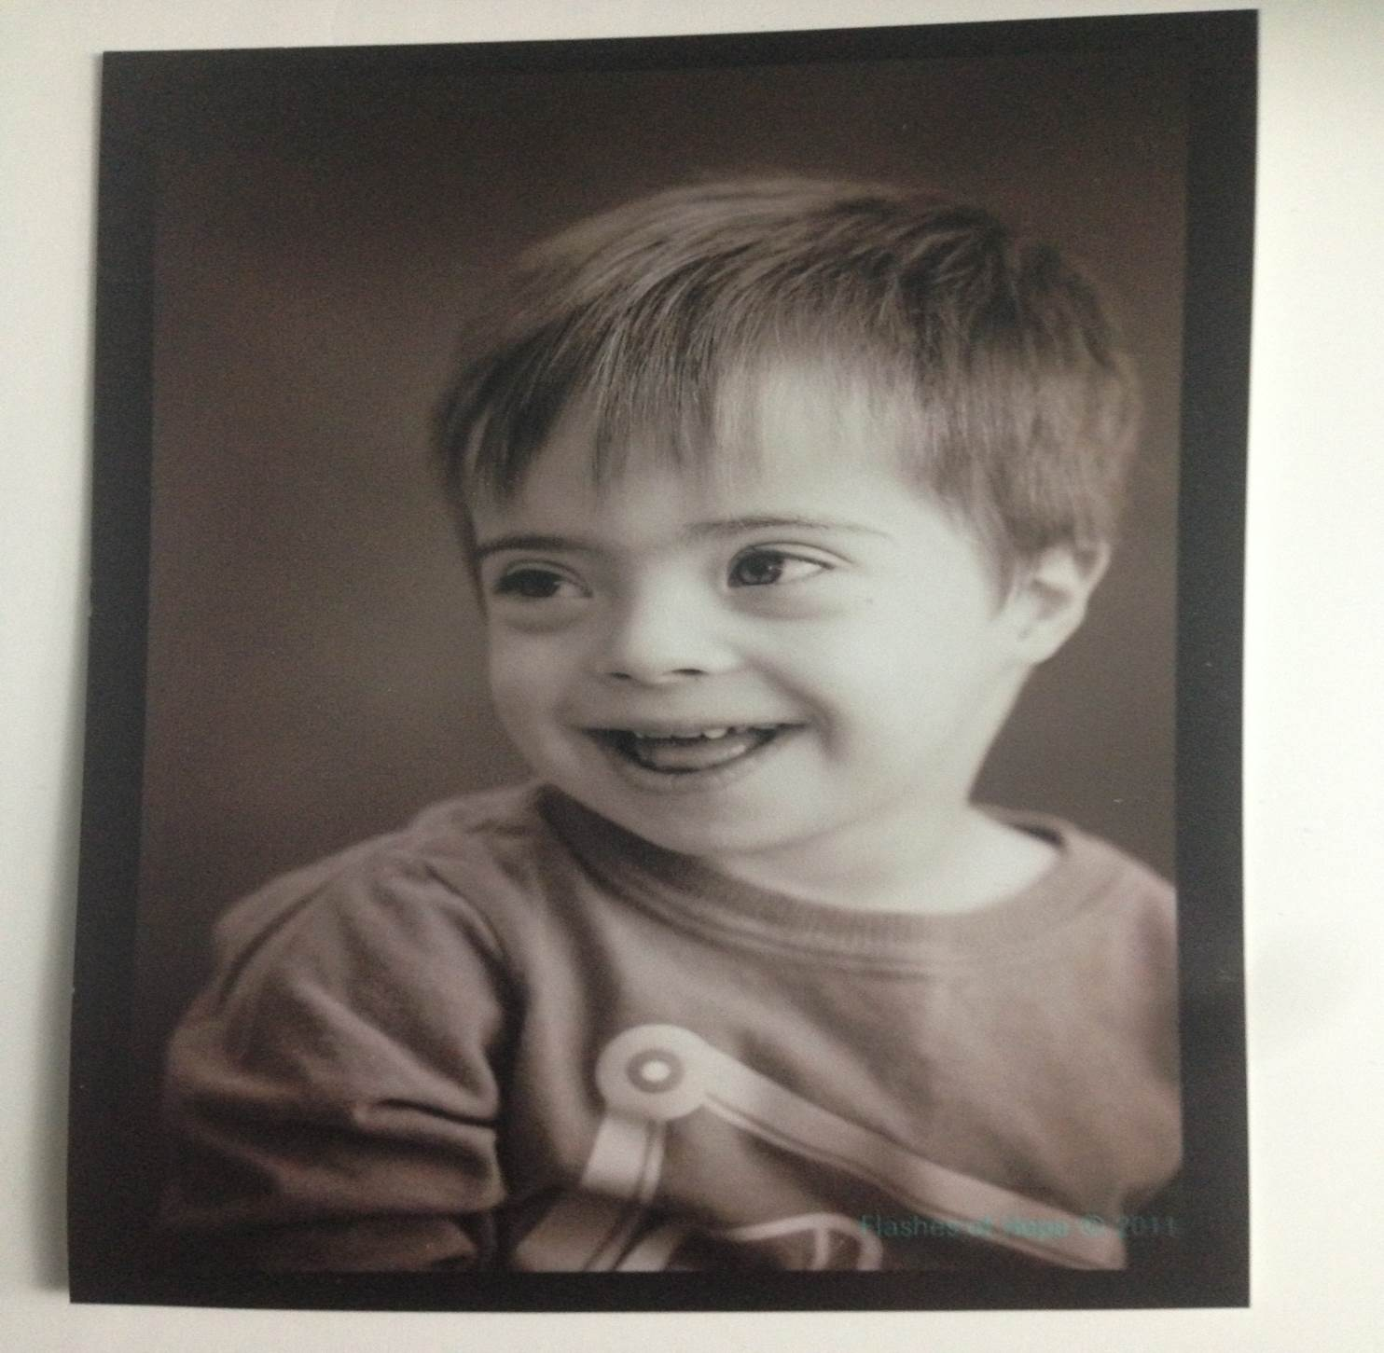
Questions?

Slide 59
THANK YOU!
QUESTIONS?
Please type them in the chat box at the bottom
left hand side of your screen.

Slide 60
Next ASPHO Webinar
Meet ASPHO Online for
Every Vascular Tumor is NOT a Hemangioma. What the Hematologist/Oncologist needs to know about Rare Vascular Tumors Webinar
November 2
3pm CST
For more information about the upcoming webinars and other ASPHO webinars, visit www.aspho.org/webinar

