Slide 1


Slide 2
Review of Peripheral Blood and Bone Marrow Morphology: Malignant Diseases
Mark D. Fleming, M.D., D.Phil.
Copyright © 2019 by ASPHO

Slide 3
Hematopoietic Lineage Specific Markers
Hematopoietic
CD45 (LCA)
Immaturity
HLA-DR (MHC-II)
CD34
TdT (lymphoid)
CD117 (myeloid)
B lymphoid
CD19
CD20
sCD22/cCD22
CD79a
CD10 (CALLA)
κ/λ Ig light chain
sIg or cIg
T lymphoid
CD1a (immature)
CD2
sCD3/cCD3
CD4
CD5
CD7
CD8
CD99 (immature)
NK cell
CD16
CD56
Myeloid
CD13
CD14 (monocytic)
CD15
CD33
CD64/65 (monocytic) Myeloperoxidase
Lysozyme
Histochemistry
PAS (block-like in ALL)
MPO (myeloid)
NSE (monocytic)
Copyright © 2019 by ASPHO

Slide 4
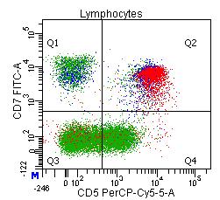
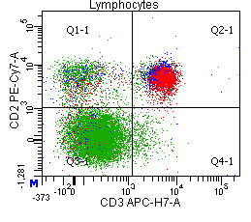
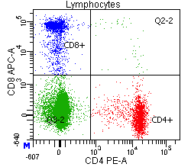
Normal B and T cell phenotypes
Copyright © 2019 by ASPHO

Slide 5
Acute Lymphoblastic Leukemia
Copyright © 2019 by ASPHO

Slide 6
Six year-old girl with T21 and cardiac anomalies s/p repair now with lethargy and pallor.
WBC 5.7 K/μL
Hb 8.7 g/dL
Plt 95 K/ μL
87% blasts
Copyright © 2019 by ASPHO

Slide 7
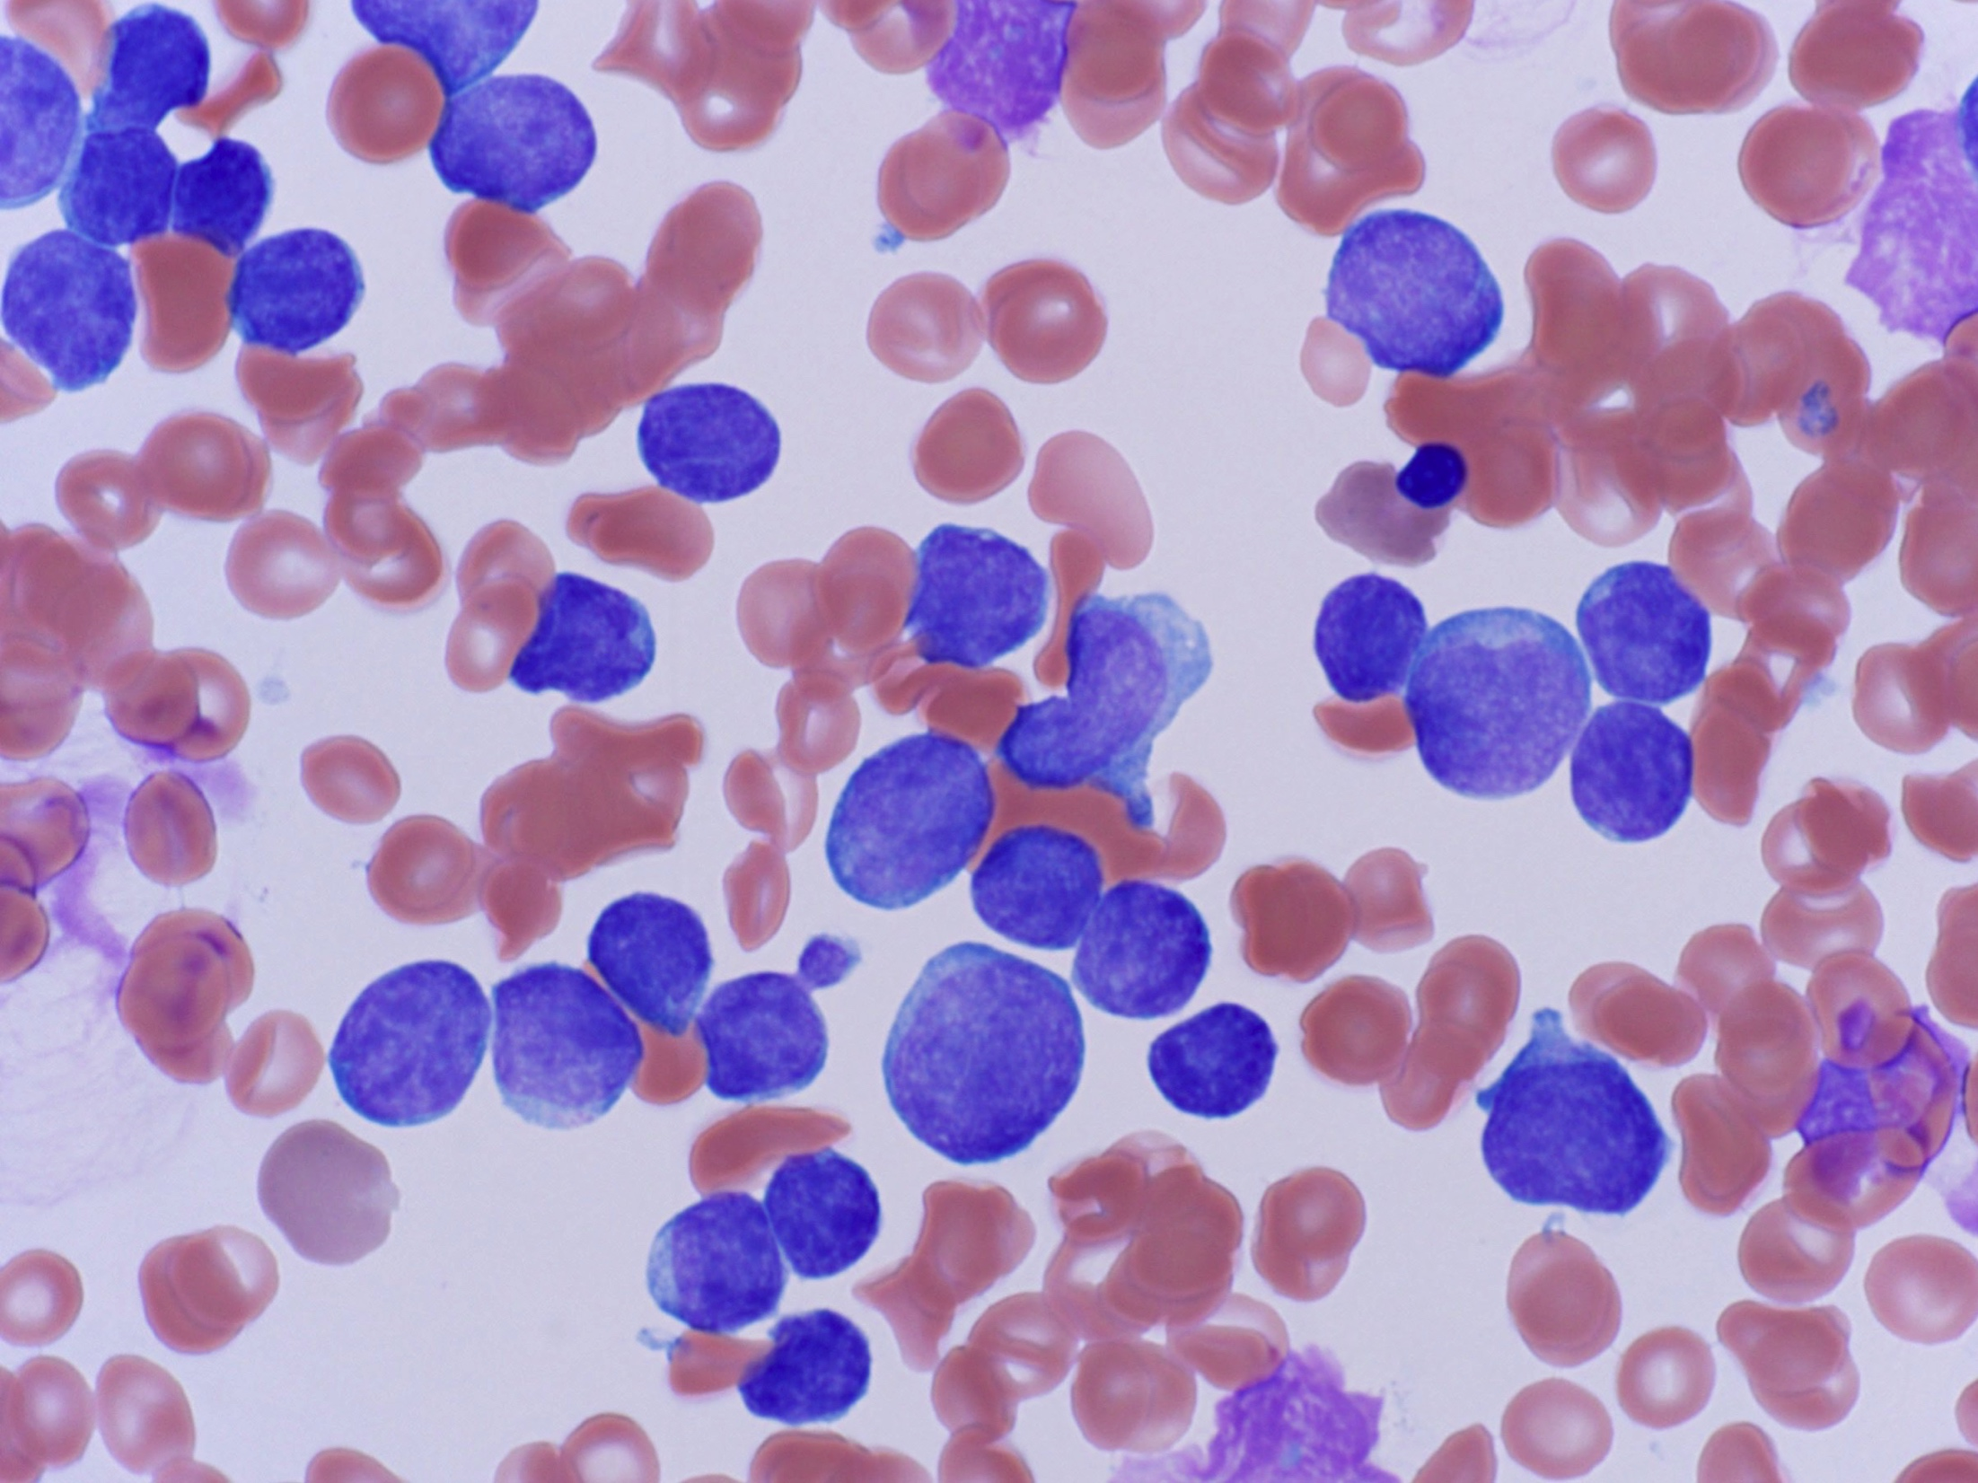
Copyright © 2019 by ASPHO

Slide 8
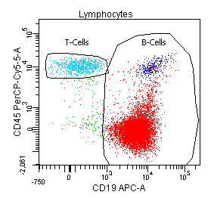
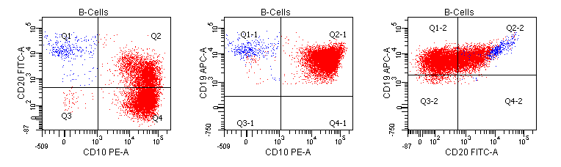
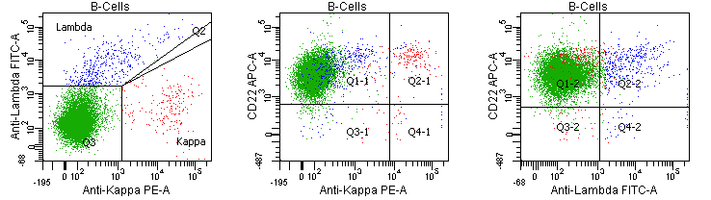
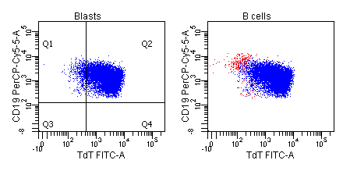
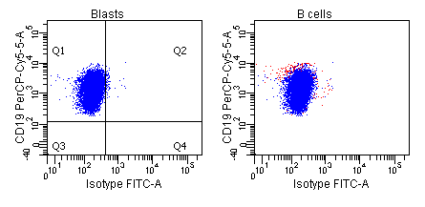
Peripheral blood,
flow cytometry:
CD45- (dim)
HLA-DR+
CD19+
CD20 variable+
sCD22+
CD10+
sIg-
TdT+
T cell/Myeloid-
TdT-
TdT+
Copyright © 2019 by ASPHO

Slide 9
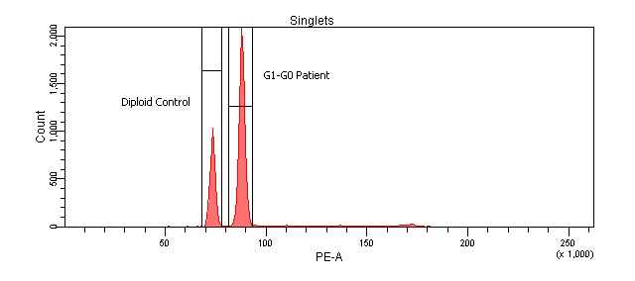
DNA INDEX: 1.198
Cytogenetics:
47,XX,+21c[17]/56,sl,+X,dup(1)(q21q42),add(2)(q37),+4,+6,+10,+14, +14, +17,+21c,+mar[6]
Copyright © 2019 by ASPHO

Slide 10
B-ALL Cytogenetics
  High hyperdiploid B-ALL (51-66 chromosomes) ~25%
    Corresponds to DNA Index of >1.16
    Gains of chromosomes 4, 10, 14, 17, 21, X most common
    Most common cytogenetically evident karyotypic abnormality in B-ALL
TEL-AML = ETV6-RUNX1 = t(12;21)(p13;q22) ~25%
  Cryptic translocation
    Need to do FISH or RT-PCR!
  Often associated with del 12p (other copy of TEL)
  Most common translocation in B-ALL
t(5;14)(q31;q32), IL3-@IGH
  Profound eosinophilia
  One of the few morphologically distinct ALLs
t(1;19)(q23;p13.3), E2A-PBX1
DS-ALL
  Usually normal (47,+21c) karyotype
  Cryptic CRLF2 translocations
Copyright © 2019 by ASPHO

Slide 11
More B-ALL Cytogenetics
(bad actors)
MLL rearranged
  Most common ALL cytogenetics in infants
  11q23, multiple partners
  Sometimes cryptic: FISH confirms
Philadelphia chr positive (Ph⁺)
  BCR-ABL, t(9;22)(q34;q11.2)
  Karyotype/FISH/PCR
    RT-PCR p190: de novo ALL
    RT-PCR p210: CML and CML in blast crisis
Low hypodiploid ALL
  Usually 32-39 chromosomes
  Very poor prognosis
  TP53 mutations (often germline)
Near haploid ALL
  24-31 chromosomes
  Masquerades as hyperdiploid ALL
    Doubling of haploid genome
    Resolved by DNA ploidy flow: haploid peak
Ph-like B-ALL
  Tyrosine kinase fusions (e.g., EPOR, CRLF2)
  ±JAK2/3 alterations
  ± IKZF1 deletions
IKZF1 (Ikaros) deletions
iAMP21
  Complex copy of chromosome 21 with multiple regions of gain, amplification, inversion and deletion
  Detected only by FISH
Copyright © 2019 by ASPHO

Slide 12
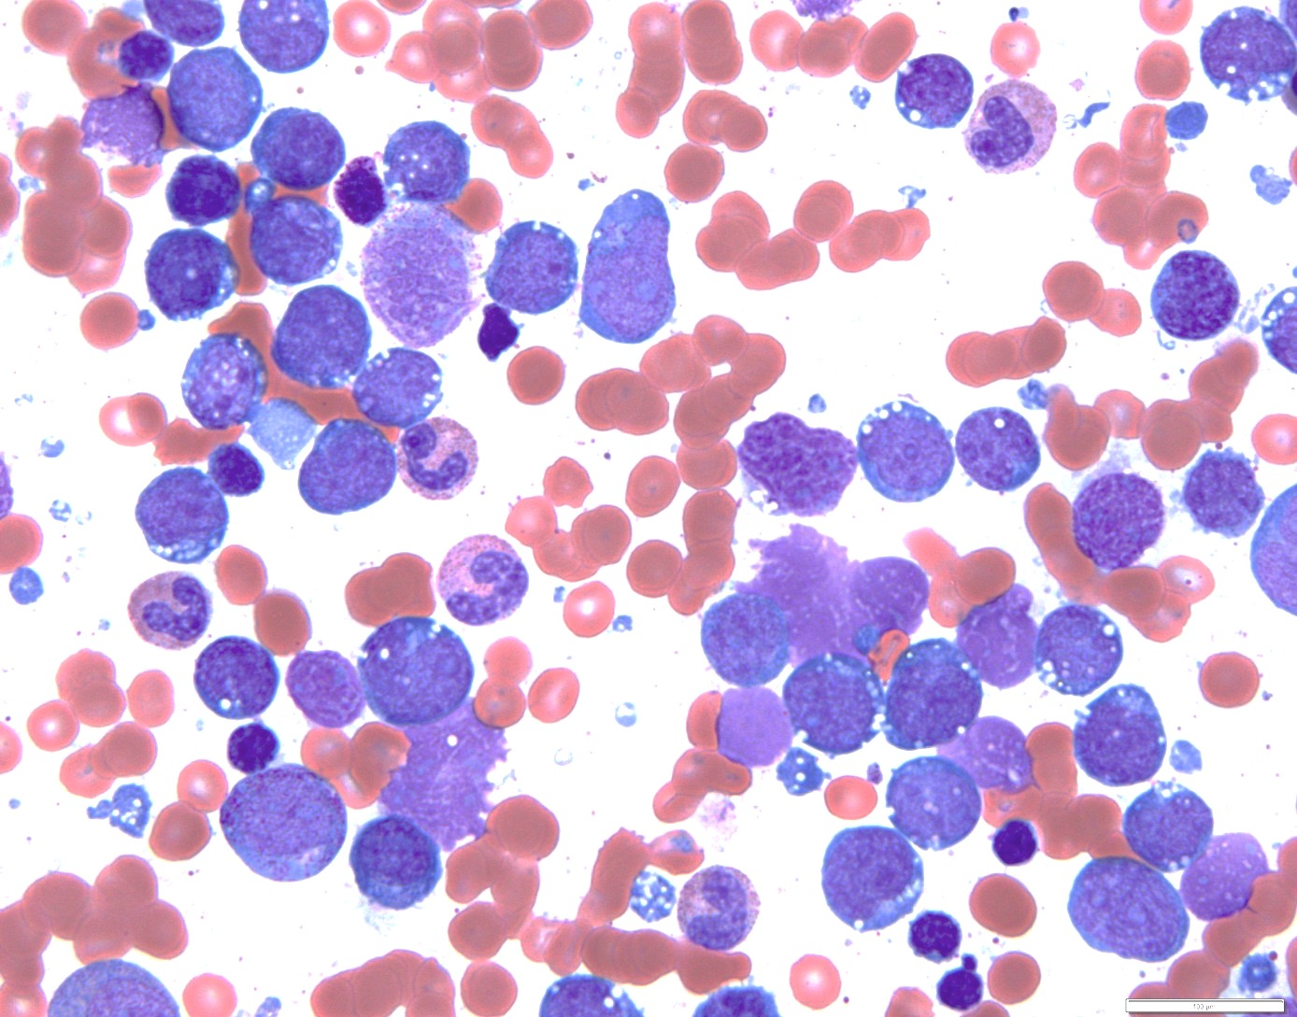
Copyright © 2019 by ASPHO

Slide 13
Bone marrow,
flow cytometry:
CD45+
HLA-DR+
CD19+
CD20+
sCD22+
CD10+
sIgM+
Clonal sIgκ
TdT-
T cell/myeloid-
Copyright © 2019 by ASPHO

Slide 14
Burkitt Lymphoma/Leukemia
Intermediate-sized lymphoid cells with mature chromatin and deeply basophilic cytoplasm often with vacuolization.
  Lymphoma/leukemia are the same disease manifesting with different predominant organ involvement: extramedullary tissues vs. blood/bone marrow
Mature B cell immunophenotype
  CD45 bright/CD19/CD20/sCD22/CD10 positive
  Monotypic (clonal) surface immunoglobulin kappa or lambda light chain
  Negative for CD34 and TdT
  Contrast with B-ALL that is often also CD10 positive, but has an otherwise immature phenotype that is CD45 dim, TdT+, CD34±, and negative for sIg and often negative for CD20.
MYC rearrangement: brings MYC in proximity to the @Ig locus enhancer, not a fusion cDNA/protein
  t(8;14)(q24;q32), MYC;@IGH
  t(8;22)(q24;q11), MYC;@IGL
  t(2;8)(p12;q24), MYC;@IGK
  (Burkitt-like lymphoma with 11q aberration, often dup(11)(q23q13) but this isn’t the boards answer)
Copyright © 2019 by ASPHO

Slide 15
12 y.o. boy with WBC 86.2 K/μL and an anterior mediastinal mass
Copyright © 2019 by ASPHO

Slide 16
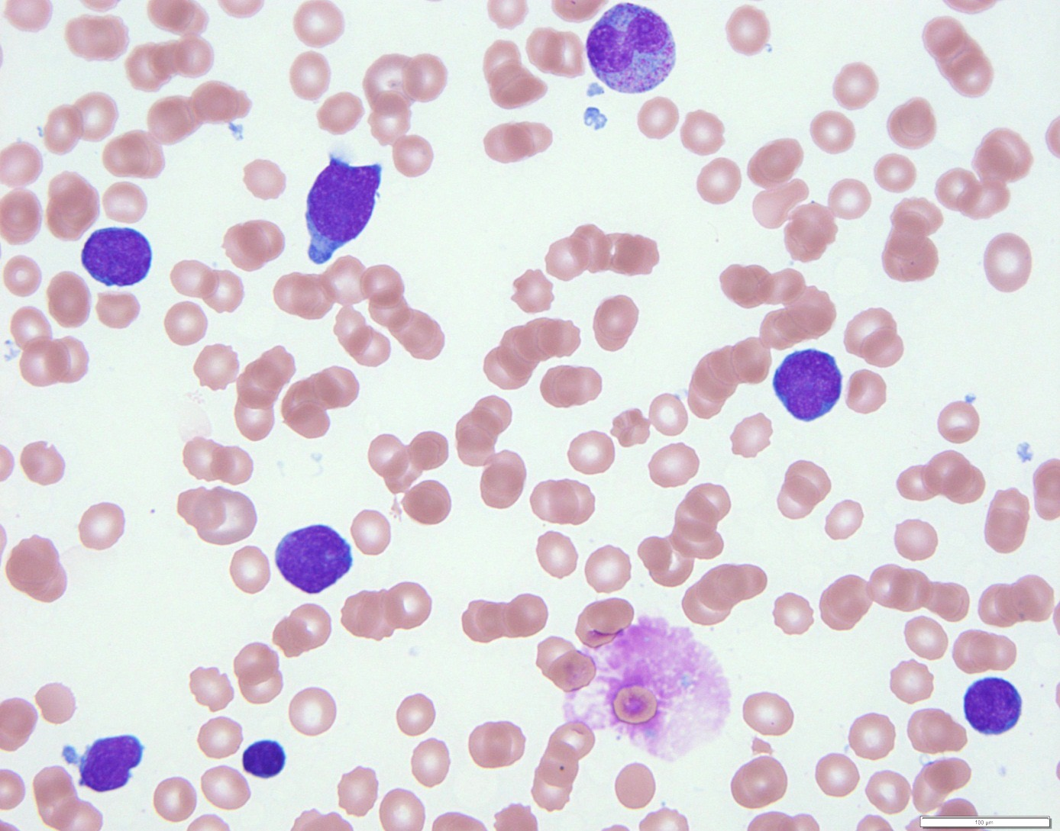
Copyright © 2019 by ASPHO

Slide 17
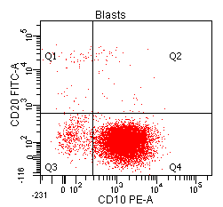
Flow
Peripheral blood flow cytometry:
CD45 dim+
HLA-DR-
CD117-
CD34-
TdT+
CD10+
Other B cell-
Myeloid-
CD1a-
CD2+
sCD3-
cCD3+
CD5+
CD7+
CD4/8-
Cytogenetics:
  Normal karyotype
  FISH: chr 9p (CDKN2A) deletion
Copyright © 2019 by ASPHO

Slide 18
T lymphoblastic Leukemia/Lymphoma
Distinction between leukemia and lymphoma is “semantic”
  Blood/bone marrow vs. tissue manifestation of the same group of diseases.
  Leukemia often defined by the presence of substantial marrow involvement
Rearrangements between T cell receptor loci and are most common (unlike most B-ALL)
  TCR loci:
    α and δ loci: 14q11.2
    β locus: 7q35
    γ locus: 7p14-15
  Partner genes:
    HOX11 (TLX1): 10q24
    HOX11L2 (TLX3): 5q35
    Many other hematopoietic transcription factors
TAL1 translocations 1p32
  Often cryptic interstitial deletion
Deletion of 9p is common
  P16/INK4A/CDKN2A
Copyright © 2019 by ASPHO

Slide 19
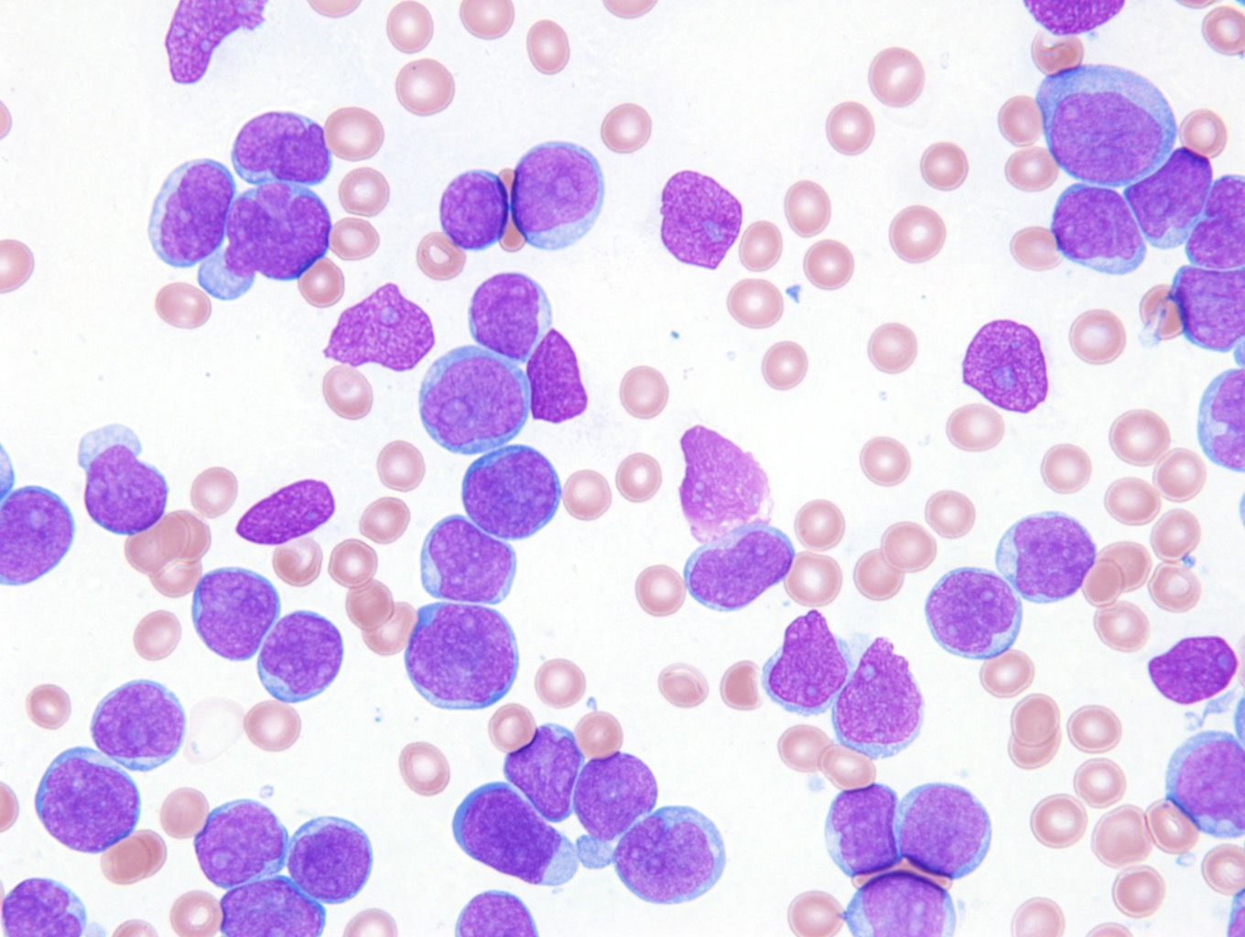
Copyright © 2019 by ASPHO

Slide 20
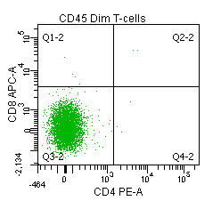
Bone marrow, flow cytometry:
CD45 dim+
HLA-DR+
CD117 dim+
CD34+
TdT+
CD19/20/22-
CD10-
CD1a-
CD2+
sCD3-
cCD3+
CD5-
CD7+
CD4-
CD8-
CD13 dim+
Other myeloid-
Copyright © 2019 by ASPHO
Notes:
KM, 2103763, FC-11-186, T-ALL

Slide 21
T lymphoblastic Leukemia/Lymphoma Immunophenotypes
Often lack expression of one or more T lineage markers:
  CD2, CD3, CD4, CD5, CD7, CD8
  May be CD10 (common ALL antigen/CALLA) positive
  Sometimes co-express myeloid markers
Early T-precursor (ETP) phenotype
  Defined by gene expression pattern
  Immunophenotype is a surrogate:
    CD1a-, CD10-, CD8-, CD5 weak+ or negative
    Positive for one or more stem/myeloid markers: CD117, CD34, HLA-DR, CD13, CD33, CD11b, CD65
Copyright © 2019 by ASPHO

Slide 22
Acute Myeloid Leukemia
Copyright © 2019 by ASPHO

Slide 23
16 y.o. girl with pancytopenia and ? peripheral blasts
Copyright © 2019 by ASPHO

Slide 24
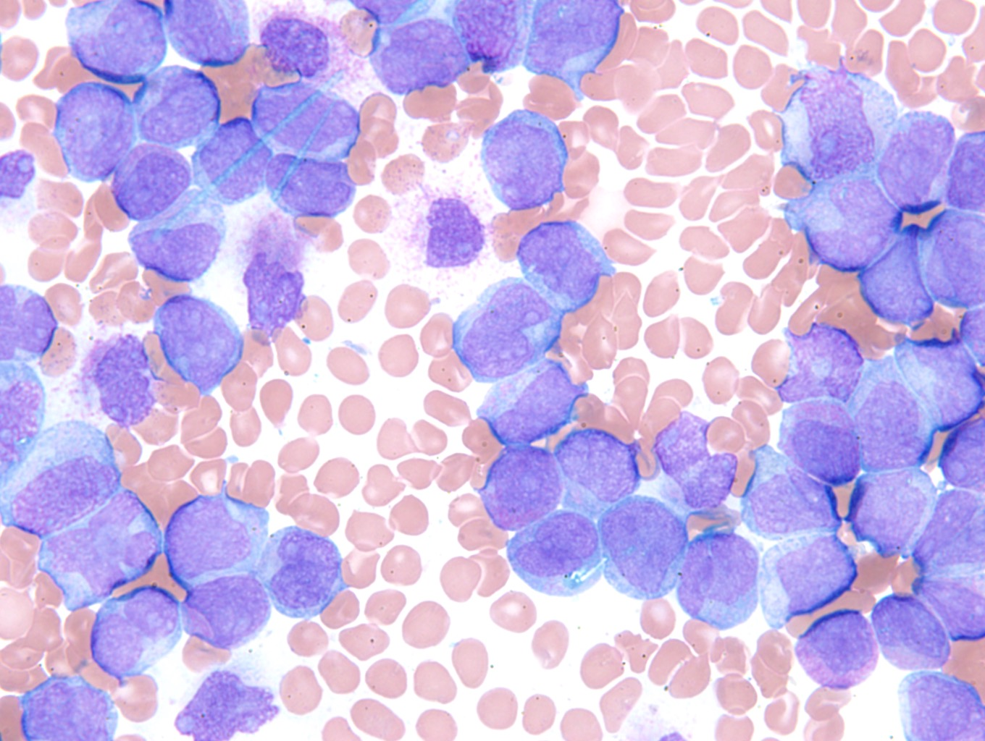
Copyright © 2019 by ASPHO

Slide 25
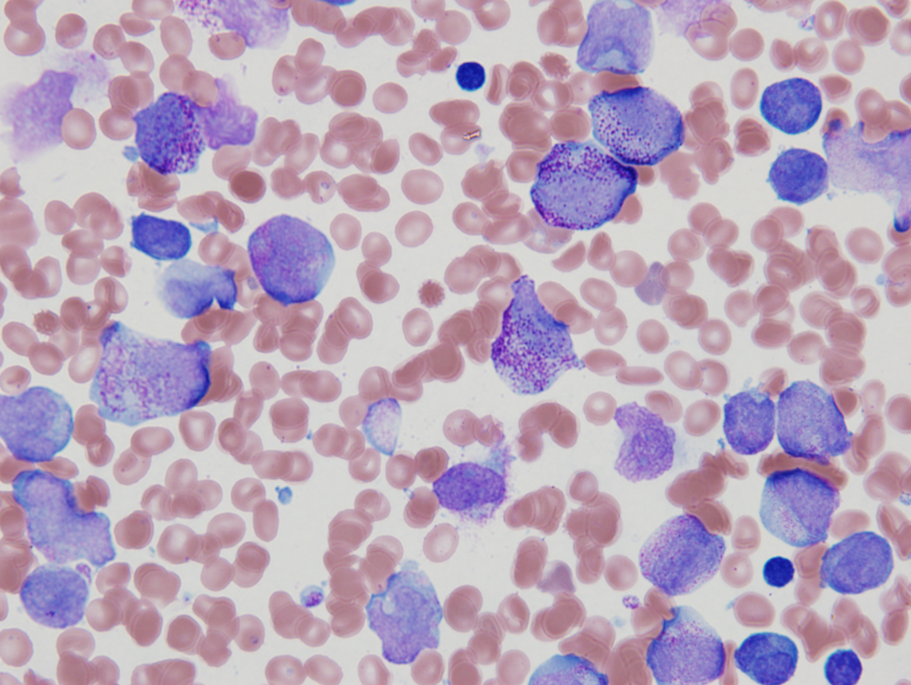
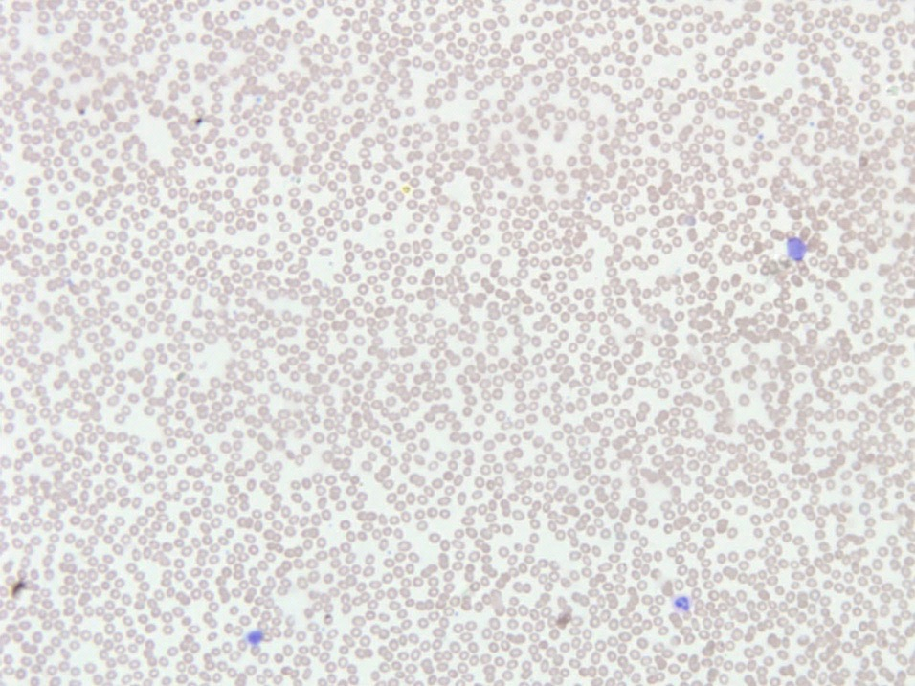
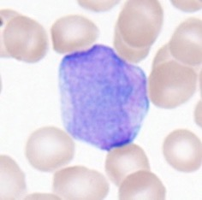
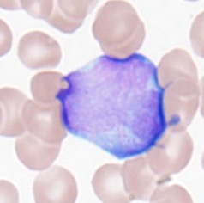
“Same” disease, different patient…
Copyright © 2019 by ASPHO

Slide 26
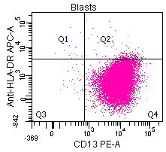
Peripheral blood,
flow cytometry:
CD45 dim+
HLA-DR-
CD34-
TdT-
CD117+
CD13+
CD15+
CD64+
CD19/20/22-
CD2/CD5/CD7-
MPO strongly+
Karyotype:
  46,XX,t(15;17)(q22;q12)[20]
Copyright © 2019 by ASPHO
Notes:
MH, 2050417, FC-11-309, microgranular APML

Slide 27
Acute Promyelocytic Leukemia
Defined by a retinoic receptor-α (RARA) translocation
  t(15;17)(q22;q12): PML;RARA
  All-trans retinoic acid (ATRA) sensitive
  Some variant translocations[e.g. t(11;17)(q23;q12)] are ATRA resistant
Hypergranular variant (typical or classic FAB M3)
  Hypergranular dysplastic promyelocytes, many with multiple Auer rods, Intensely MPO+
  HLA-DR-/CD34-/CD117+/CD15+/CD64+/CD2-
    One of the few HLA-DR negative acute leukemias (T-ALL, AMKL, and some AMoL being the other major exceptions)
Microgranular variant (FAB M3v)
  Bi-lobed blasts with submicroscopic granules, only occasional hypergranular promyelocytes, still intensely MPO+
  Often has a variant immunophenotype: HLA-DR+/CD34+/CD117+/CD15+/CD64+/CD2+
Copyright © 2019 by ASPHO

Slide 28
16 y.o. boy with a h/o AML s/p SCT now with pancytopenia
Copyright © 2019 by ASPHO

Slide 29
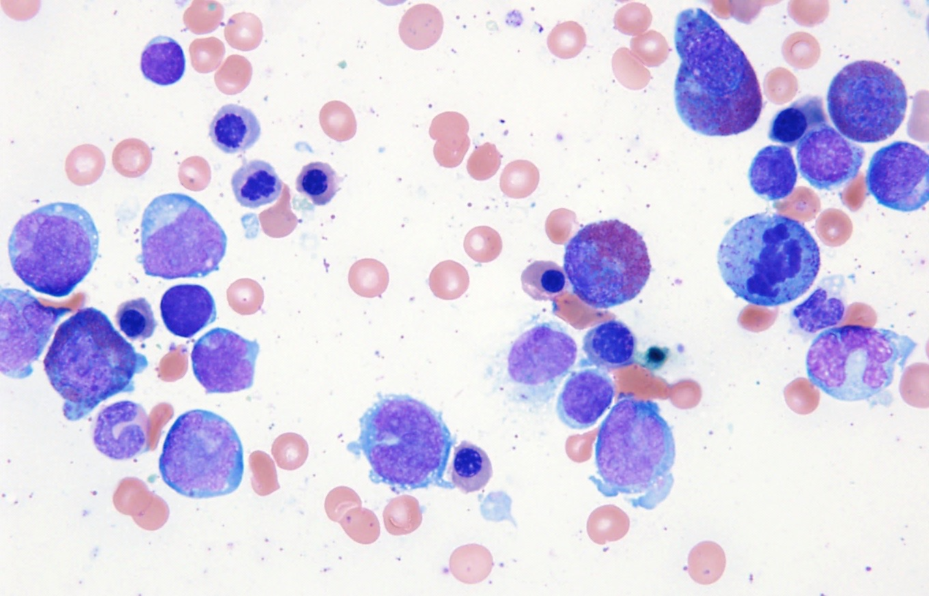
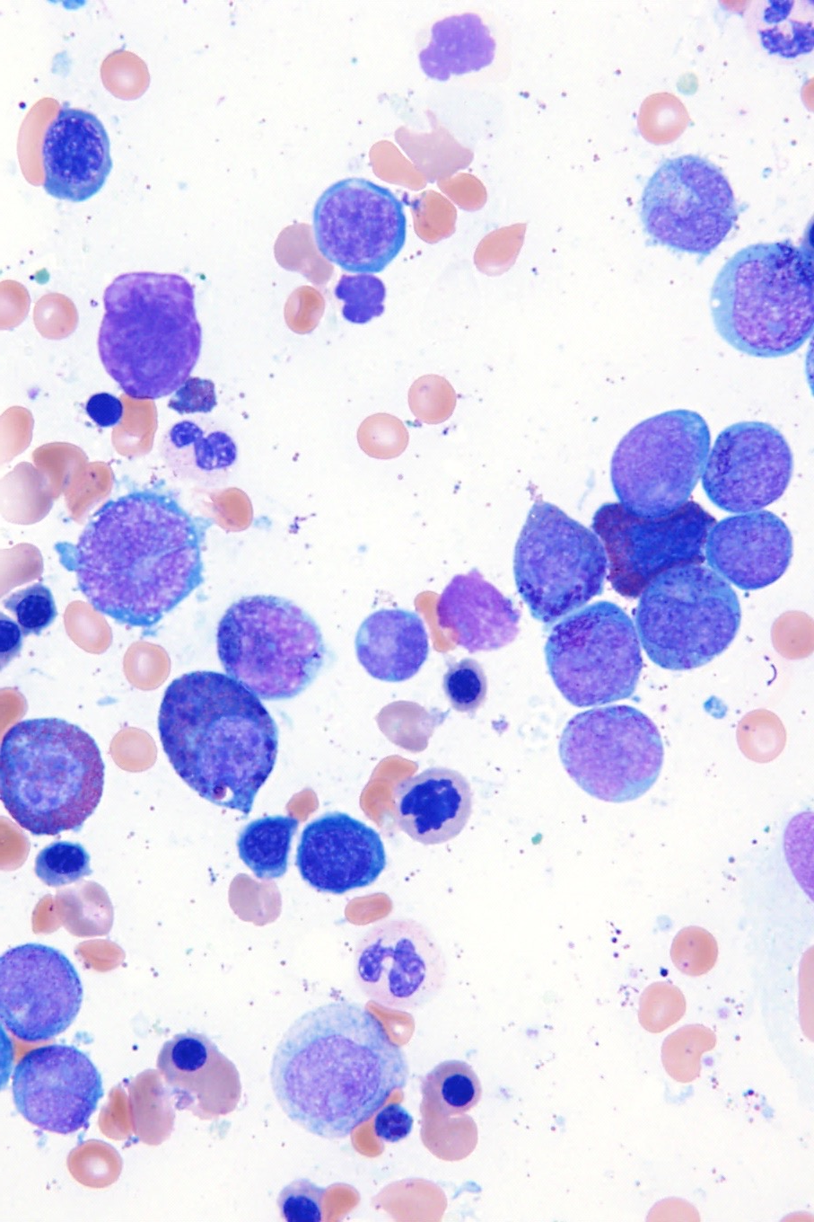
Copyright © 2019 by ASPHO

Slide 30
Bone marrow, flow cytometry:
CD45 dim+
HLA-DR variably+
CD117+
CD34+
CD13 dim+
CD33 dim+
CD64/CD65 variably+
CD7 dim+
Other T cell-
B cell-
TdT-
MPO+
Copyright © 2019 by ASPHO

Slide 31
Cytogenetics
Karyotype:
  46,XY,inv(16)(p13.1q22)[3]/47,sl,+21[15]/46,XY[2]
FISH:
  nuc ish(CBFBx2)(5'CBFB sep 3'CBFBx1)[84/200]
  Positive for a CBFB rearrangement (42.0% of cells)
Acute myelomonocytic leukemia with inv(16)(p13.1q22) (FAB M4Eo)
Copyright © 2019 by ASPHO

Slide 32
11 y.o. girl with leukocytosis, anemia and thrombocytopenia
Copyright © 2019 by ASPHO

Slide 33
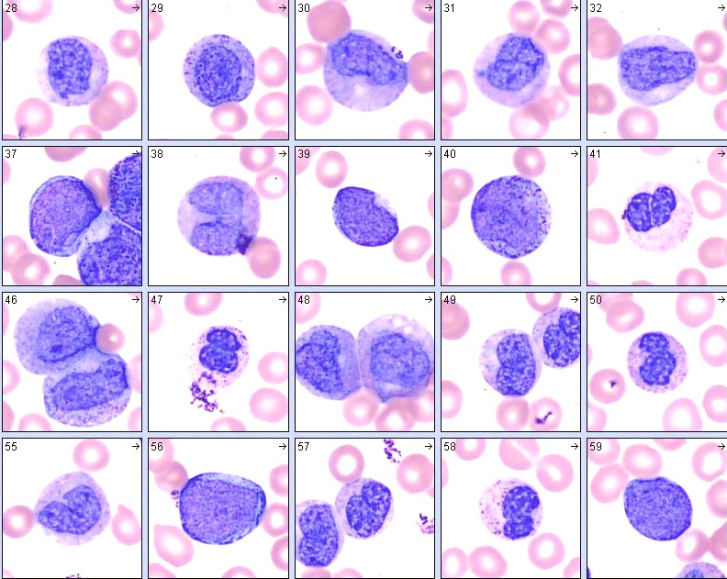
Copyright © 2019 by ASPHO

Slide 34
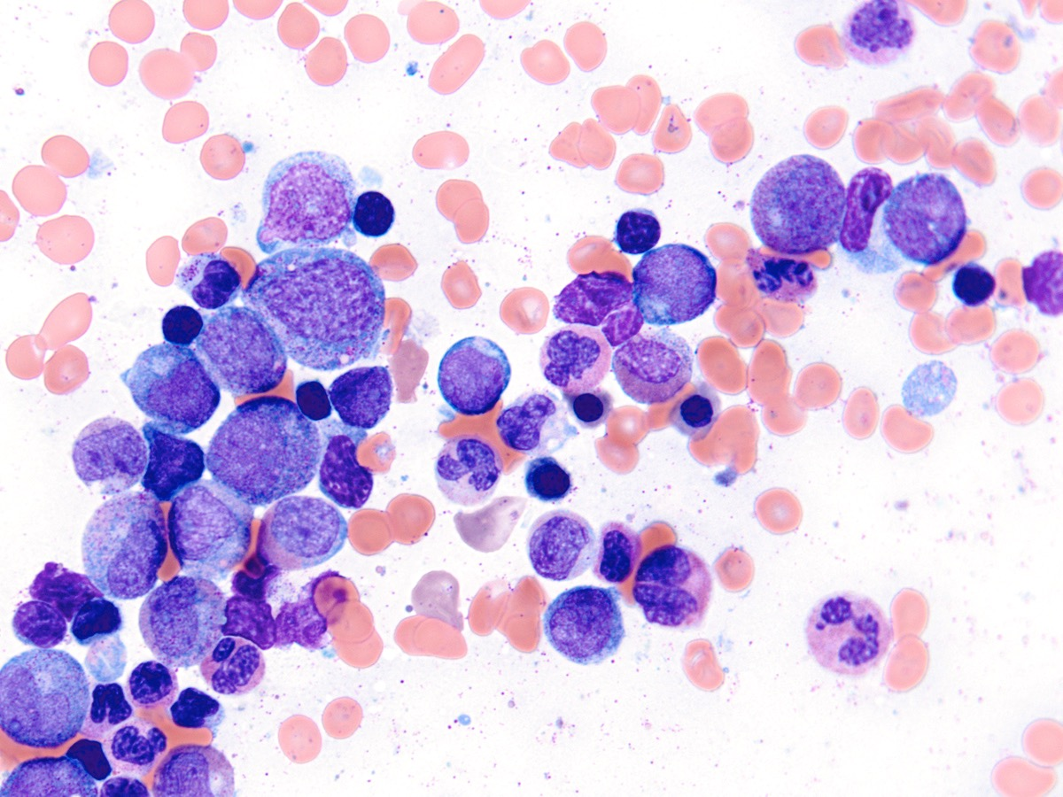
Copyright © 2019 by ASPHO

Slide 35
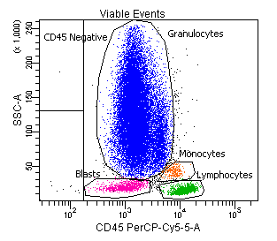
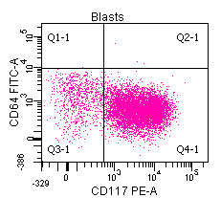
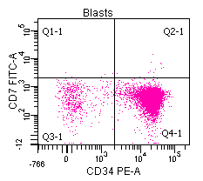
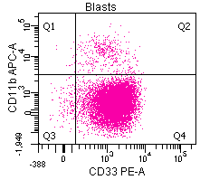
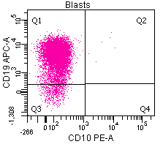
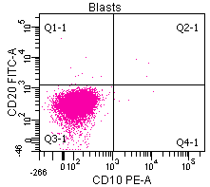
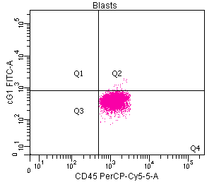
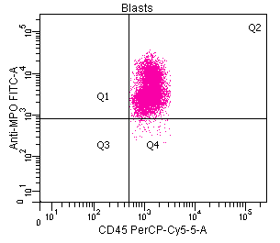
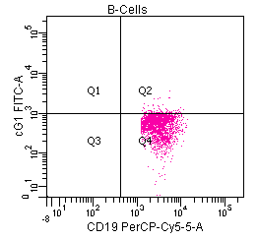
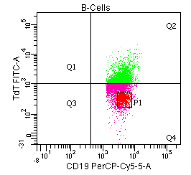
Copyright © 2019 by ASPHO

Slide 36
Bone marrow aspirate: 10% blasts, dysplastic myeloid maturation
Bone marrow, flow cytometry:
CD45 dim+
HLA-DR+
CD117
CD34+
TdT-/+
MPO+
CD19+
CD20/CD22-
CD10-
CD13+
CD33+
Other myeloid-
Cytogenetics
  46, XX, t(8;21)(q22;q22)[15]/46,XX[5]
FISH:
  Positive for an ETO/AML rearrangement (65% of cells).
Acute myeloid leukemia with t(8;21) (FAB M2)
Copyright © 2019 by ASPHO

Slide 37
“Core binding factor” (CBF) acute myeloid leukemia
inv(16)(p13.1q22) or t(16;16)(p13.1;q22)
  FAB M4Eo
    Myelomonocytic differentiation with abnormal eosinophils
    “Eo-basos”—eosinophil precursors with basophilic granules.
  CBFB-MYH11
  FISH or RT-PCR necessary; often cryptic on karyotype
t(8;21)(q22;q22)
  FAB M2 morphology
    Myeloid leukemia with maturation
    Salmon pink granules and long, slender Auer rods
  RUNX1-RUNX1T1; AML-ETO
    RUNX1 = AML1 = CBFA
  Karyotype or FISH
These and certain other AML are defined by cytogenetics, not blasts >30%
Copyright © 2019 by ASPHO

Slide 38
Infants with leukemia
Copyright © 2019 by ASPHO

Slide 39
Infant female with WBC 100 K cells/μl
Copyright © 2019 by ASPHO

Slide 40
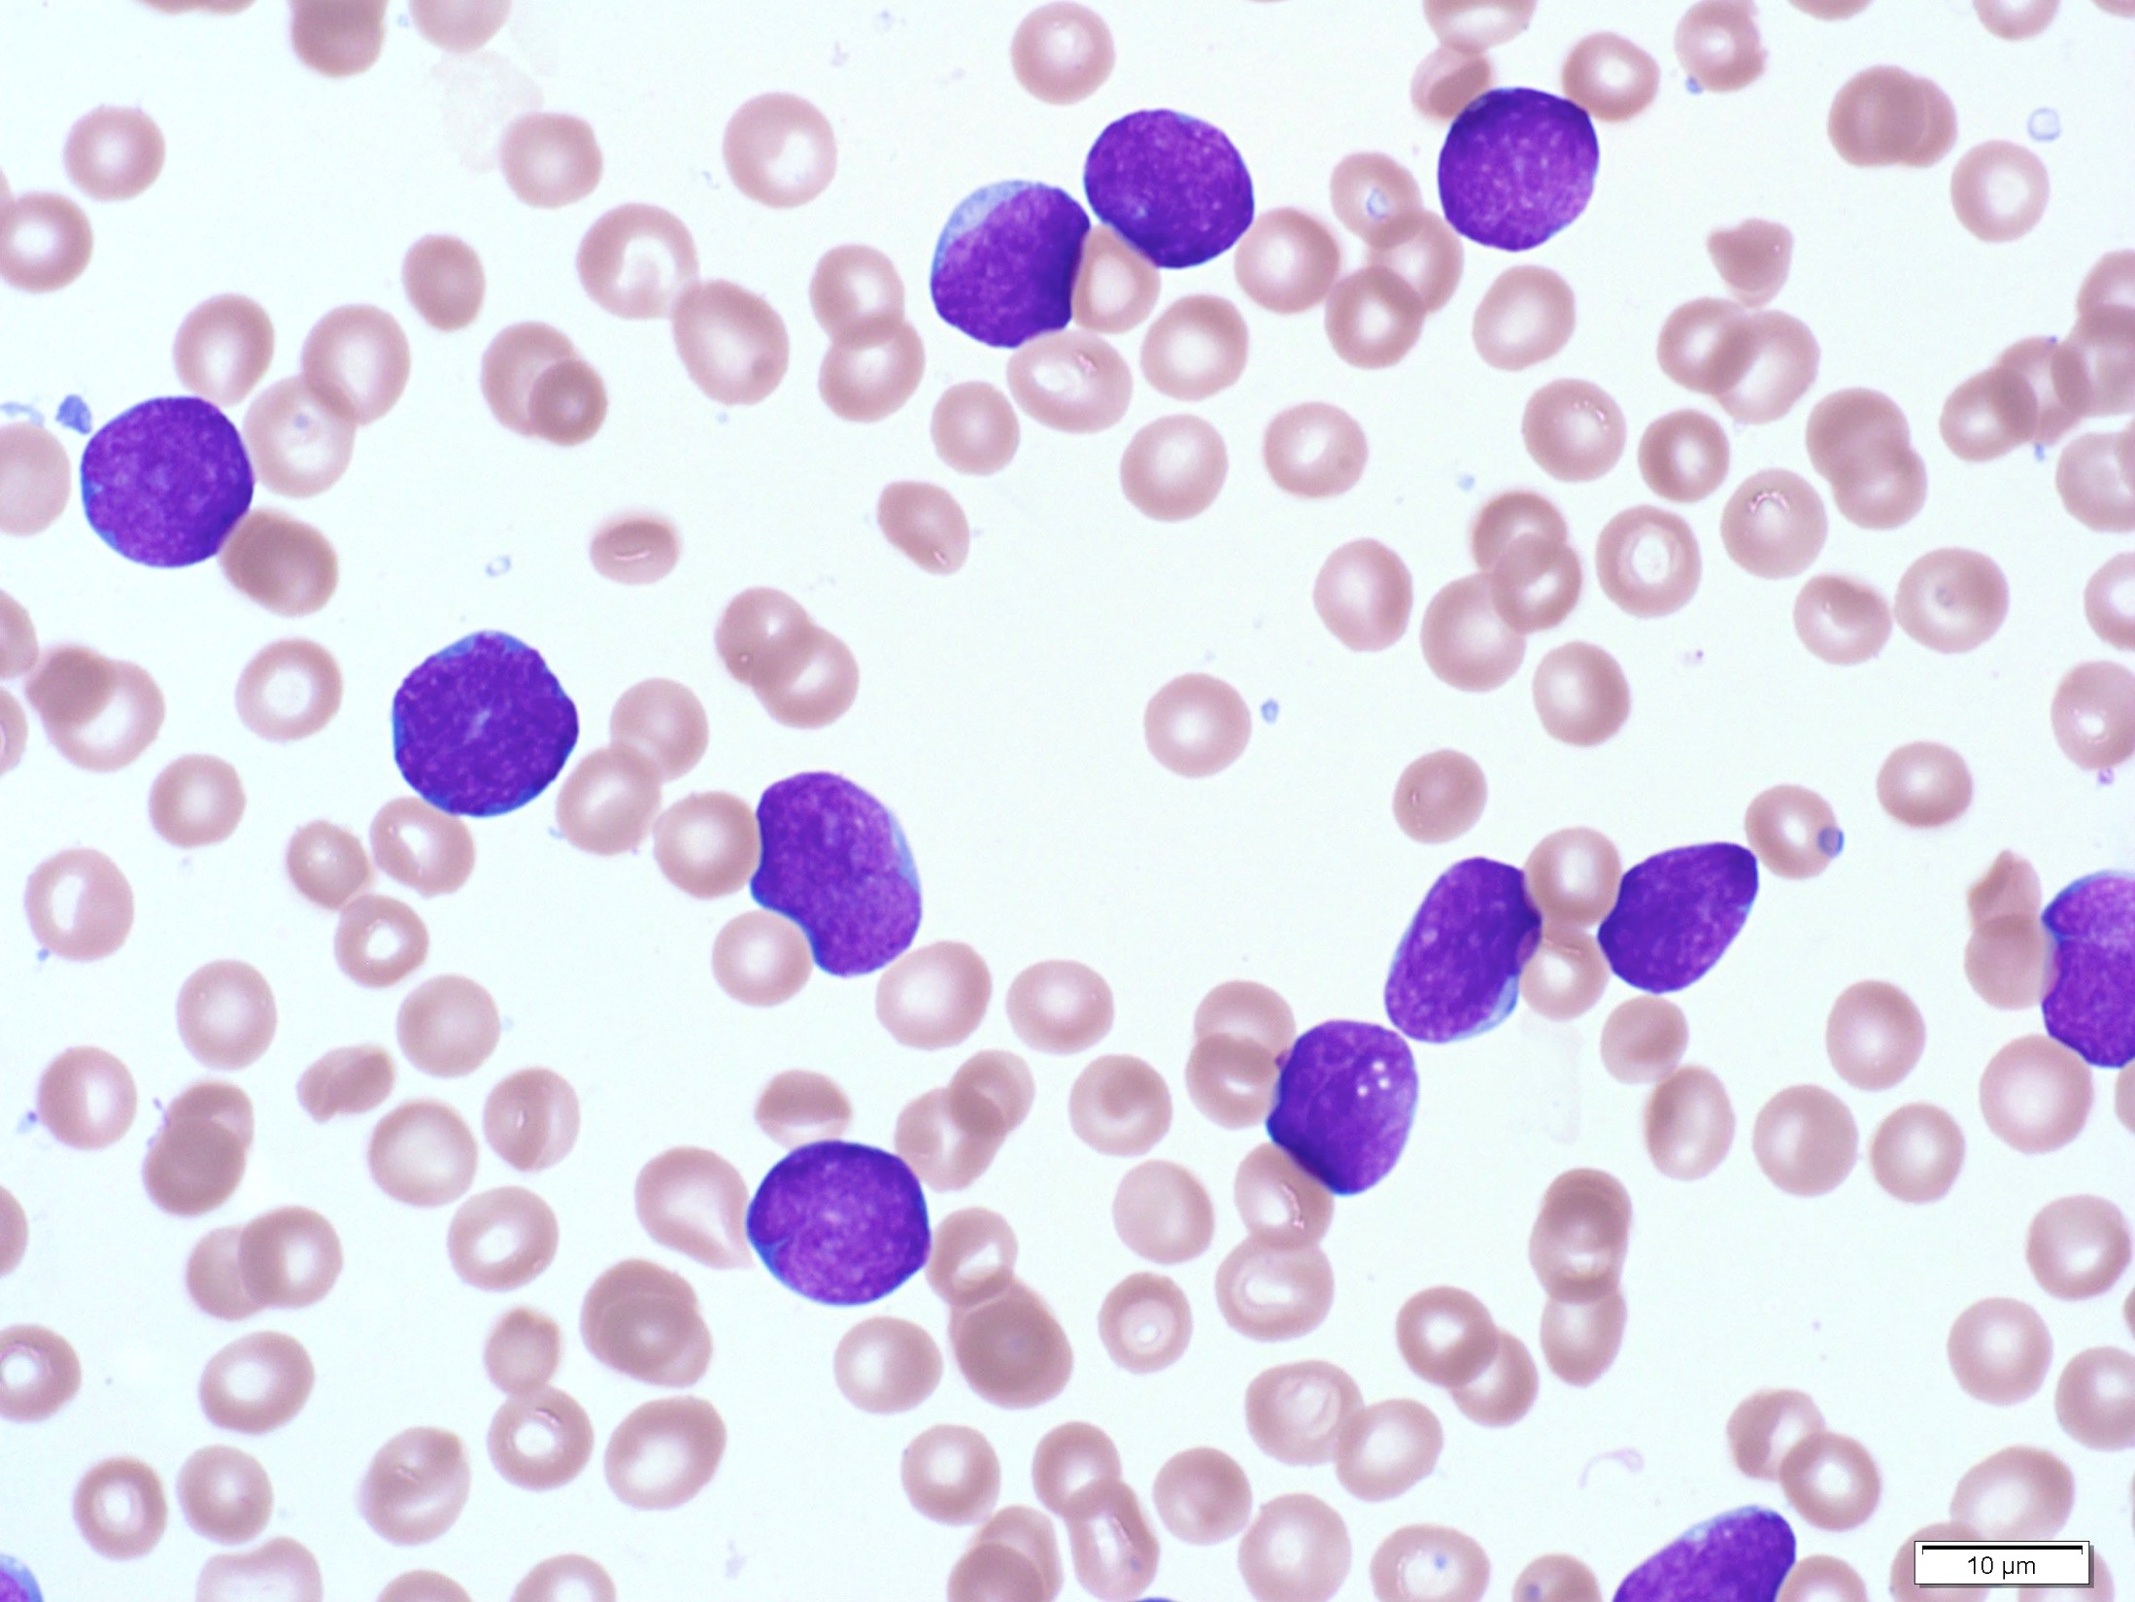
Copyright © 2019 by ASPHO

Slide 41
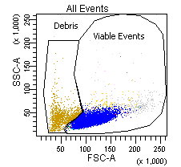
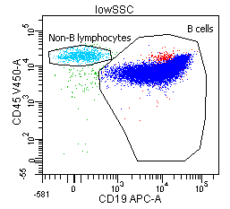
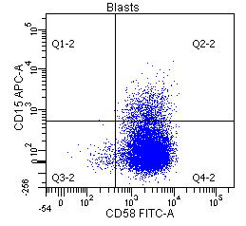
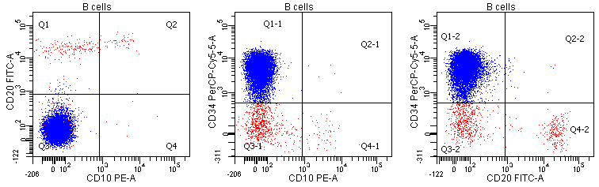
Peripheral blood,
flow cytometry:
CD45 dim+
HLA-DR+
CD34+
TdT+
CD19+
CD20-
sCD22+
CD10-
sIg-
CD15-/+
T cell-
Other myeloid-
Karyotype:
46,XX,t(4;11)(q21;q23)[20]
Copyright © 2019 by ASPHO

Slide 42
Infant female with WBC 100 K cells/μl and multiple non-tender, violaceous skin nodules
Copyright © 2019 by ASPHO

Slide 43
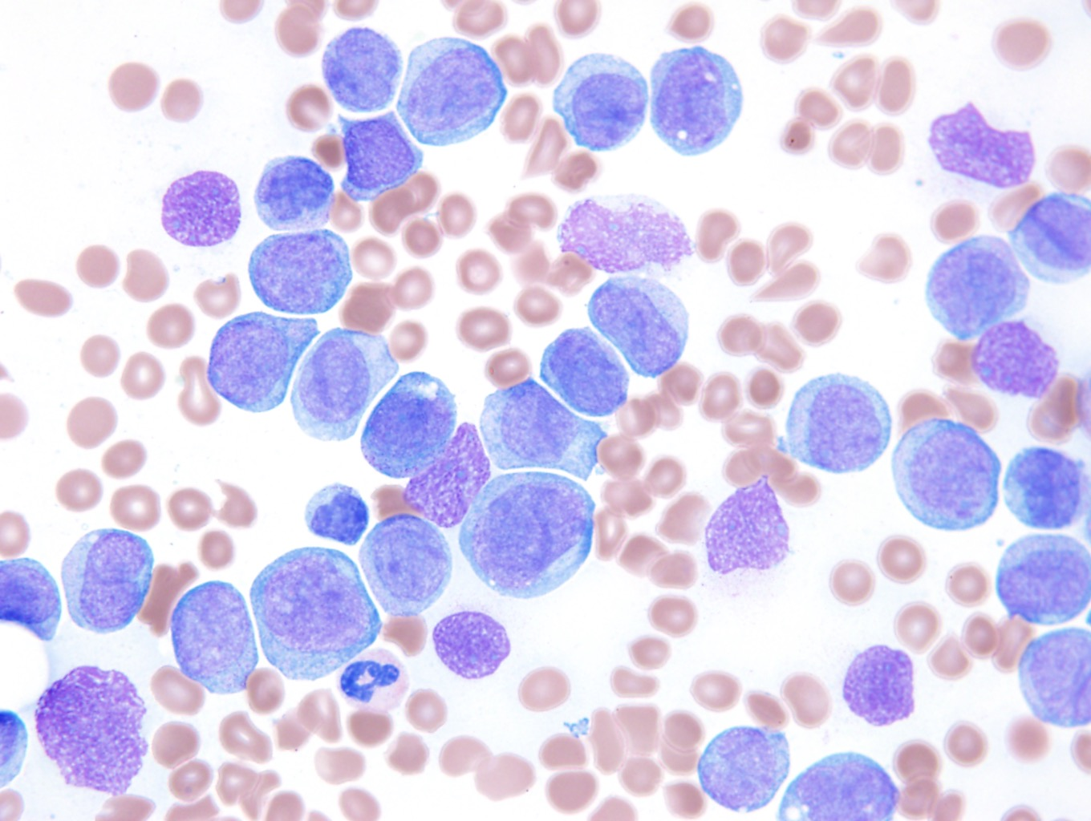
Copyright © 2019 by ASPHO

Slide 44
Peripheral blood flow cytometry:
CD45 dim+
HLA-DR+
CD117 variably+
CD34-
TdT-
MPO-
B cell-
T cell-
CD13 dim+
CD33-
CD14+
CD64+
CD65+
Karyotype:
  46,XX,t(6;13)(q27;q14),inv(10)(p12.2q21.1)[14]//46,XY[6]
FISH:
  nuc ish(MLLx3)(5'MLL sep 3'MLLx1)[176/200]
  Positive for a rearrangement of the MLL gene at 11q23 (88.0% of cells)
Copyright © 2019 by ASPHO

Slide 45
Acute monoblastic leukemia
Large blasts, NSE+, often involving skin, CNS and other extramedullary sites.
MLL translocations common, particularly in infants
  Many translocation partners
    t(9;11)(p23;q23), t(6;11)(q27;q23), t(10;11)(p12;q23), t(11;19)(q23;p13.3), etc…
    t(4;11)(q21;q23) seen in ALL is unusual in AML
  Often not identifiable by karyotype
    MLL FISH required
  MLL translocations also seen in biphenotypic and therapy-related leukemias
Copyright © 2019 by ASPHO

Slide 46
30-week pre-term female infant with hydrops and common atrioventricular canal
WBC 76.1 K cells/μL
  24% NRBCs
  68% blasts
HCT 39.5%
PLT 360 K cells/μL
PT/PTT 64/73.5, fibrinogen <35.
Uric acid 7.8, LDH 2885
Copyright © 2019 by ASPHO

Slide 47
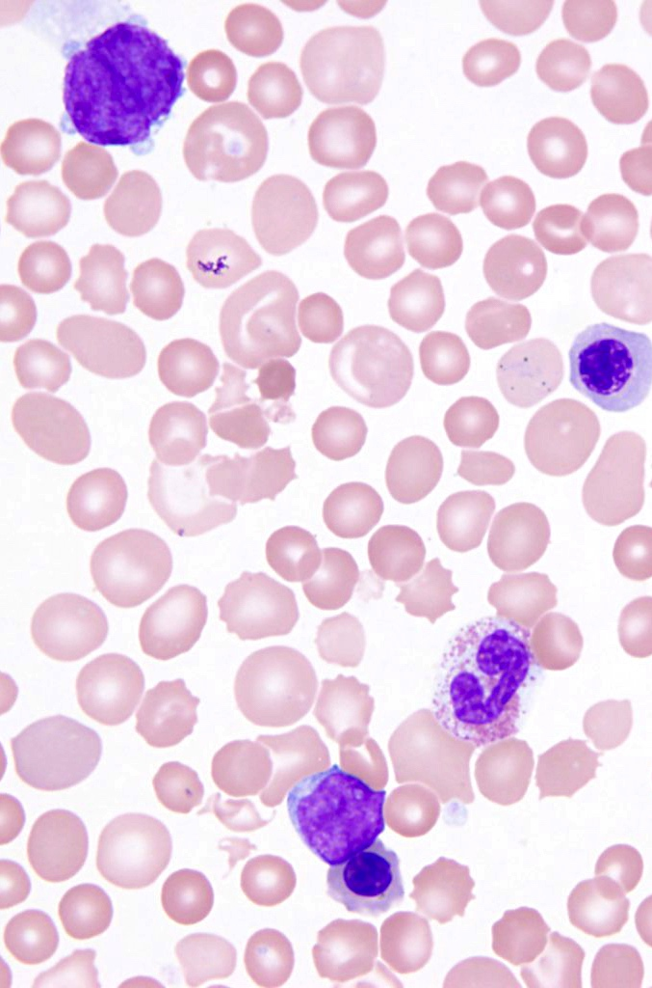
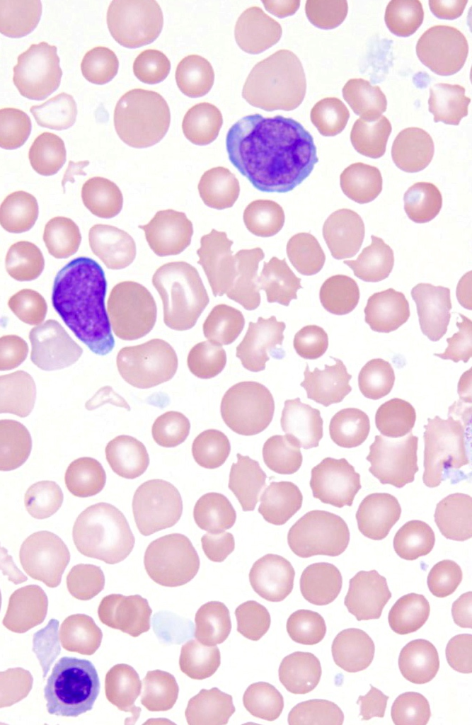
Copyright © 2019 by ASPHO

Slide 48
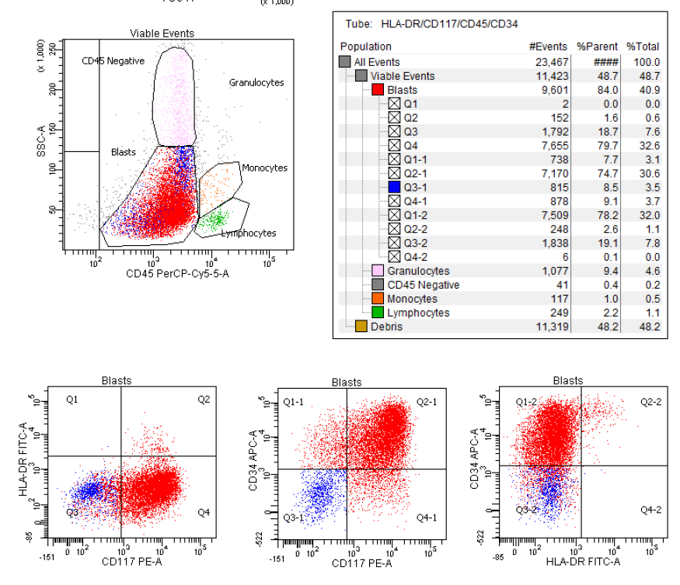
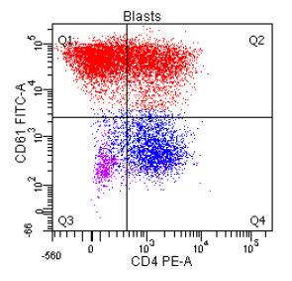
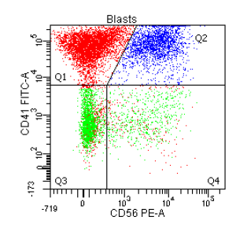
Peripheral blood, flow cytometry:
CD45 dim+
HLA-DR-
CD117+
CD34+
CD61 bright+
CD41 bright+
CD71 variable+
CD4 variable+
CD7 variable+
CD56 subset+
CD13 dim+
CD33 dim+ to negative
CD64 dim+ to negative
Negative for HLA-DR, CD2, CD10, CD14, CD15, CD16, CD19, CD20, and MPO.
Copyright © 2019 by ASPHO

Slide 49
Transient Abnormal Myelopoiesis (TAM) of Down Syndrome
AKA: Transient Myeloproliferative Disorder (TMD)
“Megakaryoblastic” proliferation occurring prior to or within days of birth.
4B’s: Big, blue, blebby blasts
CD34/CD117/CD71/CD41/CD61/CD4/CD7/CD11b/CD13+ HLA-DR- blasts
TAM associated with trisomy 21 and somatic GATA1 exon 2 mutations
  Results in expression of only a short isoform of GATA1
20-30% of TAM will evolve to acute megakaryoblastic leukemia (DS-AMKL)
  Typically <30 months of age
  Immunophenotype indistinguishable from TAM.
  Acquisition of secondary chromosomal aberrations.
  Acquisition of secondary somatic mutations.
Spectrum of pathologies ranging from TAM to MDS to AML
  More inclusive term “myeloid neoplasm of DS” coined to reflect this evolution
Copyright © 2019 by ASPHO

Slide 50
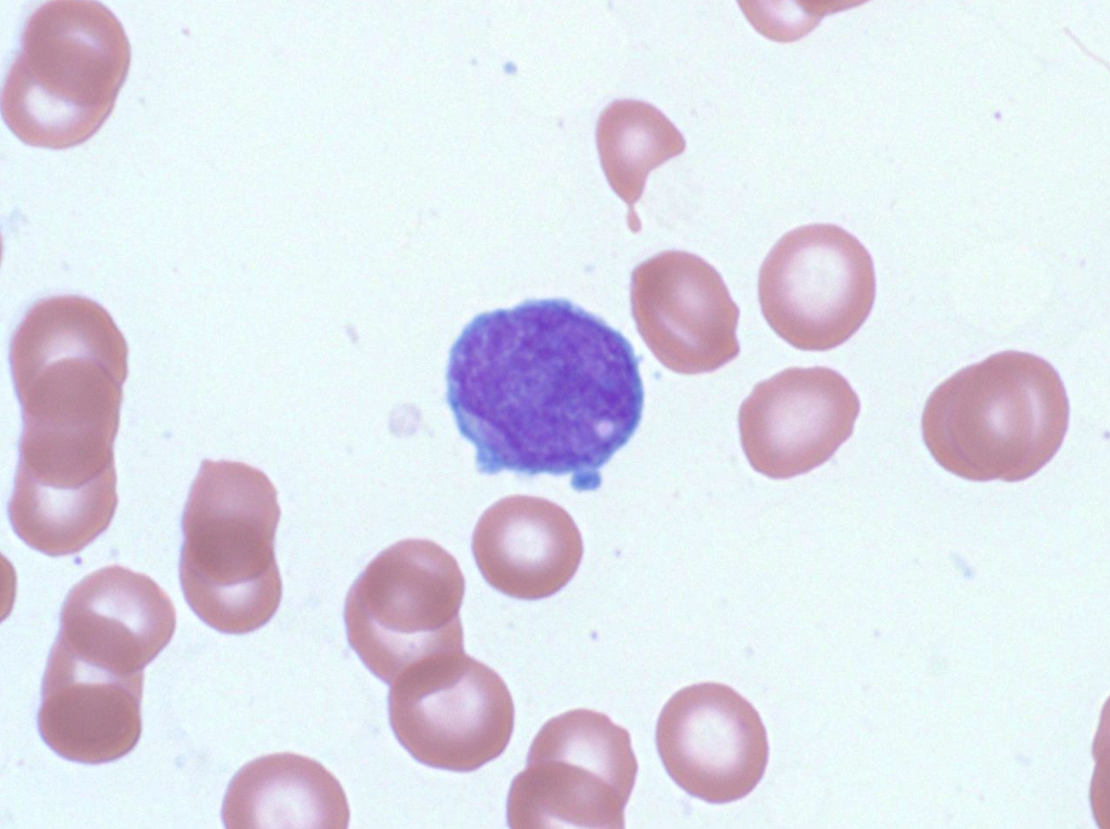
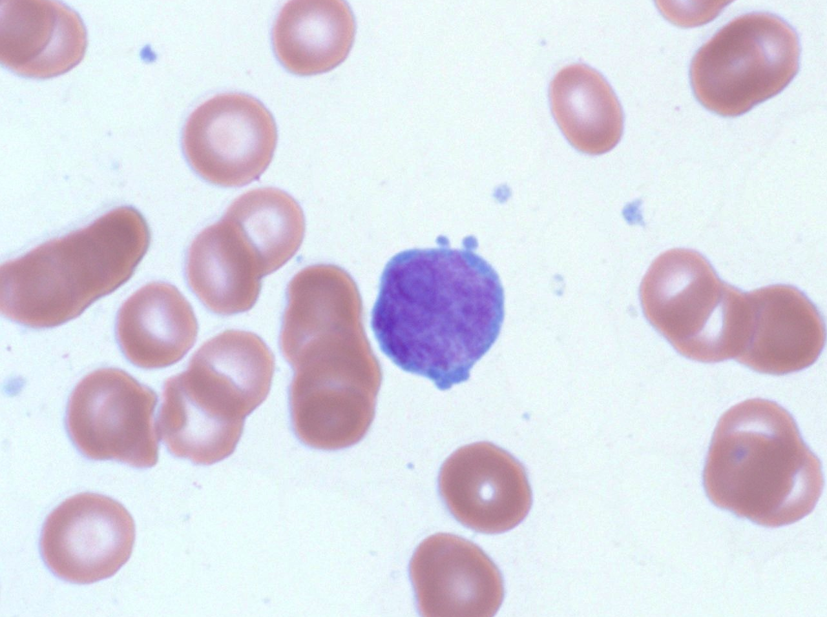
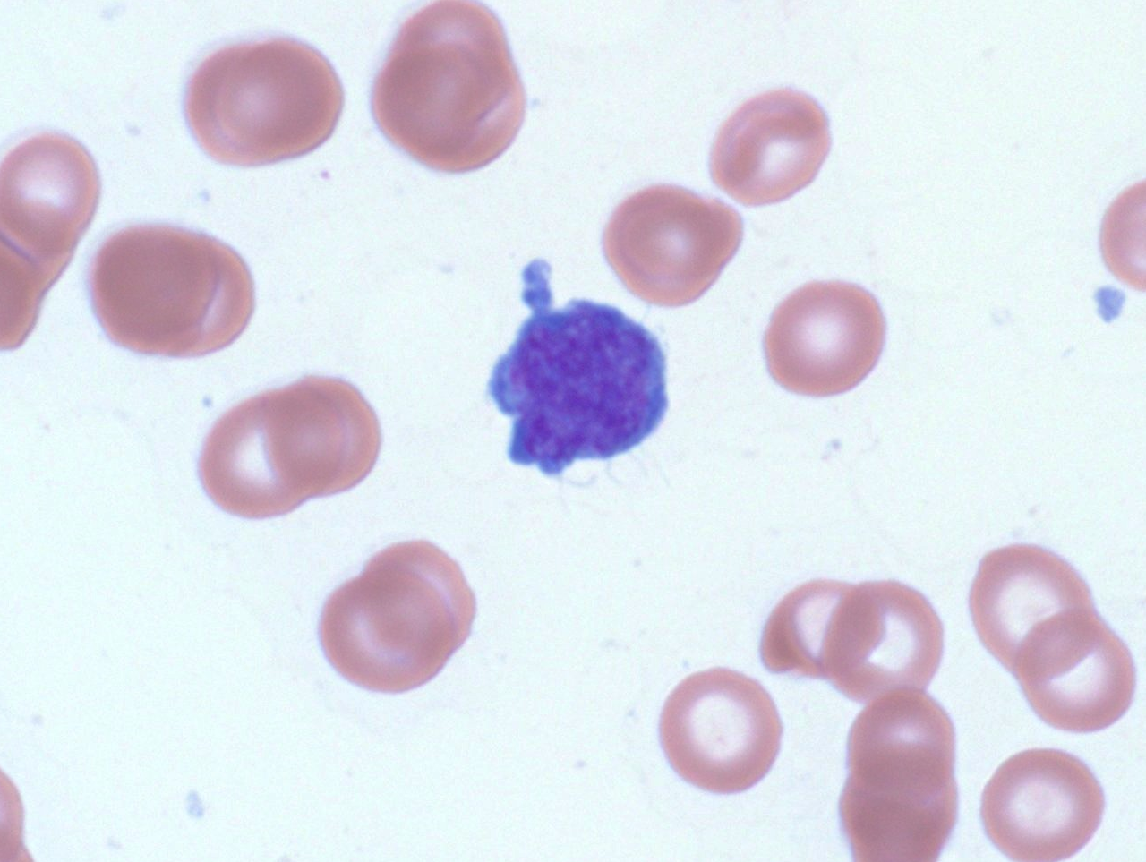
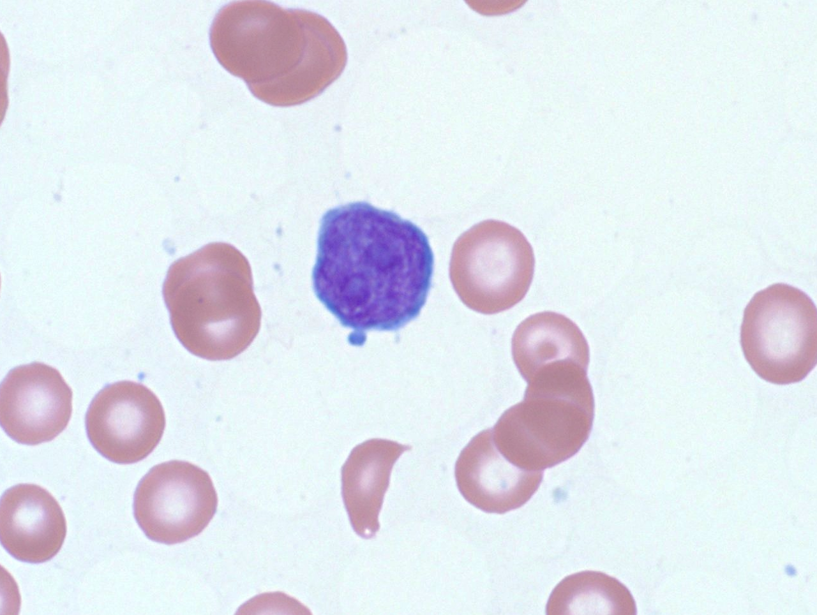
Copyright © 2019 by ASPHO

Slide 51




Bone marrow aspirate, flow cytometry:
Blasts: 31% of viable events
CD45 dim+
CD117 variable+
CD61+
CD41+
CD4+
CD13 subset+
CD33 dim+
Negative: CD13, HLA-DR, CD56, CD2 and CD34
Copyright © 2019 by ASPHO

Slide 52

Copyright © 2019 by ASPHO

Slide 53


Reticulin
Copyright © 2019 by ASPHO

Slide 54
46,XY,add(1)(p34),t(1;2)(p13;p21),add(2)(p13),t(6;21)(q23;q22), add(14)(q22),del(17)(p11.2),add(22)(q13)[cp3]/46,XY[17]
Acute Megakaryoblastic Leukemia (FAB M7)
t(1;22)(p13;q13) RBM15-MKL1 = OTT-MAL
  Acute megakaryoblastic leukemia
  Infants without Down syndrome
Copyright © 2019 by ASPHO

Slide 55
18 mo. male with leukocytosis since the age of 10 mos.
Nondysmorphic
Heart murmur
Otherwise well
Patient Normal range
WBC 36.12 K cells/μL 5.97 - 10.49
Hemoglobin 11.4 g/dL 11.0 - 12.8
Platelet 59 K cells/μL 208 - 413
Neutrophil/Band 49 % 32 - 75
Lymphocyte 36 % 11 - 54
Monocyte 6 % 4 - 9
Eosinophil 5 % 1 - 4
Atypical Lymphocyte 2 % 0 - 4
Promyelocyte 1 % 0 - 1
Other Cell 2 % NA
NRBC 1 0 - 1
Copyright © 2019 by ASPHO

Slide 56

Copyright © 2019 by ASPHO

Slide 57


Copyright © 2019 by ASPHO

Slide 58
Other data:
HbF increased for age
Bone marrow karyotype: 46,XY
FISH negative for: monosomy 7, trisomy 8, and a partial deletion of 7q.
PTPN11 gene coding sequence:
  c.227A>G/p.Glu76Gly (somatic)
Copyright © 2019 by ASPHO

Slide 59
Juvenile Myelomonocytic Leukemia (JMML)
Diagnostic criteria
I. Clinical and hematologic features (all 4 features mandatory)
• PB monocyte count ≥1 × 10⁹/L
• Blast percentage in PB and BM <20%
• Splenomegaly
• Absence of Philadelphia chromosome (BCR/ABL1 rearrangement)
II. Genetic studies (1 finding sufficient)
• Somatic mutation in PTPN11 or KRAS or NRAS
• Clinical diagnosis of NF1 or NF1 mutation
• Germline CBL mutation and loss of heterozygosity of CBL
III. For patients without genetic features, besides the clinical and hematologic features listed under I, the following criteria must be fulfilled:
• Monosomy 7 or any other chromosomal abnormality or at least 2 of the following criteria:
• Hemoglobin F increased for age
• Myeloid or erythroid precursors on PB smear
• GM-CSF hypersensitivity in colony assay
• Hyperphosphorylation of STAT5
Copyright © 2019 by ASPHO
Blood 2016 127:2391-2405

Slide 60
Other
Copyright © 2019 by ASPHO

Slide 61
21 yo male with a longstanding history of Crohn's disease treated with immune suppression, including 6-MP
Six-week history of symptoms consistent with macrophage activation syndrome (MAS)
s/p MAS-directed therapy including steroids, cyclosporine, anakinra, and infliximab, with little improvement.
Copyright © 2019 by ASPHO

Slide 62


Copyright © 2019 by ASPHO

Slide 63



Bone marrow, flow cytometry:
~11% of events
Lymphs with increased SSC
CD45 bright+
TdT-
CD2 bright+
CD3 dim+ to negative
CD5-
CD7+
TCRαβ-
TCRγ/δ+
-
CD56+
Granzyme/TIA1/PRF-
B cell markers -
Myeloid markers-
Copyright © 2019 by ASPHO

Slide 64


CD56
Karyotype:
46,XY,i(7)(q10),+8,der(8;22)(q10;q10)
Copyright © 2019 by ASPHO

Slide 65
Hepatosplenic γ/δ−T cell lymphoma
Rare leukemia/lymphoma
Aberrant γ/δ T-cell phenotype
Isochromosome 7q in most cases
Sporadic: teenage males
Immunosuppression associated: especially IBD
Presents with hepatosplenomegaly/cytopenias/HLH
Copyright © 2019 by ASPHO

Slide 66
Hemophagocytic lymphohistiocytosis/HLH
Familial
  Usually <18 mos of age
  Decreased NK cell function
  Mutations in genes responsible for cytotoxic granule exocytosis/function
Infection
  Herpes viruses (esp. EBV)
  Many, many others…
Malignancy-associated
  T cell lymphomas
  Anaplastic large cell lymphoma
  Treat the underlying cause…e.g., HSCT for familial forms, antimicrobials for infections, tumor-directed chemotherapy
Copyright © 2019 by ASPHO

Slide 67
16 y.o. male with a history of chronic digital warts and an episode of atypical mycobacterial lymphadenitis now with pancytopenia
Copyright © 2019 by ASPHO

Slide 68


Copyright © 2019 by ASPHO

Slide 69

CD3
Copyright © 2019 by ASPHO

Slide 70

CD34
Copyright © 2019 by ASPHO

Slide 71
Diagnostic findings
Morphology:
  Hypercellular marrow with multilineage dysplasia and 4% blasts
Cytogenetics:
  45,XY,-7[13]/46,XY[7]
Genetics:
  GATA2 c.1113G>T, p.N371K (germline)
Copyright © 2019 by ASPHO

Slide 72
Myelodysplastic Syndromes (MDS)
Clonal hematopoietic disorders characterized by:
Cytopenias
  (Hgb <10g/dL ANC <1800/uL, Plt <100k/uL)
Dysplasia (in >10% of a lineage)
Recurrent genetic abnormalities
Copyright © 2019 by ASPHO

Slide 73

MDS categories WHO 2016
Copyright © 2019 by ASPHO
Blood 2016 127:2391-2405

Slide 74
Germline predisposition to MDS/AML
Myeloid neoplasms with germ line predisposition without a preexisting disorder or organ dysfunction
  AML with germ line CEBPA mutation
  Myeloid neoplasms with germ line DDX41 mutation
Myeloid neoplasms with germ line predisposition and preexisting platelet disorders
  Myeloid neoplasms with germ line RUNX1 mutation
  Myeloid neoplasms with germ line ANKRD26 mutation
  Myeloid neoplasms with germ line ETV6 mutation
Myeloid neoplasms with germ line predisposition and other organ dysfunction
  Myeloid neoplasms with germ line GATA2 mutation
  Myeloid neoplasms associated with BM failure syndromes
  Myeloid neoplasms associated with telomere biology disorders
  JMML associated with neurofibromatosis, Noonan syndrome or
  Noonan syndrome-like disorders
  Myeloid neoplasms associated with Down syndrome
Blood 2016 127:2391-2405
Copyright © 2019 by ASPHO

Slide 75
19 year old female with recent fatigue and a 5 lb weight loss
Wisdom teeth extracted, and one month later had difficult-to-control bleeding from the extraction sites
WBC 469, Hgb 7.9, Hct 21.7, Plt 671, showing a neutrophilic leukocytosis with a left shift.
Bone marrow biopsy/aspirate
Copyright © 2019 by ASPHO

Slide 76

Copyright © 2019 by ASPHO

Slide 77


Copyright © 2019 by ASPHO

Slide 78


46,XX,t(9;22)(q34;q11.2)[20]
FISH positive for BCR-ABL1 rearrangement in 196/200 cells
RT-PCR positive for p210 transcript
Copyright © 2019 by ASPHO

Slide 79
Chronic Myeloid Leukemia
Clonal stem cell disorder
  Classified as a myeloproliferative neoplasm (MPN)
Characterized by:
  Neutrophilic leukocytosis with a left shift
  Basophilia/Eosinophilia
  Thromobocytosis
  Anemia
Defined by:
  BCR-ABL translocation
Evolves to:
  “Blast crisis”
  Typically B-ALL in pediatric patients
  Myeloid more common in adults
Other MPN
  Polcythemia vera (PV)
    JAK2 V617F
  Essential thromobocytosis (ET)
    JAK2 V617F, MPL or CALR mutations
Copyright © 2019 by ASPHO

Slide 80
9 y.o. male with pancytopenia, bone pain and “diffuse marrow signal abnormality” by MRI
Copyright © 2019 by ASPHO

Slide 81

Copyright © 2019 by ASPHO

Slide 82

Copyright © 2019 by ASPHO

Slide 83

Copyright © 2019 by ASPHO

Slide 84

Copyright © 2019 by ASPHO

Slide 85


Desmin
Myogenin
Copyright © 2019 by ASPHO

Slide 86
Karyotype
  49,XY,t(2;13)(q36;q14),+12,+14,+r[cp4]/46,XY[16]
FISH
  nuc ish(FOXO1x2)(5'FOXO1 sep 3'FOXO1x1) [27/500],(EWSR1x2)[500]
  “Leukemic” Alveolar Rhabdomyosarcoma
Copyright © 2019 by ASPHO

Slide 87
Thank you! mark.fleming@childrens.harvard.edu
Copyright © 2019 by ASPHO

